Slide 1
New Source Review Initiative - Reducing Air Pollution from the Largest Sources
Progress Report
Beverly A. Spagg
Air Directors Meeting
November 8-10, 2016

Slide 2
NSR Initiative - Overall Initiative Progress
Over the last 10 years this initiative has reduced emissions by over 3.0 Million tons per year through Consent Decrees
Coal-fired plant emissions have gone down by more than 7.0 Million tons per year since 2006 (CDs plus other factors)
Approximately 170,000 tons reduced from the Acid, Cement and Glass sectors

Slide 3
NSR Initiative - Overall Initiative Progress Power Plant Consent Decree Reductions

Slide 4
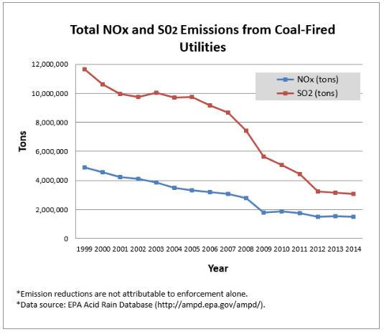

Slide 5
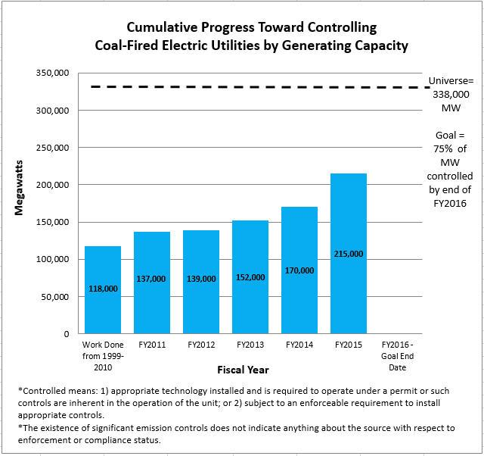

Slide 6
NSR Initiative – Acid Sector Consent Decrees
Type of Facility | Company / Name of Agreement | Date | NOx Reductions | SO2 Reductions | Total Reductions | Penalty | Number of Facilities
Acid | Agrium/Royster Clark | 2/6/2007 | 200 | 0 | 200 | $750,000 | 1
Acid | Rhodia | 4/26/2007 | 0 | 19,000 | 19,000 | $2,000,000 | 8
Acid | E.I. DuPont | 7/20/2007 | 0 | 13,000 | 13,000 | $4,125,000 | 4
Acid | Chemtrade/Marsulex | 1/12/2009 | 0 | 3,000 | 3,000 | $700,000 | 6
Acid | Lucite/DuPont | 4/2/2009 |  | 1,000 | 1,000 | $2,000,000 | 1
Acid | Mosaic | 10/5/2009 |  | 8,000 | 8,000 | $2,400,000 | 2
Acid | Doe Run | 1/1/2010 |  | 42,000 | 42,000 | $7,000,000 | 1
Acid | Terra | 1/1/2011 | 1,200 |  | 1,200 | $625,000 | 9
Acid | El Dorado | 3/19/2014 | 800 |  | 800 | $725,000 | 10
Acid | Simplot | 12/3/2015 |  | 2,540 | 2,540 | $899,000 | 5

Slide 7
NSR Initiative – Acid Manufacturing Sector Progress through Consent Decrees
Settlement of 10 companies encompassing 47 plants
Total NO_{x} and SO₂ reductions: 90,740 tons
Penalties collected: $21 million

Slide 8
NSR Initiative – Cement Sector Consent Decrees
Type of Facility | Company / Name of Agreement | Date | NOx Reductions | SO2 Reductions | Total Reductions | Penalty | Number of Facilities
Cement | St. Mary's Cement | 9/8/2008 | 2,700 | 0 | 2,700 | $800,000 | 1
Cement | Cemex Victorville CA | 1/15/2009 | 1,890 | 0 | 1,890 | $2,000,000 | 1
Cement | Lafarge | 1/21/2010 | 9,900 | 26,000 | 35,900 | $5,075,000 | 13
Cement | CEMEX Fairborn OH | 2/10/2011 | 2,963 | 673 | 3,636 | $1,400,000 | 1
Cement | Cal Portland Cement | 12/15/2011 | 1,200 | 360 | 1,560 | $1,425,000 | 1
Cement | Essroc Cement | 12/29/2011 | 5,000 | 2,000 | 7,000 | $1,700,000 | 6
Cement | CEMEX Lyons CO | 4/19/2013 | 870 | 0 | 870 | $1,000,000 | 1
Cement | Ash Grove Cement | 6/19/2013 | 8,000 | 9,900 | 17,900 | $2,500,000 | 9
Cement | Holcim Hagerstown, MD | 7/11/2013 |  | 230 | 230 | $700,000 | 1

Slide 9
NSR Initiative – Cement Manufacturing Sector Progress through Consent Decrees
Settlement of 9 companies encompassing 34 plants *
Total NOx and SO2 reductions: 71,696 tons
Penalties collected: $16.6 million

Slide 10
NSR Initiative – Glass Sector Consent Decrees
Type of Facility | Company / Name of Agreement | Date | NOx Reductions | SO2 Reductions | Total Reductions | Penalty | Number of Facilities
Glass | St. Gobain, Madera CA | 4/1/2005 | 0 | 400 | 400 | $929,000 | 1
Glass | St Gobain Containers | 1/21/2010 | 4,162 | 1,386 | 5,548 | $2,250,000 | 15
Glass | Durand Glass | 10/1/2012 | 174 |  | 174 | $300,000 | 1
Glass | Owens Brockaway | 12/3/2012 | 2,007 | 466 | 2,473 | $1,450,000 | 5
Glass | Guardian Glass | 9/29/2015 | 6,400 | 550 | 6,950 | $312,000 | 7

Slide 11
NSR Initiative – Glass Manufacturing Sector Progress through Consent Decrees
Settlement of 5 companies encompassing 29 plants
Total reductions are 15,545 tons
Penalties collected: $5.2 million

Slide 12
NSR/PSD Overview of REGION 4 Enforcement Status
Sector | Universe | Addressed | Case Under Negotiation | Consent Decree Monitoring | % Non-Compliance
Glass | 22 | 86% | 3 | 4 | 32%
Acid | 24 | 96% | 6 | 5 | 46%
Cement | 20 | 95% | 5 | 3 | 40%
Utilities | 284 | 100% | 0 | 8

Slide 13
NSR Initiative - Overall Initiative Progress Recent Settlements
Guardian Industries (Glass)
Settlement reduces emissions by more than 7,300 tons per year
Control systems and emission reductions at 7 glass plants in 7 different states (CA, IA, MI, NY, PA, SC, TX)
$150,000 mitigation project in San Joaquin Valley, CA
Alabama Power
Amendment of a 2006 Consent Decree
$1.5 million mitigation – electric vehicle charging
3 power plants in Alabama, over 2,000 MW controlled

Slide 14
NSR Initiative - Overall Initiative Progress Recent Settlements
Duke Energy
Settlement is the culmination of 15 years of litigation and settlement discussions
Original claims involved 25 units at 8 plants
Final settlement involves 5 plants in NC totaling 3,000 MW of gen capacity
Emission reductions from the settlement based on recent baseline emissions are 2,300 tons of NOx and SO2
Using earlier baselines the protracted litigation and overall pursuit of this case resulted in over 300,000 tons of reductions

