Slide 1
Asbestos NESHAP Inspection and Safety Procedures Course
Chapter Seven
Inspector Safety
2014
Notes:
This section primarily deals with OSHA’s asbestos construction standard, 29 CFR 1926.1101.
If the instructor is unfamiliar with this standard or how asbestos abatement is performed, it is imperative that he or she read the student notebook section and the standard before attempting to lecture on this material.
Safety in this context means job site safety in regards to a site where asbestos is being or has been disturbed.
The material in this section is applicable for the federal regulator in a variety of ways, but is also very important to the local and state asbestos program staff who may have to make regular compliance visits to sites where asbestos is being actively removed.
There are many terms in this section. These notes will not explain the details of each term. The instructor should consult Chapter 7 of the Student Manual and the glossary for more detailed information.

Slide 2
Safety Requirements & Guidelines
OSHA – on-site worker safety regulations
  where asbestos has been disturbed
  where asbestos is being disturbed
EPA – inspector safety guidelines
Notes:
There are 2 major topic areas in this chapter on inspection and safety procedures.
OSHA – Requirements for worker safety while on a site where asbestos has been disturbed or is being disturbed.
EPA – Recommended guidelines for inspector safety.

Slide 3
OSHA Asbestos Standards
General Industry Requirements
29 CFR 1910.1001
Applies to workers in the workplace
Applies when workers could be exposed to asbestos
Applies when workers are not purposefully disturbing asbestos as part of their jobs
Notes:
We will look at the OSHA regulations first.
There are three principal OSHA regulations that apply to asbestos in the workplace and they apply in the following settings: general industry, construction industry, and shipyards.
The general industry requirements are found in OSHA regulation 29 CFR 1910.1001.
This regulation applies to workers in a variety of industrial settings where exposure to asbestos could occur but where workers are not purposefully removing or otherwise disturbing asbestos in their normal or occasional work.

Slide 4
OSHA Asbestos Standards
Construction Industry
29 CFR 1926.1101
Applies to those who could be exposed to asbestos during construction activities
Includes asbestos removal activities
Notes:
The second OSHA regulation covers the construction industry and is found in 29 CFR 1926.1101.
This regulation applies to construction workers who could be exposed to asbestos during various construction work. This incudes workers involved in asbestos removal.

Slide 5
OSHA Asbestos Standards
Shipyards
29 CFR 1915.1001
Applies to ships and shipyard activities
Similar requirements to the those found in the construction industry regulation
Notes:
The third category is shipyards and ships, found in OSHA regulation 29 CFR 1915.1001.
This regulation has requirements that are very similar to the construction industry requirements.

Slide 6
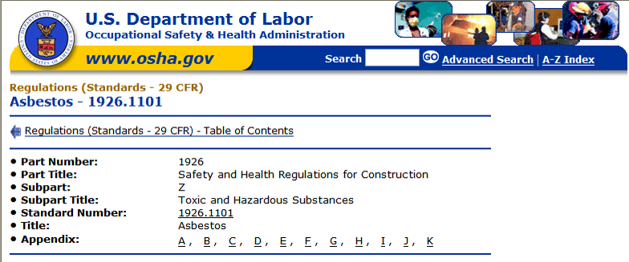
OSHA Construction Standard
Most pertinent to NESHAP enforcement personnel
A summary of details can be found at the end of Chapter 7
Notes:
The OSHA Construction Standard applies to asbestos-disturbing activities.
The slide shows a screen capture from the OSHA web page indicating how to access the complete regulation.
There is a tabular summary of the standard at the end of Chapter 7 that can be very helpful in summarizing the requirements for those less familiar with its contents.

Slide 7
Scope and Application
Demolition and salvage
ACM removal and related asbestos control activities
Construction, alteration, repair, maintenance and renovation
Spill/emergency clean up
Containment, housekeeping and waste issues
Asbestos product installation
Notes:
The bullets in this slide show the scope and extent of the OSHA Construction Industry Standard for asbestos.

Slide 8
Definitions
Amended water
Class I, II, III and IV asbestos work
Competent person
Critical barrier
Decontamination area or “decon”
  Clean room
  Shower
  Equipment room
Demolition
Notes:
These definitions are taken from a composite review of the general industry, construction industry, and shipyard sections of the OSHA regulations.
Discuss each of these definitions very briefly, using as a basis the definitions in Chapter 7 of the student manual.
These terms will be used in slides throughout this chapter and in the remainder of the course.

Slide 9
Definitions (cont.)
Disturbance
Glove bag
HEPA
  Filter
  Vacuum
Intact
Negative initial exposure assessment (NEA)
PACM
Regulated area
Removal, renovation and repair
9
Notes:
9
Continue brief description of terms.

Slide 10
Presumed Asbestos Containing Material (PACM)
Surfacing materials and thermal surface insulation (TSI) in buildings constructed no later than 1980
Flooring and adhesives installed no later than 1980
Other materials that are known or should be known to contain asbestos
Who can determine and designate PACM?
Notes:
The first bullet is the full definition of presumed asbestos-containing material.
The second and third bullets are introduced in the “Communication of Hazards” sections of the OSHA regulations.
Anyone who has a reasonable knowledge of the materials used in a building can create an inventory of PACM.
It takes an accredited inspector doing an AHERA inspection to prove that PACM is or is not ACM.
Proving that PACM is not ACM is called referred to in the regulations as “rebuttal of the presumption.”

Slide 11
OSHA Classes of Work
Classes I and II work typically involve larger projects
Class I work involves removal of TSI and surfacing material
Class II work involves:
  Anything other than TSI and surfacing material
  Often flooring, roofing, asbestos cement siding, etc.
Notes:
The OSHA classes of work are the most common way to describe the work being performed that may be subject to asbestos regulations.
Describe the classes of work.

Slide 12
OSHA Classes of Work
Classes III and IV are usually smaller projects
Class III
  Maintenance and repair
  Non-removal
Class IV
  Projects where workers come in contact with, but do not disturb ACM or PACM
  Cleanup at Class I, II, and III projects
  Typical training focus is hazard avoidance
12
Notes:
12
Continue defining the classes of work.

Slide 13
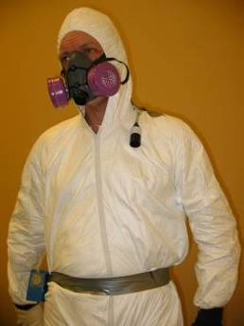
Permissible Exposure Limits (PELs)
Time-weighted Average Limit (TWA)
  0.1 fibers per cubic centimeter (f/cc)
  8-hour time-weighted average
  Often referenced as the OSHA PEL for asbestos
Excursion Limit (EL)
  1.0 f/cc
  30-minute sampling period
Notes:
There are two permissible exposure limits that are applicable in the OSHA regulations.
Describe each.
If either limit is exceeded, full personal protective equipment is required, regulated areas must be established, and engineering controls must be employed.
Compliance with PELs is based on personal sampling, not “area” air sampling.
An OSHA violation occurs if personal sampling shows that either limit has been exceeded and (1) workers are not protected and/or (2) the area is not properly designated and controlled.

Slide 14
Multi-employer Worksites
Employers conducting work requiring establishment of regulated areas must:
  Communicate to other employers
    nature of work with asbestos or PACM
    existence of regulated areas and requirements
    protective measures targeted to workers
  Abate the asbestos hazards
  Put in place and use protective measures for their employees
Notes:
This concept applies to employers who are doing work that creates the responsibility for establishing and maintaining an asbestos regulated areas.
Multi-employer worksites will have more than one entity with employees conducting work on a site.
The first category of employers is the business or contractor that has disturbed asbestos and triggered the requirement that a regulated area be established.
The person responsible for this work within the employer organization is frequently called the “competent person.”
Most commonly, the competent person is the AHERA-accredited and/or state-licensed supervisor.

Slide 15
Multi-employer Worksites
Other employers at adjacent locations on a multi-employer worksite must:
  Use protective measures for their employees
  Verify daily the integrity of enclosures and effectiveness of controls
  Assure that fibers are not migrating to adjacent areas
General contractors:
  Have general authority
  Must determine and require compliance by asbestos contractors
15
Notes:
15
Also at the site may be other employers working adjacent or nearby to the entity disturbing asbestos.
They (other employers) have responsibilities as well to protect their work area and employees and ensure that fibers are not encroaching into their work area.
A general contractor, if one is employed on a site, has responsibility and authority to require and to assure all entities working on the site are in compliance with OSHA requirements.

Slide 16
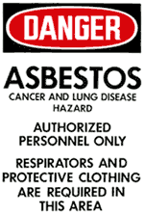
Regulated Areas
Required if PELs are, or could be, exceeded
Apply to all Class I, II and III work
Expectations
  Use of personal protective equipment (PPE) including disposable suits and respirators
  Visible demarcation
  Limitations on access & activities
  Supervision by a “competent
    person”
Notes:
Regulated areas are denoted by the OSHA-required asbestos danger sign shown on the slide.
Explain the basic requirements for regulated areas as shown on the slide.
The next section of this course, Chapter 8, will include a very detailed discussions of asbestos removal work areas and techniques.

Slide 17
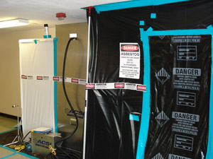
Asbestos Regulated Area
Notes:
This is a picture of a properly prepared asbestos regulated area.
This would be a Class I work area.
Note details such as mandatory signage and demarcation.
A regulated area is commonly protected with polyethylene sheeting, commonly shorted to “poly.”

Slide 18
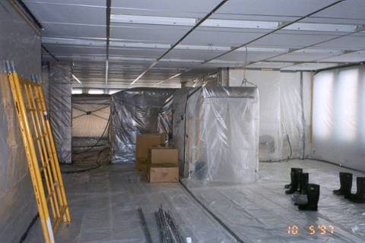
Asbestos Regulated Area
18
Notes:
18
Another photo of a properly prepared regulated areas.

Slide 19
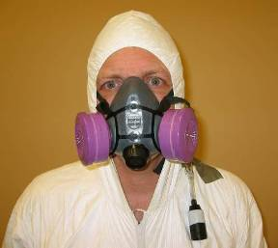
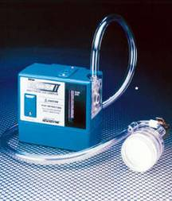
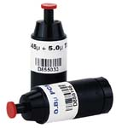
Exposure Monitoring
Employer must:
  determine the airborne concentration of asbestos
  evaluate work conditions for unprotected employees
  validate respirator selection
  take air samples of worker breathing areas
  assess PEL & EL compliance
Exposure monitoring is usually the responsibility of the competent person via a subcontractor
Notes:
Exposure monitoring or “personal air sampling” is an OSHA requirement.
Exposure monitoring is required for any activity where asbestos can be disturbed.
Employers are required to ensure that proper respirators are being used where required.
Personal air sampling data must be documented and maintained as a record of compliance with this requirement.
The competent person most often hires a subcontractor with skills and equipment necessary to gather personal air samples.

Slide 20
Negative Exposure Assessment (NEA)
Objective and contemporary data
Shows that a product or activity cannot release asbestos exceeding PELs
Similar project
Written report must be on-site
If no NEA, initial exposure monitoring must occur at the current worksite
Notes:
A negative exposure assessment, or NEA, is an assessment that uses data to establish the applicability of regulations to a worksite.
NEAs consist of the analysis and review of personal monitoring and regulated area data showing that a product or activity cannot release asbestos in levels that exceed PELs.
Such data must be from a recent similar project – within the past 12 months.
Objective, independent NEA data is virtually unavailable except in the roofing industry.
In order to be relevant and applicable, available data must be from a project, process, material, control method, work practice, or other similar activity that closely resembles the current project, activity, etc.
An NEA is NOT a couple of pages of air sample data. It is a thorough, formal, written report documenting the situation at a worksite and KEPT on-site and showing that there will be no exposure to asbestos in excess of the permissible exposure limit.
Most contractors will NOT have an NEA. In such cases, monitoring should occur at the site of the current work.

Slide 21
Other Monitoring Issues
Periodic monitoring requirements – if no NEA
  Class I and II – daily
  Non-Class I or II work where the PEL is expected to be exceeded – sufficient intervals to properly document work conditions
Employee notification requirements
  Individually in writing or centrally-posted
  ASAP (< 5 working days after results are received)
Notes:
Describe that periodic monitoring must occur, when personal sampling is to occur, and notification requirements. Monitoring is to occur daily for Class I and Class I operations. If not Class I or II but the PEL may be exceeded, monitoring must occur at a frequency that adequately documents work conditions.
Information must be provided to employees either in writing or through postings at central locations commonly frequented by the employees. Information must be distributed or posted no more than five days after results are received.
Air sampling issues will be covered in more detail in Chapter 10.

Slide 22
Engineering Controls & Work Practices
Mandatory for all OSHA work class levels
  HEPA vacuums
  Wet methods (where feasible)
  Prompt cleanup and disposal in leak tight containers (roofing exception)
Approaches to PEL/EL compliance
  Local exhaust ventilation w/HEPA (typically a “negative air machine”)
  Enclosures or isolation (virtually always enclosures for Class I and II work areas)
  If engineering controls cannot keep exposures below PELs, supplement with required respiratory protection
Notes:
Engineering controls and work practices are required for all OSHA work class levels.
HEPA vacuums are not just simple shop vacuums with cheap HEPA filters from a box store.
True HEPA vacs are designed and made for hazardous material handling.
Leak tight containers are most often two 6 mil labeled bags if feasible or double 6 mil wrap. This is required by most states.
Wet methods may be used where feasible but exceptions include sites with electrical hazards, roofing issues, freezing temperatures, and similar complications.
To achieve compliance with permissible exposure limits and excursion limits, exhaust devices with HEPA filtering are used to ventilate the work area.
Negative pressure machines pull air out of a contaminated area with enough velocity and volume to ensure that no positive pressure exists in the work area to allow fibers to migrate outside the area.
Workers and work areas are protected by enclosures or isolation (with enclosures almost always used in Class I and II areas).
Respiratory protection is required where engineering controls alone cannot keep exposures to fibers below the PELs and ELs.

Slide 23
Prohibited Work Practices
Use of high speed abrasive disk saws
Use of compressed air
  to remove asbestos
  within a negative pressure enclosure
Dry sweeping of ACM dust/debris
Shoveling of ACM dust/debris
Employee rotation to reduce employee exposure
Notes:
There are a number of prohibited work practices at all Class I jobs and many Class II jobs:
use of high speed abrasive disk saws
use of compressed air to remove asbestos
Proper work practices and controls must be used:
No dry sweeping or shoveling of ACM dust and debris.
No rotation of employee work assignments to reduce exposure. Proper work practices and controls must be used.

Slide 24
Class I Work Area Requirements
Supervision by a competent person
For areas >25 LF or 10 SF or no NEA:
  Critical barriers (interior) – seal openings to work area
  Barrier or isolation method to control fiber levels below background levels or to meet AHERA final clearance levels
NPE usage is a general industry practice regardless of project size
  Required by many local and state programs
  Not required for some exterior work and roofing
Notes:
Class I work requirements include:
The area must be supervised by a competent person.
If the area being disturbed amounts to more than 25 linear feet or 10 square feet or there is no negative exposure assessment, the following requirements exist – interior critical barrier openings to the work area must be sealed; a barrier or isolation method must be used to keep fiber levels outside the work area below background levels or in conformance with AHERA final clearance levels.
It is a general industry practice to use negative pressure enclosure, regardless of project size. Many local and state programs require NPE except for some exterior work and roofing work.
Pictures to help explain these issues will be presented in a moment.

Slide 25
Class I Control Methods
Use negative pressure enclosure
  4 air changes/hour, -0.02” pressure differential
  Must be maintained throughout project
Isolate and seal HVAC; e.g., use 2 layers 6 mil poly sheeting
Use impermeable drop cloths and cover immovable objects.
Typically walls and floors are sealed, most commonly with poly and duct tape.
Notes:
These are well known OSHA work practices.
Negative pressure enclosures (NPE’s) must have a manometer attached to the work area to assure that a pressure differential of at least -0.02” is maintained throughout the project.
Isolation and sealing of HVAC systems is required and may be achieved by use of 2 layers of 6 mil poly sheeting.
The layers of poly sheeting on walls and floors vary. This is not a requirement specifically mandated by OSHA. Some states and certain job specifications may include itemized requirements that are specific.

Slide 26
Class I Control Methods
(cont.)
Glove bag system
  Typically for pipe insulation
  2 workers
  150 degree max. temp.
  Must evacuate with HEPA vacuum
  Cannot move bag down pipe
Mini enclosures
  Often used for small-scale removal work; 2 persons max.
  NPE requirements
  HEPA vacuum and clean
Notes:
Glove bags are normally used to address pipe insulation.
Limitations are two workers and 150 degree maximum temperature.
Careful usage and handling are important. Bags cannot be moved along the length of the pipe.
EPA vac evacuation is used to remove debris and air from the bag. The bag should be flat when the evacuation is complete.
Mini-enclosures are common for small jobs and no more than two workers.
Class I decontamination procedures are not mandatory for mini-enclosures.

Slide 27
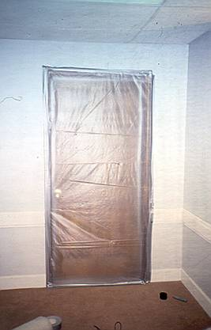
Critical Barrier
Notes:
Critical barrier on door; 2 layers of poly.

Slide 28
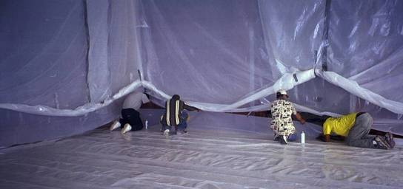
Work Area Prep w/ Poly
Notes:
Workers installing wall and floor poly.

Slide 29
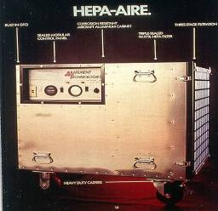
Negative Air Machine (NAM)
Produces negative pressure
Uses HEPA filter
Notes:
A typical negative air machine (NAM).
Effective air flow 1,500-2,000 CFM (cubic feet/min).

Slide 30
Class II Work Requirements
Supervision by a competent person
Indoors w/no NEA – if > PELs or ACM removed non-intact:
  Critical barriers or other isolation method
  Drop cloths
  HEPA vacs/wet methods/prompt clean up and disposal
Significant requirements for removal/disturbance of flooring, roofing, asbestos cement products, gaskets etc.
Notes:
Class II work, involves projects of various sizes, does not involve surfacing material or thermal system insulation.
The most common Class II projects involve roof work, flooring material, and asbestos siding such as Transite®.
These projects require supervision by a competent person, critical barriers or other isolation methods, drop cloths, and careful cleanup and disposal.
There are significant requirements for removal and disturbance of many products as noted on the slide.

Slide 31
Class III Work Requirements
Repair and maintenance work where ACM is likely to be disturbed but removal is not the purpose of the project
Must protect “bystander” employees
Emission controls are based on the severity of the disturbance
Use wet methods
Use local exhaust ventilation, if feasible (not common with glove bags)
Notes:
Class III work is defined as work where ACM including TSI and surfacing ACM and PACM may be disturbed, though removal is not the intent of the project.
Such work must be managed in a way that protects employees in the area who are not responsible for the direct work on ACM but they are nearby.
The level of emission control is dependent on the severity of the disturbance or likely disturbance.
Class III controls most commonly involve a glove bag, a mini enclosure, or flooring work that does not generate more than 1 standard asbestos waste bag of ACM waste.
Personal protective equipment is always used with thermal system insulation and surfacing material.
For other materials, PPE is not required if a proper negative exposure assessment is available, though NEAs are rare.
Class III work should use wet methods and local exhaust ventilation unless glove bags are used.

Slide 32
Class III Work Requirements
(cont.)
Use impermeable drop cloths and mini-enclosures or glove bags when drilling, sanding, or otherwise disturbing TSI or SM
Use drop cloths and plastic barriers or other controls when an NEA cannot be produced
Use respirators:
  where TSI or surfacing material is disturbed
  an NEA cannot be produced
  Where PELs have been exceeded
Notes:
Continuing with Class III requirements, drop cloths and mini-enclosures or glove bags are to be used when drilling, cutting abrading, sanding, chipping, breaking, or sawing of TSI or surfacing material is occurring or may occur.
Drop cloths and plastic barriers or other similar controls are to be used when a negative exposure assessment is not available.
Respirator use is prescribed when TSI or surfacing material is disturbed or likely to be disturbed, when an NEA cannot be produced, and where the PEL as defined in the OSHA regulations has been exceeded.

Slide 33
Class IV Work Requirements
Work involving maintenance custodial duties, no disturbance, and clean-up of dust/waste/debris.
Requirements include:
asbestos awareness training
HEPA vacs, wet methods, prompt clean-up
Class IV allows cleanup from Classes I, II, and III but such work is usually done by workers trained for Class III or higher.
Notes:
Class IV work most often applies to those whose work does not require the disturbance of ACM but who could come into contact with ACM. This includes cleaning and light maintenance staff.
Although Class IV workers are allowed to clean up debris generated from Class I, II or III work, most entities relegate this to Class III (or higher) trained workers.

Slide 34
Respiratory Protection
Provide respirators and compel use as part of a respiratory protection program
Provide appropriate, NIOSH-approved respirators, that are fit-tested
Provide powered air-purifying respirators upon request
Conduct medical evaluations
Notes:
Detailed information on respirators is provided in Chapters 11 and 12.
Briefly, respirators should be available and in use where required.
They should be appropriate for the work to be done, meet NIOSH standards, and fit the employees.
Medical monitoring is required where respirator use is mandated.

Slide 35
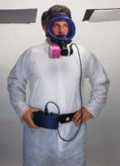
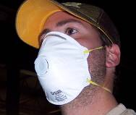
Respirators vs Dust Masks
Institute true respiratory protection program
No dust masks!!!
Notes:
Detailed information on respirators is provided in Chapters 11 and 12.
Brief respirator overview; full treatment for Inspectors later in the program

Slide 36
Respirator Requirements
Class I
  all jobs
  at a minimum, without an NEA, projects must make available PAPRs if the exposure level is expected to be at or below 1.0 f/cc.
Class II – where ACM is not removed intact
Class II & III
  all jobs using dry removal …
  … except if an NEA exists, a sloping roof is involved, or material is removed intact
Notes:
This describes when respirators are required.
The general industry practice is to train workers in use of respirators if asbestos is to be disturbed.
There must be a project NEA if the intent is to work without a respirator.
Respirators are required for all Class I jobs. At a minimum, without an NEA, a powered air-purifying respirator must be made available if exposure is expected to be at or below 1.0 fiber per cubic centimeter.
Respirators are required for Class II work if ACM is not removed intact.
For Class II and II jobs not using the wet method, respirators are required except if a negative exposure assessment exists, the material is on a sloping roof, or if the material is removed intact.

Slide 37
Respirator Requirements
Class III
  where TSI or surfacing material is being disturbed
  where there is no NEA and materials other than TSI and surfacing material are involved
Class IV
  if in regulated area where employees are otherwise required to use respirators
  an uncommon occurrence
Notes:
This describes when respirators are required.
The general industry practice is to train workers in use of respirators if asbestos is to be disturbed.
There must be a project NEA if the intent is to work without a respirator.

Slide 38
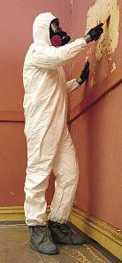
Protective Clothing Required
Fiber counts > PELs
No NEA
Class I > 25 LF or 10 SF
Full body covering - head, feet, hands
Periodic examination (once per shift) – repair or replace if rips or tears
Proper transport and laundering are expected if to be reused, though disposable clothing is common.
Notes:
It is a general industry practice to use protective clothing for all Class I-III work.
It is required if fiber counts are expected to be greater than the PELs, if there is no NEA, and if a Class I job involves more than 25 linear feet or more than 10 square feet of material.
Protective clothing includes coverings for the entire body including head, feet, and hands.
Examination of clothing is required once per shift. If ripped or torn, it must be repaired or replaced.
Laundering is virtually unheard of today due to the availability and use of disposable garments.

Slide 39
Hygiene Facilities – Class I
Class I > 25 LF/10 SF
3 stage decontamination (decon) area
  Clean room
  Shower; hot/cold running water, and filtration
  Equipment room
Alternative, if not indoor decon not feasible
Compel proper entry, use , and exit
  Cannot leave work area before decontaminating except in true emergencies such as fire, injury
Notes:
This is a very important and often overlooked issue – hygiene facilities!
Many abatement workers are poorly trained and may not know how to set up cleaning facilities properly.
If not supervised workers, may not properly decontaminate.
For Class I work with more than 25 linear feet or 10 square feet of asbestos, a 3-stage decon area is required with a clean room, shower, and equipment room.
If a full, indoor decon room cannot be accommodated, a suitable alternative must be created, even if outdoors.
There are clear expectations for decontamination except in the event of serious emergencies. Proper use including entry and exit from decon are required at all other times.

Slide 40
Decontamination Units - Plan View
Water heater
Airlock
3-5’
Airlock
3-5’
Poly
Door
Flaps
Equipment Room
Clean Room
Shower
Air Flow
Work
Area
Worker Decon Unit
Shower Water Filtration Unit
Load Out Room
Wash Down Room
Air Flow
Waste Load Out Unit
Contaminated area
Airlocks are a recommendation and can be required by the local/state program
Notes:
This is a plan view of a typical design for a decontamination system that is required for Class I work.
Many states have specific requirements for the construction of decon rooms.
Notice the work area with outflow of air plus a wash down room, load out room, and equipment room that are dirty.

Slide 41
Hygiene Facilities – Classes I-III
Class I < 25 LF/10 SF
Class II & III > PELs or no NEA
  Equipment room or area adjacent to work area for employee and equipment decon
  Ensure proper cleaning of clothing, equipment and containers (waste bags, etc.)
  Ensure proper entry/exit
Notes:
Decontamination is also required for smaller Class I projects as well as certain Class II and II work where PELs are exceded or there is no NEA.
In such cases there must be an equipment room or decontamination room adjacent to the work area.
Entry and exit procedures must be properly followed from the work area.

Slide 42
Hygiene Facilities – Class IV
Class IV work
If working in regulated areas, employees must comply with the requirements of higher classifications.
If not working in regulated areas, modified decon facilities may be used.
Notes:
For Class IV jobs, employees must comply with requirements of higher classifications if working in regulated areas.
If not working in regulated areas, modified decon facilities may be used.

Slide 43
Hazard Communication
Applicable to:
Building/facility owners
Employers with employees subject to the Construction Standard
Notes:
Building and facility owners as well as employers have responsibilities for communicating hazards associated with asbestos .
Employees subject to the asbestos construction standard must be informed by their employers of the hazards and exposure avoidance procedures for asbestos.

Slide 44
Hazard Communication
Building/Facility Owners
Determine presence, location and quantity of ACM/PACM at work site before work begins
Notify (in writing or verbally) the following:
  Applicants and bidders for work in such areas
  Employees and adjacent personnel
  Tenants (commercial businesses)
Any newly discovered ACM/PACM is to reported to those at work site within 24 hours of discovery
Notes:
Property owners must determine the presence or absence, the location, and the quantity of asbestos-containing materials and presumed asbestos-containing materials before work starts at a work site.
Notification may be in writing or given verbally to individuals applying or bidding for work, employees at the site, and tenants of commercial businesses. The latter does not apply to apartment dwellers.
“Newly discovered” usually means that ACM or PACM was undiscovered during the initial asbestos inspection and was later found to be present.
If a material dates back to 1980 or earlier, it should be sampled and analyzed and the results communicated within 24 hours.
Missed materials are not uncommon in demo work.

Slide 45
Hazard Communication
Employers
Inform owners, workers, adjacent personnel
Advise of presence, location and quantity of ACM/PACM
Explain precautions to be taken
Notes:
Employers have responsibilities for notification too, even if they are not the owner of a building they occupy.
When employers discover ACM or PACM, they are to inform owners, their workers, adjacent workers, and others who may be affected.
They must advise of the presence, location, and amount of asbestos material that has been discovered.
They must let everyone know what individuals are to do to avoid risks of asbestos exposure.

Slide 46
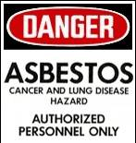
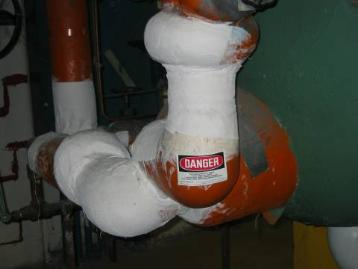
Warning Signs & Labels
Signs in areas of ACM/PACM to inform employees and asbestos workers
Labels affixed to products containing asbestos
Notes:
OSHA requires signs and labeling in conspicuous areas where workers could come in contact with asbestos materials.
The signs are similar to regulated area signs, but exclude the respiratory protection language.

Slide 47
Training
Class I
  Worker - 32 hours
  Supervisor - 40 hours
  Hands-on
  MAP agenda
  8 hour annual refresher
Class II
  If all Class II, same as Class I
  If single medium – often roofing, flooring, asb cement
    Worker - 8 hours
    Supervisor – 8 hours + additional training (not specified)
  Hands-on
  Annual refresher
Notes:
Class I workers and certain Class II workers are required to receive initial training of 32 hours; supervisors get 40 hours; annual refresher training is 8 hours.
The Class I agenda as specified for model accreditation plan asbestos abatement worker training.
Agendas found within the AHERA MAP and ASHARA programs can be customized to meet this Class I training requirement.
Many states have specific approval processes for asbestos training programs.
States issue accreditation for the AHERA disciplines; generally not Class II, III or IV.
Class II training is 8 hours of hands-on with an annual refresher.

Slide 48
Training
Class III
  LEA-type maintenance/custodial training
  16 hours with appropriate hands-on
  AHERA agenda, but can be customized
  ~4 hour annual refresher
Class IV
  2 hour
  Annual refresher
  AHERA agenda, but can be customized
Notes:
Class III training must be consistent with the Local Education Agency maintenance and custodial staff training requirements.
2 hours of awareness training is supplemented by 14 hours of training on asbestos handling, respiratory protection, and hands-on training focusing on respiratory protection, other personal protection measures, and good work practices.
Class IV training is two hours with an annual refresher. This training is for staff regardless of whether they will be required to work with asbestos.

Slide 49
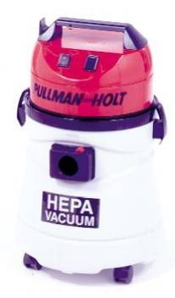
Housekeeping
HEPA vacuums
Specified procedures for flooring material
  Low abrasion buffing
  No dry buffing or sanding
Proper cleaning, packaging and disposal
  Waste, debris and dust in areas with accessible TSI and surfacing material or visibly deteriorated ACM
Notes:
Housekeeping referrs to day-to-day handling of ACM.
HEPA vacuums are used for clean up of work area dust and debris. They are NOT shop vacs.
ACM waste must be placed in leak tight containers and disposed properly. A dumpster behind the building is not an appropriate disposal facility.
There are specific requirements exist for flooring material (low abrasion and no dry buffing or sanding.
Proper cleaning, collection, packaging, and disposal are required. Materials subject to this requirement includes waste, debris, and dust in areas with thermal system insulation or ACM that is obviously in a deteriorated condition.

Slide 50
Medical Surveillance
Class I, II, III work 30 or more days/year, OR
30 days at or above PELs, OR
Required to wear a negative pressure respirator
No cost to employee
Initial and annual exam
Must be performed by appropriate medical personnel
Notes:
Medical surveillance is not an automatic requirement just because workers are near asbestos. This is a common misconception.
The first two bullets are the requirements for the OSHA asbestos construction standard.
The third bullet is also important. If required to wear a respirator, a baseline medical evaluation is a must. Fit testing must occur. After these two requirements have been met, then use of the respirator is allowed.
Medical surveillance is to be provided at no cost to the employee.
After the baseline examination, annual reexamination is required. Both must be performed by qualified medical personnel.
Annual exam results are compared to the baseline exam to determine any changes that might necessitate corrective measures.

Slide 51
Medical exam must include …
Medical questionnaire – Appendix D –
medical and work history
Physical exam – physician determines extent
Pulmonary function test – measures lung capacity
  ==============================
X-rays are commonly used, though not required unless the physician orders them
The exam reports includes the physician’s opinion
Results required to be provided to employees within 30 days of receipt
Notes:
The first 3 bullets are requirements of a medical examination.
The format of the medical questionnaire is found in Appendix D of the asbestos construction standard.
Physicians offices generally issue documents to prove a respirator can be worn by the worker(s)

Slide 52
Recordkeeping
Objective data
  For NEA; rebutting PACM
  For as long as the data is of value
Exposure monitoring
  For at least 30 years
Medical monitoring
  Throughout employment plus 30 years
Training
  Throughout employment plus 1 year
Notifications
  Transferred to successive owners
Notes:
Recordkeeping is important. Records must be properly maintained, made available for review within regulatory constraints, and transferred as appropriate.
Good records can be used as objective data to support negative exposure assessments and to establish that ACM does not exist.
Exposure monitoring must be kept for at least 30 years.
Medical monitoring must be kept throughout the duration of employment plus for 30 years thereafter.
Training records must be kept for the duration of employment plus one year.
Required notifications are communications to employees and other applicable entities and individuals that must be transferred to successor owners.
Records can also include other documents such as inspection reports.

Slide 53
Competent Person
Properly qualified – knowledge and ability
Properly trained
  Class I/II – MAP Supervisor (40 hours)
  Class II/IV – LEA (16 hours; job specific)
Full authority at a site
Frequent and regular inspector of job sites
  Class I; once per shift minimum
  Class II, III, IV; as needed/requested
Notes:
We’ve discussed briefly the role of a “competent person” earlier. This slide provides a bit more detail.
The competent person is the person in charge with all site authority. He or she must know the characteristics and hazards of asbestos and be able to make decisions necessary to provide adequate control of asbestos as well as take corrective action when necessary. A competent person is not someone who, when asked a question or presented an issue, says, “I cannot answer that. Here is my cell phone. Talk to my boss.”
The CP must be properly trained. For Class I and II, equivalent of a MAP supervisor – 40 hours. For Classes II-IV, the equivalent of an LEA position – 16 hours plus job-specific training.
The competent person for asbestos removal activities often has an AHERA supervisor certification and in many states, a license or other certification or accreditation.
For NESHAP demolitions, the competent person must be properly trained in the NESHAP requirements.
The CP conducts frequent and regular inspections at the work site – at least once per shift for Class I work, and as needed or requested at other jobs.
Some local and state programs may have requirements for competent individuals that are more stringent than the federal rules.

Slide 54
Appendices
There are mandatory and non-mandatory appendices that are relevant to the asbestos program
Mandatory appendices
  Appendix A; OSHA Reference Method (ORM), personal air sampling and analysis
  Appendix C; Qualitative And Quantitative Fit Testing Procedures
  Appendix D; Medical Questionnaires
    Initial and periodic
  Appendix E; Interpretation and Classification of Chest Roentgenograms (X-rays)
Notes:
Appendices are found after the body of the regulation. Some mandatory but others are not.
The non-mandatory appendices are often used as industry guidance.
On the mandatory side –
- Appendix A is the OSHA “how to” for personal air monitoring compliance.
Appendix C contains fit testing procedures.
Appendix D contains the forms for initial and periodic medical questionnaires.
Appendix E deals with chest x-rays.

Slide 55
Federal Rules and Guidance
OSHA Worker Protection Rule (WPR)
  OSHA protection to local and state government agency employees
Health & Safety Guidance for
EPA Asbestos Inspectors
3500.1 Media-specific Training Requirements
Notes:
Around 1990, EPA gave OSHA protection to local and state agency employees who were not covered by the Occupational Safety and Health Act, the law that covers general worker safety.
While local and state agency employees are not covered by OSHA in general, they are covered relative to the asbestos program as well as for a few other unrelated programs.
The document, Health and Safety Guidance for EPA Asbestos Inspectors, was published in 1990. Some of the information may not be current. We will look at a number of relevant topics from this document.
Regulation 3500.1 establishes training obligations that are applicable to the asbestos program.

Slide 56
EPA Worker Protection Rule
Extends OSHA asbestos standards to state and local government employees engaged in:
  construction
  custodial work
  automotive brake/clutch repair
OSHA general and construction standards apply
The WPR references the current OSHA standard which keeps the WPR up-to-date
Some states may have adopted the OSHA requirements and the inspector may be covered by them directly instead of the WPR
Notes:
The EPA Worker Protection Rule provides OSHA asbestos protection for local and state agency employees engaged in construction, custodial, and automotive repair work.
It was promulgated in 1987 and amended in 2000.
The WPR incorporates the general and construction standards of 29 CFR 1926.1001 and .1101.
The WPR incorporates the current OSHA standard. If the OSHA standard is changed, the new version automatically becomes applicable via the Worker Protection Rule.
Some states may adopt the OSHA rule directly and make it applicable to their employees in which case the primary regulatory authority is under the OSHA rule, not the WPR.

Slide 57
Health and Safety Guidelines for EPA Asbestos Inspectors
Provide recommendations and guidelines for personal protection of inspectors
Reduces likelihood of public exposure
Many components derived from OSHA Construction Standard
1991 document
Notes:
The intent of the health and safety guidelines, published in 1991, was to explain how inspectors should protect themselves and others while performing inspections at a site.
Much of the guidelines came from the OSHA Construction Standard.
The guidelines were issued in 1991. Some provisions are now out-of-date.
References made in this course to these guidelines are intended to address relevant, applicable, current requirements.

Slide 58
EPA Asbestos Inspector Training
Health & Safety (24 hours); annual refresher (8 hours)
Supervised field training (3 days)
Respiratory Protection (6 hours); annual refresher
Fit testing; (initial, annual)
Notes:
Federal asbestos inspector training is designed for EPA employees.
State and local as well as federal inspectors are encouraged to participate in this training program.
Inspector and supervisor training are very useful to understanding industry job site issues.
Health and safety training – initial 24 hours – annual refresher 8 hours.
Supervisor field training – 3 days.
Respiratory protection training – initial 6 hours – annual refresher.
Fit testing – initial and annual.

Slide 59
3500.1 Media-Specific
Training Requirements
Mandatory and recommended self-study and review
Asbestos NESHAP Inspection & Safety Course – APTI 350 (this course)
  Available in classroom setting
  May be designed in future for e-learning
On-the-job training
Refresher training
Notes:
EPA has mandatory training requirements under Order 3500.1.
In addition, EPA recommends ongoing training through courses and self-study.
This course, APTI 350, is available in the classroom but may be designed in the future to be accessible in e-learning format.
Other important training comes through interactions with peers at the work place and periodic refresher training, some of which may be mandated while other training may be optional.
Inspectors and supervisors should work closely together to design and maintain a robust training program that protects the employee and ensures the integrity of the asbestos regulatory program.

Slide 60

Questions?

