Slide 1
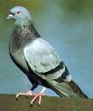
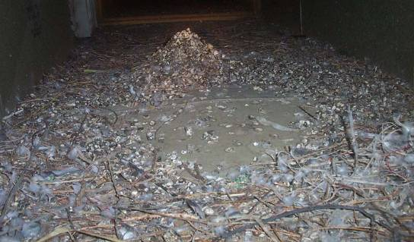
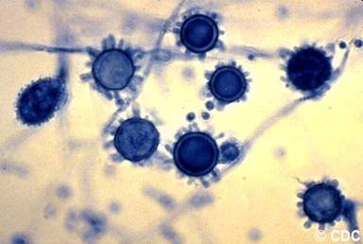
Other Considerations
Histoplasma Capsulatum spores
“Microorganisms (bacteria, fungi) found in these can cause human illness (histoplasmosis, psittacosis). Respiratory protection is warranted.

Slide 2
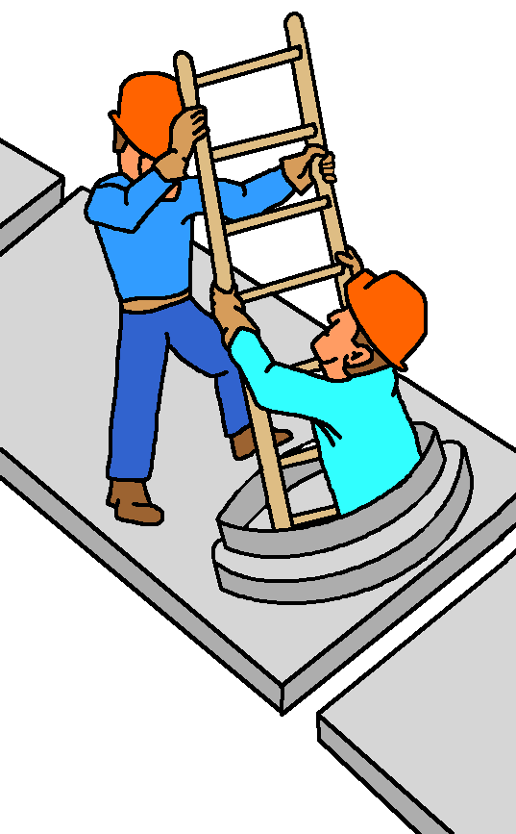
Confined Space
29 CFR 1910.146
    Is large enough and configured
    so that bodily entry can be
    performed AND
    Not designed for continuous
    human occupancy AND
    Has limited or restricted entry
    or access
Notes:
These three points are the very basic definitions of a confined space
Unless trained and equipped to enter a confined space, Inspectors should always avoid entering them

Slide 3
Oxygen Deficiency
    Poorly ventilated areas
    Chemical/gas/sewer lines
    Kerosene heaters
    Dry ice

Slide 4
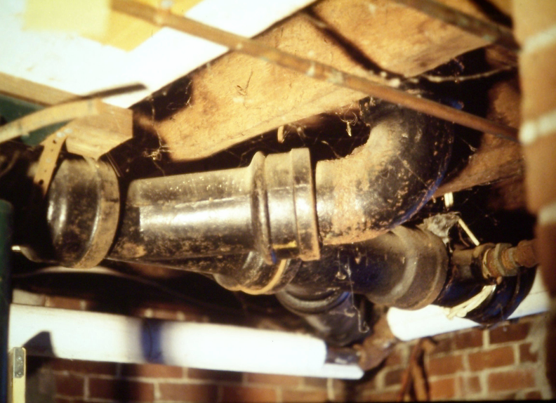
Sewer Line

Slide 5
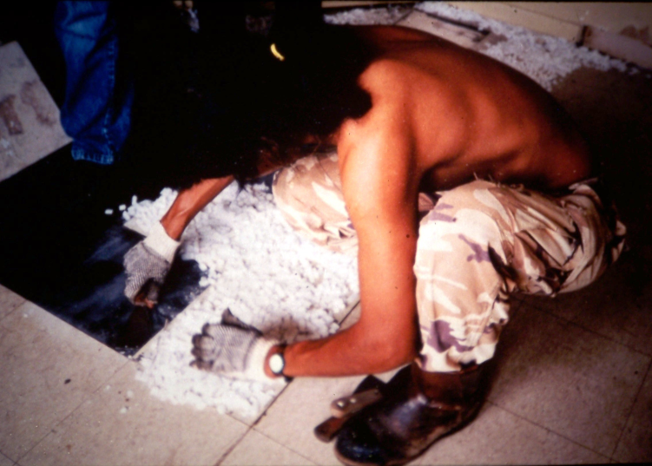
Dry Ice – Oxygen Displacement

Slide 6
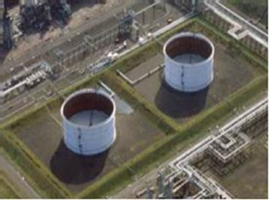
Floating Roof Tank

Slide 7
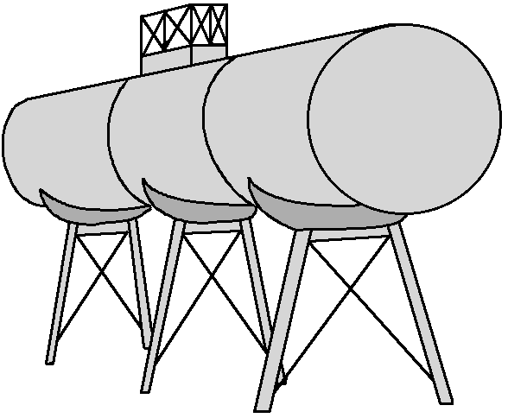
Examples of Confined Spaces
Storage Vessels
Furnaces
Tanks
Aircraft Fuel Cells
Railroad Tankcars
Vats
Pipelines
Trenches
Crawlspaces
Notes:
See slide bullets
The bottom three are not uncommon during asbestos-related work

Slide 8
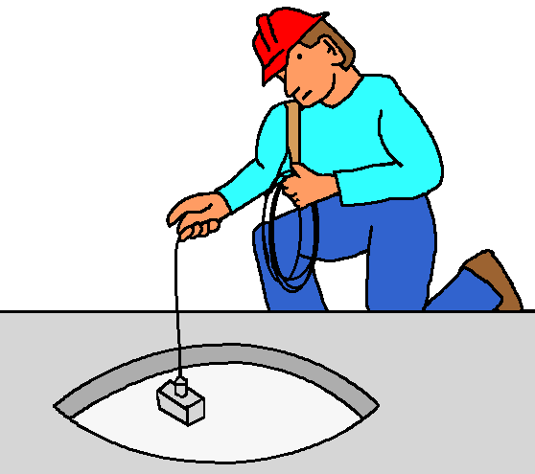
Air Monitoring
Prior to entry, test the space with a properly calibrated direct-reading instrument for:
Oxygen content
Flammable gases and
vapors
Potential toxic air
contaminants
Notes:
Confined spaces must be tested before entering
If appropriate testing with a calibrated device is not performed, do not enter, even if trained to do so

Slide 9
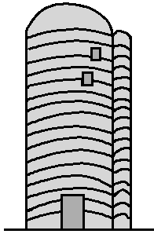
Permit Required Confined Space
Contains or has potential to contain a
hazardous atmosphere OR
Contains a material that has the potential for
engulfment OR
Has an internal configuration that an entrant
could be trapped or asphyxiated by inwardly
converging walls or by a floor that slopes
downward and tapers to a smaller cross-
section OR
Contains any other recognized serious safety
or health hazard
Notes:
The issues that require a permit required entry
Most commercial/industrial entities have very stringent programs on this issue
Always comply with site safety issues here

Slide 10
People Die in Confine Spaces Because They:
Fail to recognize a space
Trust their senses
Underestimate the danger
Do not stay on guard
Attempt to rescue others
Notes:
See slide bullets

Slide 11
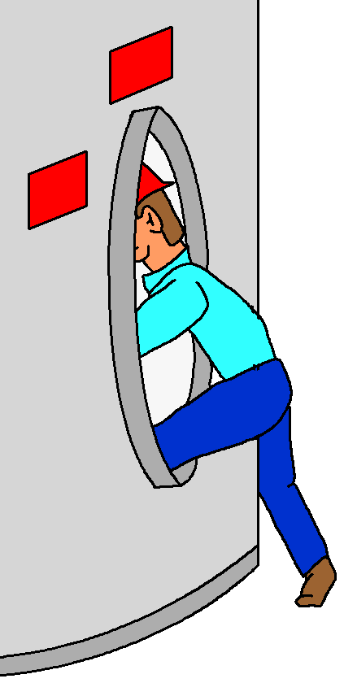
Rescuers Become Victims
60% of
fatalities are
would-be
rescuers
Notes:
This is a very important point
Workers see their friend in trouble and attempt rescue only to succumb to the hazard within the confined space

Slide 12
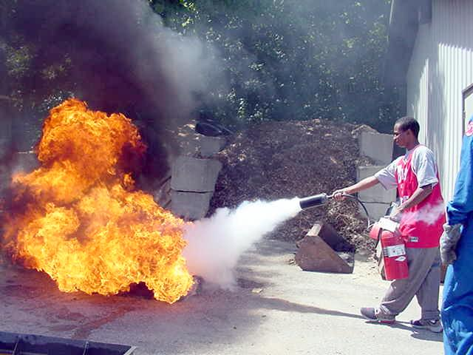
Fire Protection
Notes:
OSHA has training requirements for those that would use fire extinguishers to fight a fire
This slide demonstrates a training program for the use of a fire extinguisher
Always sweep at the base of the fire

Slide 13
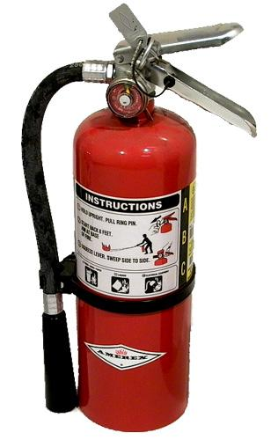
Fires Extinguishers
Visually inspected monthly
Annual maintenance test
Hydrostatic test every 5 years (Some every 12 years)
A, B, C Rating for most asbestos removal projects!
Notes:
Fire extinguisher issues
A = flammable solids
B = flammable liquids
C = electrical fires
These should be on site and readily available

Slide 14
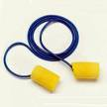
Other Hazards
Claustrophobia
  Some individuals become claustrophobic when wearing suits and respirators and can become panicky
  Gain familiarity with your PPE before you have to use it in the field
Noise
  Always have hearing protection available
  Minimum acceptable is pre-packaged foam rubber inserts
Machinery/Equipment
  Be exceptionally cautious when visiting sites where power washers, shredders, bead-blasters or high-powered vacuum machines are in use
Notes:
Claustrophobia should be detected when being trained with the PPE used; but not always
Some industrial/commercial/demolition sites can generate noise beyond the OSHA noise PEL! (90dB)
Most of these sites will require the use of hearing protection
When working near or over water the Inspector must be familiar with requirements for personal floatation devices (PFDs)

Slide 15
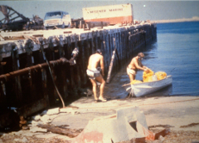
Other Hazards, cont.
Thermal Hazards
  Steam lines
    Can exceed 600°F
  Quartz and halogen lights
  Avoid using protective clothing with low melting points
    Kleenguard® ~300°F
    Tyvek® ~275°F
Drowning
  Inspections may have to be performed at:
    Offshore oil rigs
    Beneath bridge piers
  Use appropriate flotation devices as necessary
Notes:
Claustrophobia should be detected when being trained with the PPE used; but not always
Some industrial/commercial/demolition sites can generate noise beyond the OSHA noise PEL! (90dB)
Most of these sites will require the use of hearing protection
When working near or over water the Inspector must be familiar with requirements for personal floatation devices (PFDs)

Slide 16
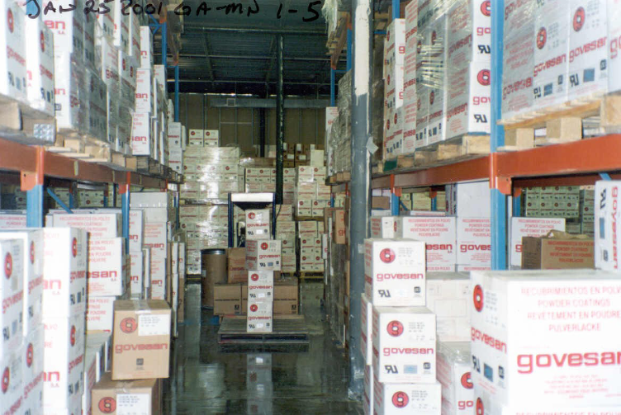
Beware of Forklifts!

Slide 17
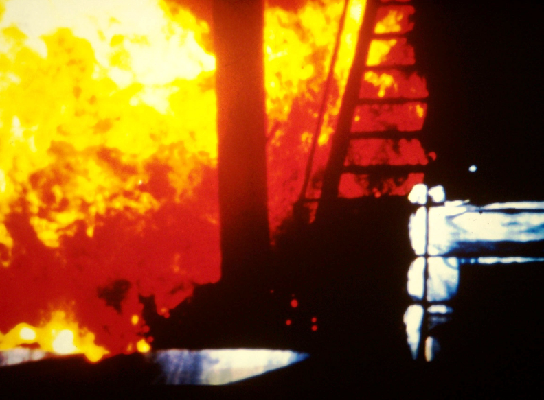
“Dropping Bottoms”
Notes:
This “flash” is seen when, in a foundry, metals which are being recycled (often oily) are dropped out from the bottom of an overhead container into a furnace. The flash is brief, but very hot, and extends a great distance from the furnace. Inspectors may have to walk through areas like this to get to the abatement site.

Slide 18
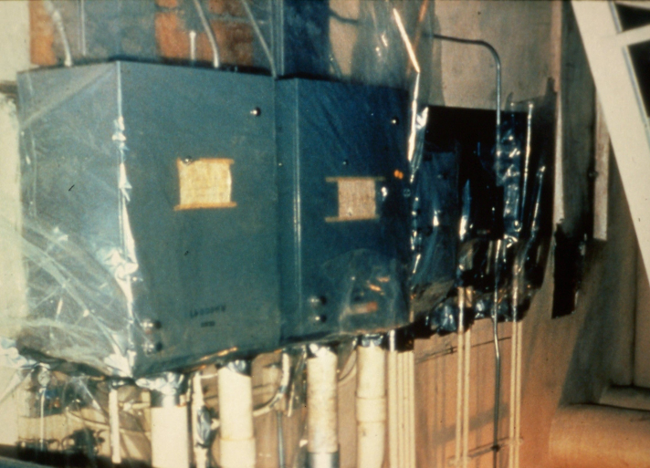
Electrical Panels

Slide 19
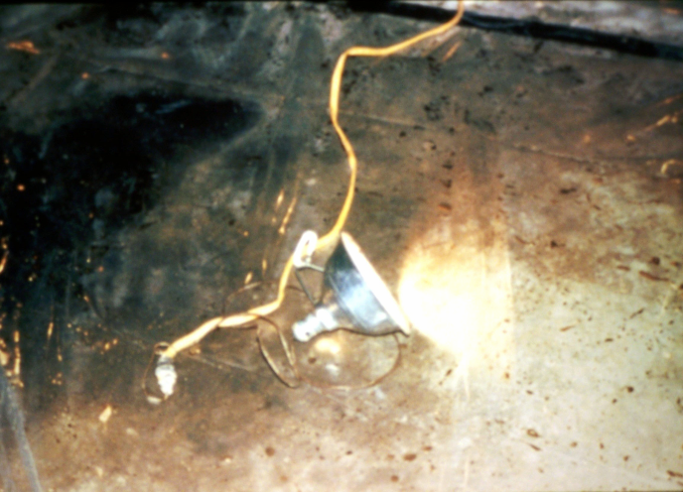
Light on Plastic

Slide 20
Dry Ice – Thermal Hazard

Slide 21
Elvis has left the building….
Questions?

