Slide 1
Asbestos NESHAP
Inspection and Safety Procedures
Course
Chapter 6
Asbestos Bulk Sampling
And Analysis
2014
Notes:
This section is a detailed treatment of how samples are obtained and analyzed to determine if building materials are asbestos-containing.
Instructors unfamiliar with the details of this chapter should read the notebook material in advance of presenting this section.
In this course we talk about two kinds of inspectors; asbestos inspectors and regulatory inspectors.
Asbestos inspectors are those individuals who have taken a 3-day AHERA asbestos inspector course, passed an exam, and can prove certification and in some states, licensing.
Regulatory inspectors are representatives of local, state and federal agencies who visit project sites to determine compliance.
The following point should be made very clear:
Asbestos inspections must be performed in advance of demolition/renovation activities by an AHERA-accredited asbestos inspector.
AHERA (and occasionally state requirements) defines the methodology by which samples are obtained.
The “AHERA protocol” is the usual and required method for obtaining samples during an asbestos building inspection.
This section is designed to explain the AHERA procedures and subsequent analysis of obtained samples.
The AHERA protocol is stressed here since many enforcement actions require reports and testimony of the asbestos inspector. Preparation of enforcement cases relies on adequate compliance assessments through inspections.
Knowledge of what is expected of asbestos inspections is very important.
Agency and State Inspectors are encouraged to attend an AHERA asbestos inspector program.

Slide 2
INTRODUCTION
Topics
  Understand the concept of a building/site inspection
  Protective Equipment
  Sampling Equipment/Materials
  Procedural Guidelines for Asbestos Sampling
  Pre-sampling Procedures
  Sampling Procedures
  Post-Sampling Activities
  Bulk Sample Analysis/Quality Control
2
Notes:
Title slide for this section

Slide 3
NESHAP
Regulates building materials that contain more than 1% asbestos
Collection of bulk samples is an essential component of a NESHAP inspection
Without bulk samples, it is difficult to determine compliance status
3
Notes:
The asbestos NESHAP regulates building materials containing greater than one percent asbestos. For this reason, the taking of bulk samples is an essential component of a NESHAP inspection. A bulk sample is a portion of a building material collected by an inspector and then analyzed to determine its asbestos content. Without bulk samples, an inspector may find it difficult, if not impossible, to determine the compliance status of a facility with respect to the NESHAP regulation.

Slide 4
AHERA
Does not apply to NESHAP compliance inspections.
Only EPA rule describing inspection and bulk sampling procedures.
Many inspectors will follow AHERA protocols for any asbestos inspection they perform.
NESHAP requires a thorough inspection.
AHERA inspections are often not NESHAP compliant.
  Usually do not involve destructive sampling.
4
Notes:
This slide explains why AHERA inspection and sample collection protocols are described in this chapter.
AHERA does not apply to NESHAP enforcement inspections, but…
AHERA represents the only federally promulgated rule that describes procedures and practices for performing asbestos inspections and collecting bulk samples.
Because of this, many accredited asbestos inspectors will follow these protocols for any asbestos inspection they might perform.
NESHAP requires a thorough inspection.
If the asbestos inspection report cites that it was performed in accordance with AHERA, it is often not NESHAP compliant.
Nondestructive operations are those where walls are not breached to find piping, flooring is not pulled apart to evaluate multiple layers, and other work is not done to find all ACM that might reasonably be expected to exist.

Slide 5
Recommendations
Collect samples whenever feasible
  Especially where violations are suspected and enforcement action is anticipated.
Follow written standard operating procedures
Only use accredited laboratories for bulk sample analysis.
  Ask the laboratory to archive the samples for you.
5
Notes:
Collect samples whenever feasible, especially where violations are suspected and enforcement action is anticipated. Follow written standard operating procedures and use only accredited laboratories for bulk sample analysis. Ask the laboratory to archive samples for you. Using improper sampling techniques or non-accredited laboratories may jeopardize an agency's ability to complete a successful enforcement action against a violator of the NESHAP.

Slide 6
Recommendations
Inspectors must be able to testify that the samples:
  Accurately represent conditions at the site
  Were maintained using proper chain of custody
  Were acquired and analyzed using proper methodology
6
Notes:
Inspectors must be able to testify that the samples:
Accurately represent conditions at the site;
Were maintained using proper chain of custody; and
Were acquired and analyzed using proper methodology.
Appropriate analyses of bulk samples will reveal the type and percentage of asbestos they contain. If the amount of asbestos in bulk samples does not exceed one percent, the materials are not RACM and therefore are not subject to the requirements of the NESHAP.

Slide 7
Protective Equipment
Follow EPA’s Health and Safety Guidelines for EPA Asbestos Inspectors
Protective Clothing
  Disposable, full-body coveralls
  Eye protection
  Hard hat
  Disposable gloves
  Safety shoes, hearing protection and other safety equipment as needed
7
Notes:
EPA's Health and Safety Guidelines for EPA Asbestos Inspectors recommends that the following personal protective equipment be used by EPA inspectors when collecting bulk samples under the Asbestos-In-Schools Rule, the Worker Protection Rule and the asbestos NESHAP:
Protective Clothing
If samples cannot be taken without a significant chance of releasing fibers, inspectors should wear the following protective clothing when collecting bulk samples:
Disposable, full-body coveralls (hood and foot covers attached);
Eye protection (if a full-face respirator is not used);
Disposable shoe coverings over safety shoes (if site conditions necessitate);
Hard hat (if applicable); and
Disposable gloves.
Inspectors should use safety shoes, hearing protection and other safety equipment as needed.

Slide 8
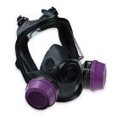
Protective Equipment
Respiratory Protection
  Should wear NIOSH-approved full-face, air purifying respirators with P-100 filters.
  Can also wear powered air-purifying respirators (PAPRs)
    Required in OSHA Class I work areas where:
      No negative exposure assessment
      Exposure assessment indicates exposure level will not exceed 1.0f/cm³ (8 hour TWA)
8
Notes:
EPA inspectors collecting bulk samples should wear full-face, air-purifying respirators with HEPA filter cartridges. This includes NIOSH-approved, tight-fitting powered air purifying respirators (PAPRs) equipped with HEPA filters.
In the absence of a negative exposure assessment (NEA), and where exposure assessment indicates the exposure level will not exceed 1 f/cm³ as an 8-hour time-weighted average, an individual within a regulated area where Class I work is being performed must be provided, as minimal protection, a PAPR equipped with high efficiency filters. [OSHA 1926.1101(h)(2)(iv)]

Slide 9
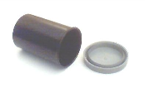

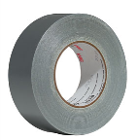
Sample Equipment/Materials
  Sample containers
    Use dry, sealable and clean container
    OSHA recommends against the use of paper or plastic bags
  Spray bottle
  Duct tape
9
Notes:
The following items are recommended for use during bulk sampling procedures:
Sample containers. Use any dry, sealable and clean container, such as a 35-mm film canister or plastic vial. Always wash canisters before use and never reuse containers that have contained asbestos. Otherwise, the inspector may be cross-examined about a lack of thorough cleaning. This could compromise the enforcement case. Although many inspectors use resealable plastic bags as sample containers, OSHA §1926.1101, Appendix K, Polarized Light Microscopy of Asbestos (Non-Mandatory), states:
“Do not use envelopes, plastic, or paper bags of any kind to collect samples. The use of plastic bags presents a contamination hazard to laboratory personnel and to other samples. When these containers are opened, a bellows effect blows fibers out of the container onto everything, including the person opening the container. “
OSHA recommends the use of 20 ml scintillation or similar vials.
Larger containers, such as quart- or gallon-sized zip-top bags may be needed, however, for samples of roofing, flooring, asbestos cements, etc., that are difficult to break down into small sizes.
Be sure to clean the sealed sample containers to prevent contamination of subsequent samples or individuals who might encounter the containers after they leave the project site.
Spray bottle. For wetting a surface (using amended water) prior to sampling to prevent generation of dust and for decontamination purposes. Asbestos compliance inspectors may use commercially available surfactants or create their own amended water by adding one (or no more than a few) drops of dishwashing liquid to a liter of water.
Duct tape. To temporarily repair a sampled area.
Bathroom caulking, water-activated repair cloth or prepared encapsulant (hand-pump sprayer only). To temporarily repair a sampled area in a noncontaminated environment.
Tamperproof tape/labels. To seal sample containers and evidence envelopes.

Slide 10
Sample Equipment/Materials
  Bathroom caulking, water-activated repair cloth or encapsulant
    To repair sampled area
  Tamperproof tape/labels
10
Notes:
The following items are recommended for use during bulk sampling procedures:
Sample containers. Use any dry, sealable and clean container, such as a 35-mm film canister or plastic vial. Always wash canisters before use and never reuse containers that have contained asbestos. Otherwise, the inspector may be cross-examined about a lack of thorough cleaning. This could compromise the enforcement case. Although many inspectors use resealable plastic bags as sample containers, OSHA §1926.1101, Appendix K, Polarized Light Microscopy of Asbestos (Non-Mandatory), states:
“Do not use envelopes, plastic, or paper bags of any kind to collect samples. The use of plastic bags presents a contamination hazard to laboratory personnel and to other samples. When these containers are opened, a bellows effect blows fibers out of the container onto everything, including the person opening the container. “
OSHA recommends the use of 20 ml scintillation or similar vials.
Larger containers, such as quart- or gallon-sized zip-top bags may be needed, however, for samples of roofing, flooring, asbestos cements, etc., that are difficult to break down into small sizes.
Be sure to clean the sealed sample containers to prevent contamination of subsequent samples or individuals who might encounter the containers after they leave the project site.
Spray bottle. For wetting a surface (using amended water) prior to sampling to prevent generation of dust and for decontamination purposes. Asbestos compliance inspectors may use commercially available surfactants or create their own amended water by adding one (or no more than a few) drops of dishwashing liquid to a liter of water.
Duct tape. To temporarily repair a sampled area.
Bathroom caulking, water-activated repair cloth or prepared encapsulant (hand-pump sprayer only). To temporarily repair a sampled area in a noncontaminated environment.
Tamperproof tape/labels. To seal sample containers and evidence envelopes.

Slide 11

Sample Equipment/Materials
  Tools
    Forceps, locking-blade knife, coring devices, screwdrivers, needle-nose pliers and laboratory spatula
  Pre-Moistened wipes
  Plastic bags
11
Notes:
Tools. Forceps, locking-blade penknife, coring device, screwdrivers, needle-nose pliers and laboratory spatula are examples.
Wet wipes. To clean tools between samples and to decontaminate equipment and sample containers.
Plastic bags. To store equipment, supplies, packaged samples and waste materials.

Slide 12

Sample Equipment/Materials
  Documentation Materials
    Field logbook
    Plastic clipboard
    Inspection checklist
    Watch
    Sample labels
    Chain-of-custody forms
    Waterproof pens
    Overhead transparency sheets
12
Notes:
Documentation materials. Field logbook, plastic clipboard, inspection checklist, watch, sample labels, chain-of-custody forms, waterproof pens and overhead transparency sheets. Inspectors can use permanent markers to write directly on plastic transparencies which can be cleansed in the shower without losing the notations. Paper should not be brought into the contaminated work area since it cannot be decontaminated.

Slide 13
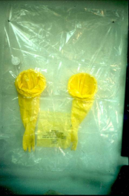
Sample Equipment/Materials
  Plastic drop cloth
  Glove bags
  Labeled waste disposal bags
  See “Appendix A: Inspection Equipment Checklist” in the student manual.
13
Notes:
Documentation materials. Field logbook, plastic clipboard, inspection checklist, watch, sample labels, chain-of-custody forms, waterproof pens and overhead transparency sheets. Inspectors can use permanent markers to write directly on plastic transparencies which can be cleansed in the shower without losing the notations. Paper should not be brought into the contaminated work area since it cannot be decontaminated.

Slide 14

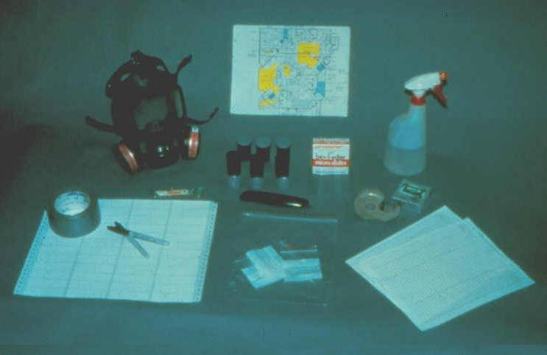

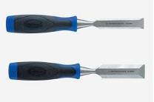


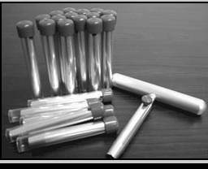

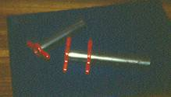

Folding
locking knife
Asbestos Inspection Supplies
For sampling roofing, asbestos cement etc.
14
Difficult to clean!
Notes:
Note respirator, labels, sampling/photo logs and spray bottle for moistening samples
The coring tool the “no” symbol is a re-usable coring tool…these should not be used, they are very difficult to clean
The coring tool with the check mark are one-time use and are often used for some materials

Slide 15
Procedural Guidelines for Asbestos Sampling
  The asbestos NESHAP does not address techniques for taking bulk samples
  Several EPA and ASTM documents provide procedures
    EPA Purple Book (June 1985)
    EPA Pink Book (October 1985)
    Health and Safety Guidelines for EPA Asbestos Inspectors (March 1991)
    ASTM E2356
    Others (see course manual)
15
Notes:
The asbestos NESHAP regulation does not address the techniques for taking bulk samples. Information regarding sample collection can be found, however, in several EPA and American Society for Testing and Materials (ASTM) publications:
Guidance for Controlling Asbestos-Containing Materials in Buildings (EPA 560/5-85-024, June 1985) ("Purple book")
Asbestos in Buildings: Simplified Sampling Scheme for Friable Surfacing Material (EPA 560/5-85-030a, October 1985) ("Pink book")
Health and Safety Guidelines for EPA Asbestos Inspectors (EPA, March 1991)
Test Method -Method for the Determination of Asbestos in Bulk Building Materials (EPA/600/R-93/116)
Asbestos Sampling Bulletin (EPA, 9/30/94)
Standard Test Method for Microvacuum Sampling and Indirect Analysis of Dust by Transmission Electron Microscopy for Asbestos Structure Number Surface Loading (ASTM D 5755-03)
Standard Test Method for Wipe Sampling, Indirect Preparation, and Analysis for Asbestos Structure Number Surface Loading by Transmission Electron Microscopy (ASTM D 6480-05).
The Purple and Pink books provide guidance for sampling in areas which are neither contaminated nor disturbed; e.g., AHERA school inspections, pre-abatement or pre-demolition inspections, etc. The Health and Safety document referenced in the third bullet above and sections of this manual describe protective equipment and procedural guidelines for collecting bulk samples. The Test Method document in the fourth bullet details preferred sample sizes for various asbestos-containing materials. The Asbestos Sampling Bulletin (fifth bullet) provides detailed information regarding the collection and analysis of bulk samples of multi-layered materials and the ASTM documents (last two bullets) describe settled dust sampling techniques.

Slide 16
The Basics…
Bulk samples – an essential part of a NESHAP inspection
Proving violations requires
  bulk samples
  proper sampling technique
  proper documentation
  proper analysis
16
Notes:
Bulk samples are obtained as part of a building inspection before asbestos removal (if necessary) and in advance of demolition/renovation work.
Regulatory inspectors must also take bulk samples during site visits to determine owner/contractor compliance.
To obtain evidence necessary to support a sound enforcement case, taking bulk samples is important along with properly sampling, good documentation, and conformance to required analytical methods.

Slide 17
What is an Asbestos Inspection?
Documenting sampling locations and taking necessary field notes so that reports written later will accurately reflect site conditions.
Taking photographs of materials found on the site and documenting on photo logs.
Sending samples to a laboratory to be analyzed for asbestos type(s) and percentages.
Generating reports that describe the activities, sampling and analytical results.
  The final reports from these activities will be the backbone of enforcement actions and potential litigation.
17
Notes:
This is a continuation of the previous slide.
Asbestos inspectors generate reports that include inventories of materials existing in structures.
Often regulatory inspectors take samples to determine what materials have been improperly disturbed.
The reports generated by regulatory inspectors are key to enforcement and possible litigation.

Slide 18
NESHAP demolition and renovation requirements
“Thoroughly inspect” prior to disturbance
“Nondestructive AHERA” likely inadequate
  roofing material
  exterior materials
  beneath carpets
  between walls
18
Notes:
The NESHAP regulation principally deals with demolition/renovation work that may involve ACM.
Typical AHERA asbestos inspections are not “destructive.”
This means walls are not opened to reveal what is behind them, carpet is not cut to see what is below it, and roofing material is not sampled among any multiple layers.
The NESHAP requires that all materials be identified. Therefore, additional sampling may have to be performed prior to demolition/renovation work.

Slide 19
NESHAP demolition and renovation requirements
  Determine presence of RACM, Category I or Category II nonfriable ACM, and friability
  Remove RACM prior to renovation or demolition.
  Notification to regulatory agency for all demolitions and most renovation activities.
    Most agency NESHAP notification forms require evidence of a building inspection and inspector information.
19
Notes:
The NESHAP regulation principally deals with demolition/renovation work that may involve ACM.
Typical AHERA asbestos inspections are not “destructive.”
This means walls are not opened to reveal what is behind them, carpet is not cut to see what is below it, and roofing material is not sampled among any multiple layers.
The NESHAP requires that all materials be identified. Therefore, additional sampling may have to be performed prior to demolition/renovation work.

Slide 20
Pre-sampling Procedures (Non-contaminated Areas)
Discuss with building officials how the samples will be obtained.
Determine equipment needed
Discuss notification of employees
Identify when samples will be collected
Limit access
20
Notes:
EPA's Health and Safety document provides the following procedural guidelines for inspectors; e.g., Asbestos-in-Schools inspectors taking bulk samples in non-contaminated areas; i.e., areas where the asbestos-containing materials have not been disturbed.
Discuss with building officials how the samples will be obtained and the rationale for selecting the sampling locations and the number of samples. Also discuss the advisability of notifying employees and/or their representatives prior to the inspection.
Determine the equipment needed during the inspection to adequately access the area; e.g., ladders and/or scaffolding.
Determine the best time to obtain the samples in each area selected; i.e., times when few people are normally in the vicinity of the work being conducted.
Limit access to the area while samples are being collected. Post area(s) with appropriate signs or construct barricades, if necessary. Under no circumstances should samples be taken when school children or other unprotected individuals are present.
Determine the minimum number of people needed in the affected area during sample collection and limit access to that number. These individuals may need to use personal protective equipment, depending on the asbestos inspector's assessment of the potential for asbestos fiber release.
Determine how the area will be decontaminated should there be an accident; e.g., a piece of asbestos comes loose and drops to the floor. Be prepared to isolate the area and to damp wipe/mop the area and/or have access to a HEPA vacuum.
Based on the best information available, determine the personal protective equipment required in the event of an accident, the conditions under which it will be worn and by whom.

Slide 21
Pre-sampling Procedures (Non-contaminated Areas)
Determine the minimum number of people necessary in the sampling area.
  PPE may be necessary for these individuals
Determine how the area will be decontaminated.
Determine what PPE is necessary for the inspector.
21
Notes:
EPA's Health and Safety document provides the following procedural guidelines for inspectors; e.g., Asbestos-in-Schools inspectors taking bulk samples in non-contaminated areas; i.e., areas where the asbestos-containing materials have not been disturbed.
Discuss with building officials how the samples will be obtained and the rationale for selecting the sampling locations and the number of samples. Also discuss the advisability of notifying employees and/or their representatives prior to the inspection.
Determine the equipment needed during the inspection to adequately access the area; e.g., ladders and/or scaffolding.
Determine the best time to obtain the samples in each area selected; i.e., times when few people are normally in the vicinity of the work being conducted.
Limit access to the area while samples are being collected. Post area(s) with appropriate signs or construct barricades, if necessary. Under no circumstances should samples be taken when school children or other unprotected individuals are present.
Determine the minimum number of people needed in the affected area during sample collection and limit access to that number. These individuals may need to use personal protective equipment, depending on the asbestos inspector's assessment of the potential for asbestos fiber release.
Determine how the area will be decontaminated should there be an accident; e.g., a piece of asbestos comes loose and drops to the floor. Be prepared to isolate the area and to damp wipe/mop the area and/or have access to a HEPA vacuum.
Based on the best information available, determine the personal protective equipment required in the event of an accident, the conditions under which it will be worn and by whom.

Slide 22
Sampling Procedures
Asbestos Inspectors may have to collect bulk samples:
  RACM in pre-abatement, active and post-abatement areas
  Other project areas such as roll-off waste containers, trailers
  Abandoned buildings
  Waste disposal sites
  Demolition sites
22
Notes:
Asbestos inspectors may need to collect bulk samples of suspect RACM in pre-abatement, active and post-abatement areas and from other sites such as roll-off waste containers, trailers, abandoned buildings, waste disposal sites and demolished sites.

Slide 23
Sampling Procedures
The following procedures should be followed:
  Identify homogeneous materials
    Similar in color and texture
  Determine friability
  Select sample site to minimize disturbance
  Place plastic under sampling site if necessary
  Spray the area to be sampled with amended water
23
Notes:
In general, the following procedures should be followed when taking bulk samples.
Identify homogeneous (similar in color and texture) thermal system insulation, surfacing and miscellaneous materials.
Determine the friability of suspect materials.
Select sample sites that will minimize disturbance of the asbestos material; e.g., the upper surface of horizontal thermal system insulation to reduce the possibility of contamination from material falling out of the sampling hole.
If necessary, place a covering such as plastic sheeting on the floor under the sample collection area.
Spray the area to be sampled with amended water to minimize release of fibers.

Slide 24
Sampling Procedures
Collect a complete core or cross-section of suspect materials.
For multi-layered systems:
  If the sample remains intact through all layers, containerize the sample as is.
  If the sample crumbles or breaks down, take samples from discrete layers.
    Carefully identify each layer and its position in the multi-layer system.
24
Notes:
Collect a complete core or cross section of suspect materials. In the case of a multi-layered system, if a bulk sample remains intact through all layers and the sample will remain intact until it reaches the analytical laboratory, containerize the sample as is. However, if such a bulk sample crumbles or breaks down at the time of sample collection, take separate samples from discrete layers at the site and carefully identify them and their position in the multi-layered system before sending them for analysis. Additional information regarding multi-layered systems is provided later in this chapter.

Slide 25
Sampling Procedures
Collect sufficient sample quantities per the lab’s recommendation.
  Always sample all the way through the suspect material!
Floor tiles, roofing felts, paper insulation, etc.
  3-4 square inches
Ceiling tiles, lose-fill insulation, pipe insulation, etc.
  1 cubic inch
25
Notes:
Collect sufficient sample quantities per the analytical laboratory’s recommendations. In general, for items such as floor tiles, roofing felts and paper insulation, obtain three to four square inches of the material. For other materials such as ceiling tiles, loose-fill insulation and pipe insulation, gather approximately one cubic inch. For samples of thin coating materials such as paints, mastics, spray plasters and tapes, attempt to collect at least 2 square inches. An insufficient volume of sampled material could be rejected by the laboratory.

Slide 26
Sampling Procedures
Collect a minimum of three representative samples from each homogeneous area of suspect material associated with a possible violation.
  AHERA requirements will be addressed shortly.
Place samples in airtight containers.
Clean sampling equipment and wash hands or change gloves to avoid cross-contamination.
26
Notes:
Collect a minimum of three representative samples from each homogeneous area of suspect material associated with a possible violation.
AHERA (40 CFR Part 763) requires that a specific minimum number of samples be obtained based on the classification of the material. OSHA [§1926.1101 (k)(5)] specifically relies upon the AHERA model. Also, many local/state agencies rely upon the AHERA model for NESHAP compliance or are more stringent. See Minimum Samples below for additional information.
Place samples in airtight containers.
Clean sampling equipment and wash hands or change gloves between samples to avoid cross-contamination.

Slide 27
Sampling Procedures
Use repair materials to seal the spot where the sample was taken, if necessary.
Seal containers so that tampering will be evident and to prevent accidental opening.
Write unique identification and initials on each container.
Record sample information in field notes.
27
Notes:
Use repair materials to seal the spot where the sample was taken, if necessary.
Seal containers so that tampering will be evident and to pre vent accidental opening.
Write a unique identification number and your initials on each sample container.
Record sample information in field notes.

Slide 28
Sampling Procedures
If dry material is encountered and a wetting violation is suspected, record this information in the field logbook and note in both the logbook and on the chain-of-custody form that the material was wetted during sample collection.
28
Notes:
If dry material is encountered and a wetting violation is suspected, record this information in the field logbook and note in both the logbook and on the chain-of-custody form that the material was wetted during sample collection.

Slide 29
Sampling Procedures
Photograph sampling location(s)
  Place an item of familiar size in the picture as a size reference.
Make a drawing of the inspection site.
  Note where samples and photographs were taken.
Decontaminate tools, sample containers and self.
Dispose of asbestos-contaminated waste properly.
29
Notes:
If dry material is encountered and a wetting violation is suspected, record this information in the field logbook and note in both the logbook and on the chain-of-custody form that the material was wetted during sample collection.

Slide 30
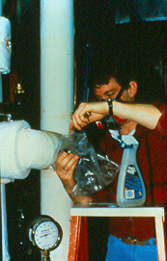
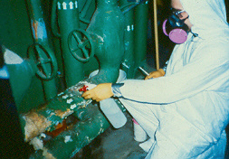
Plastic (film)
container
inside bag to
hold sample
Collecting bulk samples
Full PPE if hazards are present and always required if fiber count is >PEL/EL
ALWAYS wear your respirator
Always decontaminate between samples and clean up all sampling debris.
Notes:
If sampling in relatively clean environments, a half face respirator may suffice for personal protection. If in doubt, or in an area with known contamination, full personal protection is appropriate.
If sampling in an occupied building. never leave debris exposed that may have been disturbed during sampling. Note arrow pointing to bag around sampling container.

Slide 31
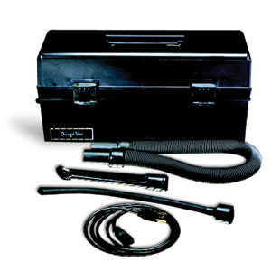
Sample Collection
Area Preparation
  Limit access to area
  Protect area where sample is being collected, especially if in an ocuppied building.
    Polyethylene sheeting on floor or other horizontal surfaces
    Have a small HEPA vacuum for pre-cleaning and post-cleaning decontamination (if necessary)
31
Notes:
Always limit acc.ess when sampling. Protect nearby people in operating buildings.
If in an operating building, always protect surfaces from contamination.
Polyethylene sheeting (usually just called “poly”) may be used to protect surfaces.
Always clean up after sampling. No contamination should be left behind to create potential exposure hazards for others.

Slide 32
AHERA Sampling Requirements
The next few slides depict AHERA's sampling requirements for performing asbestos inspections in schools.
The sample amounts given apply to each homogeneous material.
AHERA sampling procedures are required by many State/local asbestos regulations.
NESHAP: “thoroughly inspect”
32
Notes:
Transition slide to next set of slides that will describe AHERA requirements.
Taking only one sample of each “obvious” material DOES NOT constitute a thorough inspection to meet AHERA sampling requirements, and certainly does not meet NESHAP requirements.

Slide 33
Surfacing Materials
  <1,000 ft² – a minimum of 3 samples
  1,000 - 5,000 ft² – at least 5 samples
  >5,000 ft² – a minimum of 7 samples
  EPA recommends 9 samples - “Pink Book”
  Minimum sample amount: ~1 tablespoon (sample all the way to the substrate)
  “Statistically random sampling” – required!
May need or want to collect more samples than called for by AHERA.
33
Notes:
Surfacing materials include materials such as fireproofing, soundproofing, and textured ceilings.
Square footage references relate to floor space.
EPA’s “Pink Book” describes sampling methods for surfacing materials in buildings. The book is out of print but may be found on-line. This federal guidance is the statistical basis document for asbestos sampling
AHERA requires “statistically random sampling” (see AHERA and the Pink Book). This means sampling locations must be strategically spread out to assure that the material has been adequately sampled

Slide 34
Thermal System Insulation(TSI)
Minimum of 3 samples per homogeneous area
Amount of material to sample: Sample the material down to the substrate! Some TSI can be quite thick (boilers)
One pipe may have multiple homogeneous areas
  straight run
  elbow
  valve
  replacement
Patch = <6 linear or square feet, 1 sample
“Randomly distributed samples” There is no easy statistical sampling protocol for surfacing material. Sample widely!
34
Notes:
Thermal System Insulation includes insulation found on pipe and boilers and in HVAC ducts.
Piping systems can be very complex and have a variety of materials throughout the system. A minimum of 3 samples of each should be taken!
Thick materials should be carefully sampled to ensure that the entire thickness is sampled.
Insulation patches require at least 1 sample.
There is no official sampling protocol for randomly distributed sampling of surface materials but inspectors should err on the side of sampling widely. Having more than enough samples is always better than not having enough.

Slide 35
Miscellaneous Materials
“…an accredited inspector shall collect bulk samples from each homogeneous area of friable miscellaneous material that is not assumed to be ACM.”
Essentially the same requirements apply for nonfriable
Minimum of two samples – always collect adequate samples. Do not under sample!!
“In a manner sufficient to determine…” No statistical sampling protocol. In other words, take numerous samples throughout the material!
Amount of material to sample: ~2-4 square inches (sample each layer if multiple layers/materials).
35
Notes:
Miscellaneous materials are anything that is NOT surfacing or TSI. These are the broadest group and include floor tiles and associated mastic, wallboard joint compound, ceiling tiles, roofing material, and asbestos cements (as in Transite)
AHERA never set a minimum number of samples but since the regulation says “samples” (plural), a minimum of two samples of each material are considered necessary.
In many case many more samples are needed to determine which materials are ACM and which are not.
Wallboard joint compound, floor tiles, and ceiling tiles are materials that can have different compositions within the same structure.
Take as many samples as necessary to document the circumstances of the structure and ensure an adequate assessment.

Slide 36
Examples of TSI Bulk Sampling
The next couple of slides depict how inspectors gather TSI samples.
There are other methods that also work well.
There are NO specified methods of sampling in the regulations.
It is up to you to determine how best to conduct bulk sampling.
36
Notes:
Introductory slide to bulk sampling.

Slide 37
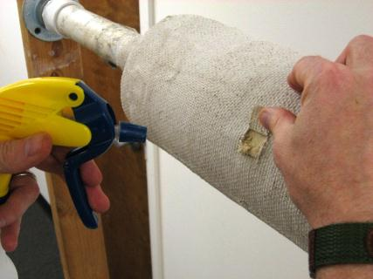
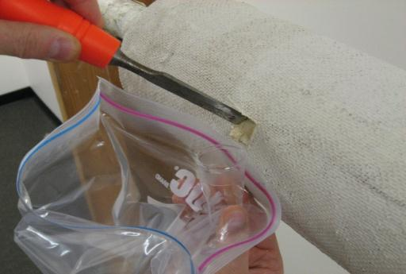
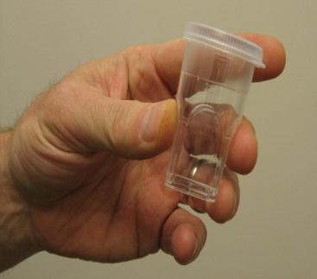
Moisten (but do not soak) the sample location before sampling. Re-spray as needed.
Place sample in a rigid container.
Surround the container with a resealable plastic bag to catch debris.
Notes:
Areas to be sampled should be moistened (not soaked) with a spray before sampling begins.
Use a rigid, sealable container for storing samples.
A larger containment bag should be used to collect any debris that is dislodged but not caught in the sample container.
Always clean the sampling tool after sampling.

Slide 38
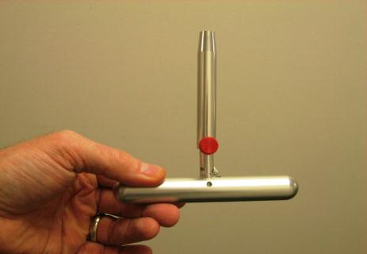
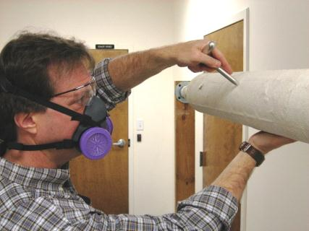
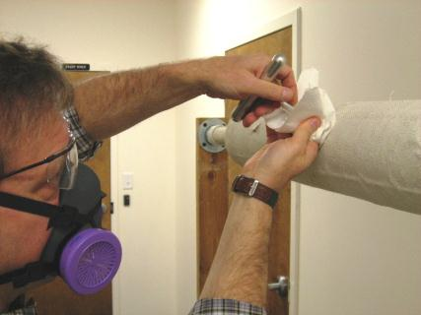
Sampling using a single-use coring device.
Use a wet wipe as you withdraw the coring device to limit dust and debris.
If possible, sample above horizontal to limit falling dust or debris.
Notes:
A single-use coring device works well for sampling TSI. Using a wet wipe as you withdraw the coring device will reduce dust and debris.
Never sample from below if possible since debris easily becomes dislodged and falls.

Slide 39
Bulk Sampling
Miscellaneous Materials
No simple method of sampling this wide array of materials.
The following slide shows sampling of floor tile.
Be sure to take enough sample, often ~2-4 square inches.
Always look for multiple layers in such areas as floors, roofing, and exterior walls.
39
Notes:
See slide
Bulk sampling of miscellaneous materials must be adapted to the material being sampled. There is no detailed guide for such sampling.
Taking adequate quantities of samples is important, as is looking for multiple layers (flooring, roofing, and walls) and sampling all of them.

Slide 40
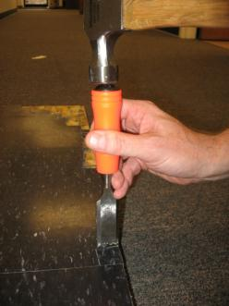
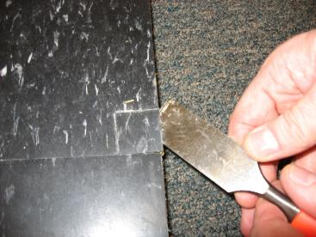
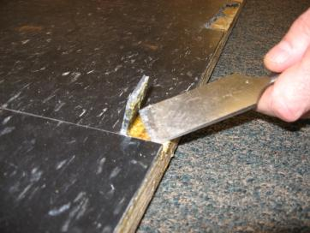
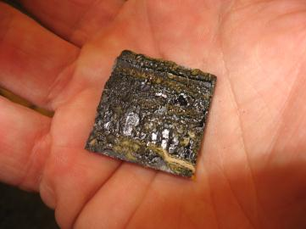
Often mastic has to be sampled separately to obtain enough to analyze
40
Notes:
The sample in the pictures is of sufficient size for analytical purposes.
If multiple layers exist, each layer should be sampled.
Mastic may need to be sampled separately from the material to which it has been bound to ensure that enough is available for analysis.

Slide 41
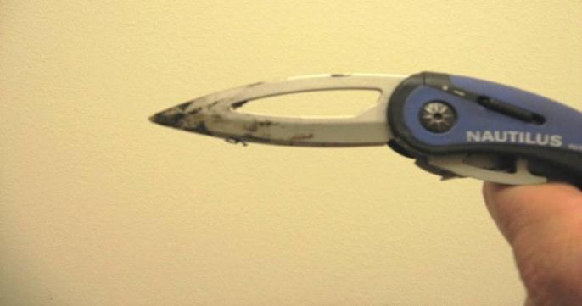
Always clean your tools!
If not, you WILL contaminate subsequent samples.
When sampling surfacing materials and TSI, wiping tools with wet wipes may be adequate. Mastics and roofing materials may require solvent cleaning.
If solvents are used in larger quantities, an MSDS may be required on site!
Make sure knife blades are locked before cleaning. Some firms do not allow the used of “fixed-blade” knives on their sites.
41
Notes:
Decontamination of tools is very important between samples.
Subsequent samples can be contaminated if proper cleaning is not accomplished.
Cross contamination of samples compromises the integrity of compliance assessment and enforcement actions.
Safety must be emphasized, whether it involves use of chemicals or tools.

Slide 42
Multi-layered System Sampling
May need to determine the applicability of the NESHAP to multi-layered systems that are encountered.
Such systems include:
  Plaster wall or ceiling
  Resilient flooring
  Plaster/stucco
  Wallboard with add-on layers
42
Notes:
Asbestos NESHAP inspectors may need to determine the applicability of the NESHAP to multi-layered systems they encounter. Such systems include plaster wall or ceiling systems, resilient flooring systems (flooring, mastic and underlayment), plaster/stucco systems and wallboard systems with add-on layers.

Slide 43
Multi-layered System Sampling
EPA has received many questions about the applicability of the asbestos NESHAP to multi-layered systems.
Published the following:
  Asbestos NESHAP Clarification Regarding Analysis of Multi-layered Systems (59 FR 542, January 5, 1994)
43
Notes:
Asbestos NESHAP inspectors may need to determine the applicability of the NESHAP to multi-layered systems they encounter. Such systems include plaster wall or ceiling systems, resilient flooring systems (flooring, mastic and underlayment), plaster/stucco systems and wallboard systems with add-on layers.
Since EPA had received many questions about the applicability of the NESHAP to multi-layered systems, it published the Asbestos NESHAP Clarification Regarding Analysis of Multi-layered Systems (59 FR 542, January 5, 1994). In this document EPA discussed the following:

Slide 44
Multi-layered System Sampling
Plaster/Stucco
  If the layers can be distinguished, they must be analyzed separately.
Add-on Materials
  Sprayed-on materials, paint, ceiling and wall texture “added” to wallboard or other base materials must be analyzed separately if possible.
44
Notes:
Plaster/Stucco
If the plaster and stucco wall or ceiling systems are layered, and the layers can be distinguished, then the layers must be analyzed separately.
Add-on Materials
All materials such as sprayed-on materials, paint, ceiling and wall texture "added" to wallboard or other base materials must be analyzed and reported separately if possible.

Slide 45
Wallboard
EPA does not consider “plasterboard” (commonly called sheetrock, wallboard and gypsum board), by itself a multi-layered material under AHERA and NESHAP.
    Asbestos Sampling Bulletin (September 30, 1994)
When joint compound or tape is applied to wallboard, it becomes an integral part of the wallboard.
Where demolition or renovation impacts such a material, composite sampling should be conducted.
45
Notes:
In its Asbestos Sampling Bulletin (September 30, 1994) EPA stated that it does not consider a sheet of "plasterboard," commonly called sheetrock, wallboard and gypsum board, by itself a multi-layered material under either AHERA or NESHAP regulations.
When joint compound or tape is applied to wallboard, it becomes an integral part of the wallboard and in effect becomes one material forming a wall system. Therefore, where a demolition or renovation impacts such a wall system, a composite analysis of the wall system (percent of asbestos in the joint compound, tape and wallboard) should be conducted.

Slide 46
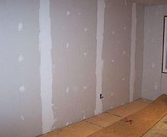
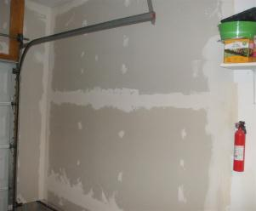
Joint Compound
Take a minimum of three samples
  Inside or outside corners
  At wallboard joint intervals
  Around nail/screw heads
Vertical Drywall
Horizontal Drywall
46
Notes:
Joint Compound
Sample where joints are expected (take a minimum of three samples):
Inside or outside corners;
At wallboard joint intervals; and
Around nail heads.

Slide 47
Demolition/Renovation
Sampling Considerations
Try to obtain intact multi-layered samples. If layers start to separate, hold sample together with a rubber band. If layers separate during sampling, sample each layer individually.
Make clear to the lab the nature of multi-layer samples. Inspector should also indicate the relative positions of the layers in the material.
Document site conditions and sample locations, and take photos to support potential enforcement actions.
47
Notes:
For compliance evaluations, if a structure is in shambles the inspector must try to relate samples to original materials with photos and other useful documentation.
This is important but many times difficult.

Slide 48
Add-on Materials
Take a minimum of three samples where joints are not expected.
Since a laboratory cannot distinguish joint compound at joints from the same materials used as a skim coat, the inspector must clearly describe the sample composition so that appropriate analysis is conducted and results are reported.
48
Notes:
Add-on Materials
Take a minimum of three samples where joints are not expected; e.g., between corners and wallboard joint intervals.
Since a laboratory cannot distinguish joint compound at joints from the same materials used as a skim coat, the inspector must clearly describe the sample composition so that appropriate analysis is conducted and results are reported.

Slide 49
Add-on Materials
At the laboratory, all samples with an outer layer having >1% asbestos will be noted. When this applies, the following must be considered:
  If only joint sampling areas are >1% asbestos, then the material is joint compound and analytical results of the layers are composited.
    If the composite result is <1%, no management is necessary. If the composite result is >1%, the material is RACM as defined by the NESHAP and management is necessary.
49
Notes:
At the laboratory, all samples with an outer layer having >1% asbestos will be noted. When this situation applies, the following must be considered:
If only joint sampling areas show layers with >1% asbestos, then the material is joint compound and analytical results of the layers are composited. If the composite result is <1%, no management is necessary. If the composite result is >1%, the material is RACM as defined by the NESHAP and management is necessary.

Slide 50
Add-on Materials
If samples from both joint compound and non-joint areas show layers with >1% asbestos, the material is considered a skim coat or add-on material.
In this case the results must not be composited and must be reported for each layer.
Material so located must be treated as separate RACM layers according to the NESHAP.
50
Notes:
If samples from both joint compound and non-joint areas show layers with >1% asbestos, the material is considered a skim coat or add-on material. In this case the results must not be composited and must be reported for each layer. Material so located must be treated as separate RACM layers according to the NESHAP.

Slide 51
Add-on Materials
EPA recommended the use of an improved analytical method for the analysis of bulk samples (59 FR 38970).
Directs laboratories to analyze individual layers or strata of a multi-layered sample and to report a single result for each layer.
The 1982 interim method had allowed analytical results for the discrete layers to be combined and reported as one result.
51
Notes:
EPA recommended the use of an improved analytical method for the analysis of bulk samples in a Federal Register notice of August 1, 1994 (59 FR 38970). This notice directs laboratories to analyze individual layers or strata of a multi-layered sample and to report a single result for each layer. The 1982 interim method had allowed analytical results for the discrete layers of a multi-layered sample to be combined and reported as one result across all layers.

Slide 52
Add-on Materials
As a result, multi-layered systems that may have contained asbestos in a single layer may have been reported by laboratories as non-asbestos-containing.
NESHAP inspectors, therefore, cannot rely on previous analysis of multi-layered materials to determine applicability of the NESHAP unless results of each layer's analysis are available.
OSHA DOES NOT allow compositing of analytical results.
52
Notes:
As a result, multi-layered systems that may have contained asbestos in a single layer may have been reported by laboratories as non-asbestos-containing. NESHAP inspectors, therefore, cannot rely on previous analysis of multi-layered materials to determine applicability of the NESHAP unless results of each layer's analysis are available. Inspectors must sample multi-layered materials and provide necessary information regarding the samples to the laboratory for proper analysis.
OSHA does not allow compositing of analytical results from layered materials. Also, many local/state agencies require materials to be sampled and analyzed by layer.
The issue of multi-layered materials and compositing is one of the most debated issues in the asbestos control industry. When these materials are disturbed during renovation and demolition activity, the layers often separate into discreet materials that, upon analysis, are determined to be ACM.

Slide 53
Other Sampling Issues
Under sampling of materials – can 2 drywall joint compound samples represent an entire building?
Material quantity estimates
  A contractor will often use the quantities estimated by the asbestos inspector on NESHAP notifications.
  These can be poorly estimated – for example, the quantity of asbestos containing wallboard (SF), window glazing compound (typically LF) or TSI (LF).
  When determining compliance during onsite visits the NESHAP inspector may find that quantities on-site differ from those listed on notifications.
  The owner or operator making the notification should verify material quantities.
53
Notes:
Under-sampling can cause an inspector to miss materials that may be nonasbestos in one part of a building but may contain asbestos elsewhere in the building.
It is punitive to the owner to say an entire wallboard system is “positive” if it is not.
Estimating material quantities is not an exact science and inspectors can be easily misled. It is the responsibility of owner/operators to verify and properly report quantities of asbestos-containing materials.

Slide 54
Demolition/Renovation
Sampling Considerations
The materials may be disturbed and mixed
Sample a variety of materials that may have constituted the original homogeneous areas.
Try to relate samples of debris to existing undisturbed materials, if possible.
54
Notes:
For compliance evaluations, if a structure is in shambles the inspector must try to relate samples to original materials with photos and other useful documentation.
This is important but many times difficult.

Slide 55
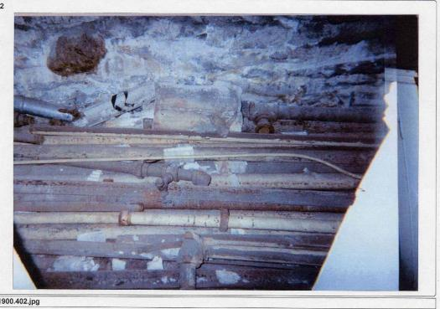
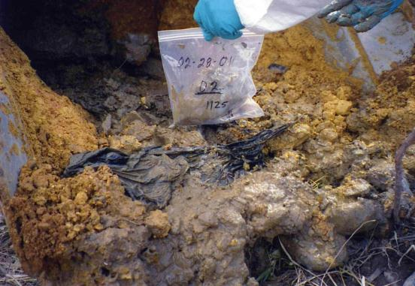
Not all site sampling is simple!
Photos/Peggy Forney/US EPA Denver
We'll look more... in the Facility Inspections chapter.
Where’s the ACM?
Notes:
What you will find when making site compliance visits can be drastically different what an asbestos inspector may find during simple asbestos inspections.
Complexities vary and require careful thought and planning on-site to address the many facets – different materials and conditions and comingled materials.
This will be discussed in more detail in the chapter on facility inspections.

Slide 56
Dust Sampling Procedures
In some situations, such as a post-removal inspection or an improperly-run abatement site, inspectors may encounter settled dust and need to determine whether it contains asbestos.
EPA has no official policy regarding dust sampling and analysis.
The American Society for Testing and Materials (ASTM) Committee D22 has developed two dust sampling collection and analytical methods.
56
Notes:
EPA has no official policy regarding dust sampling or analysis. However, the American Society for Testing and Materials (ASTM) Committee D22 has developed two test methods described below.
In some situations; e.g., a post-removal inspection, or an improperly-run abatement site, inspectors may encounter settled dust and need to determine whether it contains asbestos. Inspectors may choose to use the ASTM microvacuum or wipe technique depending upon the sampling media/equipment available.

Slide 57
Microvacuum Samples
NESHAP inspectors are encouraged to follow the microvacuum techniques described in ASTM’s Standard Test Method for Microvacuum Sampling and Indirect Analysis of Dust by Transmission Electron Microscopy for Asbestos Structure Number Surface Loading (ASTM D 5755-03).
57
Notes:
NESHAP inspectors are encouraged to follow the microvacuum techniques described in the ASTM document: Standard Test Method for Microvacuum Sampling and Indirect Analysis of Dust by Transmission Electron Microscopy for Asbestos Structure Number Surface Loading (ASTM D 5755-03). The following is a summary of this method:
The sample is collected by vacuuming a known surface area with a standard 25 or 37 mm air sampling cassette using a plastic tube that is attached to the inlet orifice which acts as a nozzle. The sample is transferred from inside the cassette to an aqueous suspension of known volume. Aliquots of the suspension are then filtered through a membrane. A section of the membrane is prepared and transferred to a TEM grid using the direct transfer method. The asbestiform structures are identified, sized and counted by TEM, using Selected Area Electron Diffraction (SAED) and Energy Dispersive X-ray Analysis (EDXA) at a magnification of 15,000 to 20,000X.

Slide 58
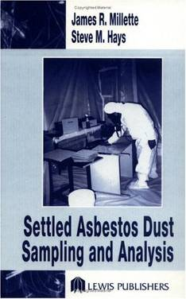
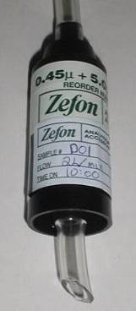
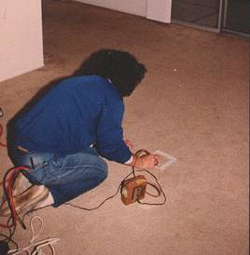
Microvacuum Dust Sampling
Usually a 10 cm x 10 cm sampling area
From the Millette/Hays book (p. 50)
<1000 structures (s)/cm² = background
>10,000 s/cm² = above background
>100,000 s/cm² = elevated
There are NO federal dust levels!
Use protective clothing, not street clothes!
58
Notes:
The ASTM Microvacuum technique utilizes a TEM air sampling cassette with a piece of sampling tubing on the tip.
It is used like a vacuum cleaner, typically on a 10 cm X 10 cm sampling area.
If this method is going to be used for any compliance assessment reasons, the sample should have available a copy of the ASTM method which should be carefully followed.
The Millette/Hays background and elevated level criteria were developed for use in product liability litigation. They are not EPA nor OSHA values.

Slide 59
Wipe Samples
Asbestos NESHAP inspectors are encouraged to follow the wipe sampling techniques described in ASTM’s Standard Test Method for Wipe Sampling, Indirect Preparation, and Analysis for Asbestos Structure Number Surface Loading by Transmission Electron Microscopy (D 6480-05).
59
Notes:
Asbestos NESHAP inspectors are encouraged to follow the wipe sampling techniques described in the ASTM document: Standard Test Method for Wipe Sampling, Indirect Preparation, and Analysis for Asbestos Structure Number Surface Loading by Transmission Electron Microscopy (D 6480-05).
ASTM recommends the use of a particle-free, sealed edge, continuous filament cloth sampling medium This material is available from commercial scientific suppliers and is commonly listed as “clean room wiper.” The sampling medium should be moistened with a 50:50 mixture of alcohol and water. Depending on the size of the sample area, inspectors should follow either the Template Assisted Sampling Procedure or the Confined Area Sampling Procedure found in the ASTM document referenced in this subsection. Once gathered, each sample should be sealed in a sample container, labeled with a unique identification number and delivered to a National Voluntary Laboratory Accreditation Program (NVLAP)-accredited laboratory for analysis. At the laboratory the sample will be analyzed via transmission electron microscopy (TEM) for its asbestos content.

Slide 60
Tape Lift Samples
In the tape lift method, adhesive materials such as transparent tape, self-stick office notes, or forensic tape are used to gather the dust sample.
Duct tape should never be used since recovery of the dust particles for analysis is essentially impossible.
60
Notes:
In the tape lift method, adhesive materials such as transparent tape, self-stick office notes, or forensic tape are used to gather the dust sample. Duct tape should never be used since recovery of the dust particles for analysis is essentially impossible.
At the laboratory the sample is prepared directly for TEM or scanning electron microscopy (SEM) analysis. This method of gathering and analyzing the sample minimally disturbs the asbestos present, but other fibers and matrix material may mask the asbestos fibers.

Slide 61
Passive Samples
In passive sampling, a clean collection surface such as a shallow metal lid is deployed to collect dust over a measured period of time.
The dust is rinsed out of the container and then analyzed via TEM.
Since the collection time is usually several weeks, asbestos NESHAP inspectors do not often use this method.
61
Notes:
Passive Samples
In passive sampling, a clean collection surface such as a shallow metal lid is deployed to collect dust over a measured period of time. The dust is rinsed out of the container and then analyzed via TEM. Since the collection time is usually several weeks, asbestos NESHAP inspectors do not often use this method. Passive samples are useful, however, in determining if dust is being deposited during the sampling period.

Slide 62
Post-Sampling Activities
Complete all documentation including checklist entries and chain-of-custody (COC) form.
  A sample COC form is provided in Figure 6-1.
  If a commercial lab is used for analysis, it may supply appropriate COC forms.
  Regulatory agencies often use their own COC forms.
62
Notes:
Complete all documentation including checklist entries and chain-of-custody (COC) form. A sample COC form is provided in Figure 6-1. If a commercial lab is used for analysis, it may supply appropriate COC forms. Many times, regulatory agencies also have their own prescribed forms.

Slide 63
Post Sampling Activities
Secure samples before conducting another inspection.
Minimize the number of individuals who handle the samples thereafter.
Ensure that anyone who acquires custody of the samples signs the COC form.
63
Notes:
Secure samples before conducting another inspection.
Minimize the number of individuals who handle the samples thereafter. The name of every individual who acquires custody of the samples must be recorded on the COC form. The samples should not be handled by multiple custodians unless necessary and unless a COC form is signed by each person who has possession of the samples.

Slide 64
Post Sampling Activities
Chain of custody is best maintained by personal delivery of samples to the analytical laboratory.
If this is not possible, the U.S. Postal Service or a commercial courier service may be used.
Since packaging and labeling requirements may differ depending on the organization chosen, inspectors should contact these couriers before shipping samples.
64
Notes:
Chain of custody can best be maintained by personal delivery of samples to the analytical laboratory. If this is not possible, the U.S. Postal Service or a commercial courier services may be used. Since packaging and labeling requirements may differ depending on the organization chosen, inspectors should contact these couriers before shipping samples.

Slide 65
Post Sampling Activities
Package bulk samples securely so that asbestos will not be released during transport.
Make sure the sample vials are securely taped shut and well-cushioned to prevent breakage.
65
Notes:
If being shipped, package the bulk samples in a manner that assures that asbestos will not be released during transport. Make sure the sample vials are securely taped shut and well cushioned to prevent breakage.

Slide 66
Post Sampling Activities
Analyze samples as necessary. It is advisable to collect extra samples and analyze only enough to satisfy the evidence requirements.
Retain original samples until an enforcement action is completed.
66
Notes:
Analyze samples as necessary. It is advisable to collect extra samples and analyze only enough to satisfy the evidence requirements; for instance, one sample containing greater than one percent asbestos. Additional samples may be analyzed as needed.
Retain original samples until such time as an enforcement action is completed.

Slide 67
Bulk Sample Analysis
Bulk sample analysis is performed to determine whether the material from which samples have been collected contains greater than 1% asbestos.
EPA provided guidance regarding the analysis of asbestos in bulk samples in Method for the Determination of Asbestos in Bulk Building Materials (EPA/600/R-93/116, July 1993).
67
Notes:
Bulk sample analysis is performed to determine whether the material from which samples have been collected contains greater than 1% asbestos. EPA provided guidance regarding the analysis of asbestos in bulk samples in its publication Method for the Determination of Asbestos in Bulk Building Materials (EPA/600/R-93/116, July 1993). This improved analytical method was designed to address certain materials:
That are known to contain asbestos fibers, but in which the asbestos percentage is low (<10%);
Where the percentage of asbestos is obscured by a matrix binder of some kind; e.g., vinyl or asphalt floor tiles; and
In which small, thin fibers are present, but are frequently not detected at the magnification and resolution limits of polarizing light microscopes.
The improved method expanded on the previous 1982 interim polarizing light microscope (PLM) method.

Slide 68
1993 Analytical Method
Improved upon the previous 1982 method.
Was designed to address:
  Low percentage samples (<10%)
  Asbestos obscured by matrix binder (e.g. vinyl or asphalt)
  Presence of small and/or thin fibers
Included additional sample preparation techniques and the use of Transmission Electron Microscopy (TEM).
68
Notes:
Bulk sample analysis is performed to determine whether the material from which samples have been collected contains greater than 1% asbestos. EPA provided guidance regarding the analysis of asbestos in bulk samples in its publication Method for the Determination of Asbestos in Bulk Building Materials (EPA/600/R-93/116, July 1993). This improved analytical method was designed to address certain materials:
That are known to contain asbestos fibers, but in which the asbestos percentage is low (<10%);
Where the percentage of asbestos is obscured by a matrix binder of some kind; e.g., vinyl or asphalt floor tiles; and
In which small, thin fibers are present, but are frequently not detected at the magnification and resolution limits of polarizing light microscopes.
The improved method expanded on the previous 1982 interim polarizing light microscope (PLM) method.

Slide 69
Bulk Sample Analysis
Analysis begins with a careful examination of the sample using a stereomicroscope.
The sample is then viewed under a polarized light microscope (PLM).
In most cases, these steps will suffice to characterize a sample as asbestos-containing (asbestos present >1%) or non-asbestos-containing (no asbestos detected, or 1% or less in the sample).
69
Notes:
As before, it begins with a careful examination of the sample using a stereomicroscope and then proceeds, as before, to the examination of sample specimens under a polarizing microscope. In most cases, these steps will be sufficient to characterize a sample as asbestos-containing (asbestos present >1%) or non-asbestos-containing (no asbestos detected, or 1% or less in the sample).

Slide 70
Stereomicroscopic Examination
A preliminary visual examination, which will help determine:
  Homogeneity
  Texture
  Friability
  Color
  Extent of fibrous components
This information helps guide the selection of further, more definitive, qualitative and quantitative asbestos analytical methods.
70
Notes:
The improved method includes additional procedures required for the reliable analysis of certain bulk building materials, such as steps for the elimination of the obscuring matrix materials, as well as specifying use of the TEM techniques of X-Ray Powder Diffraction (XRD) and Analytical Electron Microscopy (AEM).
While there are a few regulatory references to the 1982 interim method, commercial laboratories have been utilizing the 1993 method since its publication and it is considered the current standard for bulk sample analysis.

Slide 71
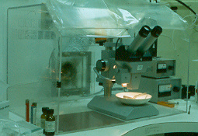
Stereomicroscope
71
Notes:
View of a stereomicroscope inside of a HEPA filtered exhaust hood.

Slide 72
Polarized Light Microscopy
Used to distinguish the various forms of asbestiform minerals on the basis of their unique optical crystallographic properties.
Also used to perform a semi-quantitative analysis of bulk samples; i.e., visual area estimation.
May need to be supplemented by other techniques such as point counting, gravimetric preparation and TEM analysis
72
Notes:
PLM, a qualitative examination, is used to distinguish the various forms of asbestiform minerals on the basis of their unique optical crystallographic properties, and also to perform a semi-quantitative analysis of bulk samples; i.e., visual area estimation and/or point-counting.
Although PLM analysis is the primary technique used for asbestos determinations, it cannot provide all needed information because of the limited visibility of the asbestos fibers. In some samples the fibers may be reduced to a diameter so small or masked by coatings to such an extent that they cannot be reliably observed or identified. For these reasons, PLM is of limited value in analyzing floor tiles and other materials containing binders or matrices. Gravimetric and/or analytical electron microscopy procedures may be required.
When PLM is used to quantify asbestos content of a sample, the following conditions should be met:
The slide sample should be homogeneous in order to be representative of the total sample and
Particles in the slide preparation should have an even distribution and approach a one particle thickness to avoid particle overlap.
Quantitation of asbestos content may be accomplished via calibrated visual area estimates and/or a point counting procedure.

Slide 73
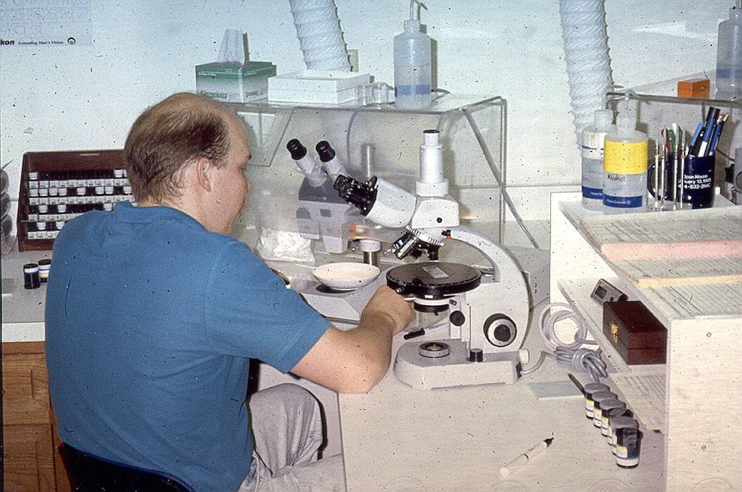
Stereoscope
PLM
Typical bulk sample analysis work station
73
Notes:
Sample is first viewed through the stereoscope.
Materials of interest are mounted on glass slides.
Identification is made using the PLM.
The asbestos percentage is estimated based on the collective observations under both microscopes.

Slide 74
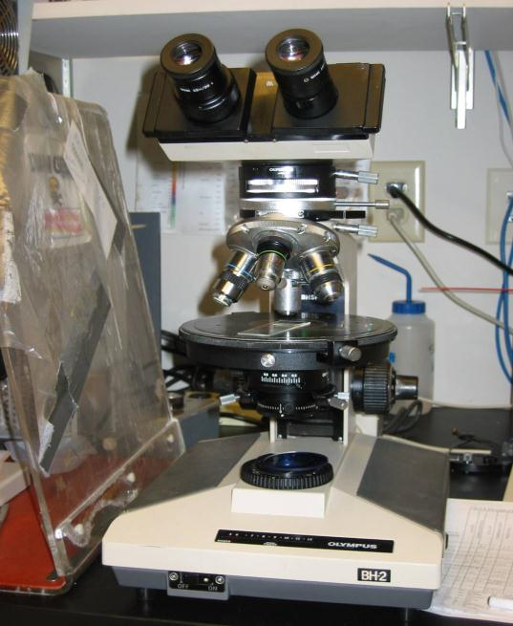
Polarized Light Microscope
74
Notes:
This photo shows a polarized light microscope. The method utilizing this device is often called PLM.
Geologists are trained in PLM use to identify rocks. Asbestos is a fuzzy rock so this microscope is the method of choice for asbestos sample analysis.

Slide 75
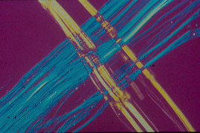
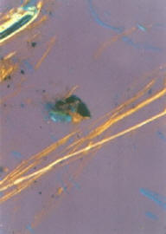
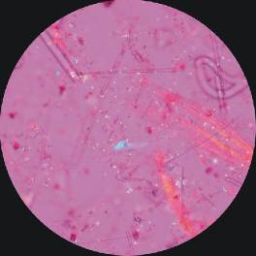
Chrysotile
at ~100X
An ideal view
Typical PLM
view
of chrysotile
in a bulk
sample
Courtesy US EPA Denver
Notes:
What we see during analysis can be confusing and can lead to difficulty in identification.
It takes extensive training and experience to become a proficient PLM analyst.

Slide 76
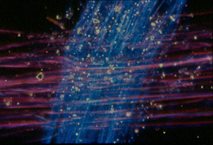

Chrysotile
Dispersion staining views through the PLM
Tremolite
76
Notes:
These are the dispersion staining colors often observed for chrysotile and tremolite.

Slide 77
Visual Area Estimation
Per EPA’s 1993 methodology, visual area estimates are made by comparing the sample to calibration materials that have similar textures and fiber abundance.
Analytical results are reported as “area percent.” If no asbestos fibers are seen, the analyst commonly reports this result as “no asbestos observed.”
77
Notes:
Per EPA’s 1993 methodology guidance, visual area estimates are made by comparing the sample to calibration materials that have similar textures and fiber abundance. A minimum of three slide mounts are examined to determine the asbestos content. Each slide is scanned in its entirety and the relative proportions of asbestos and nonasbestos are noted. EPA recommends that the ratio of asbestos to nonasbestos materials be recorded for several fields for each slide and the results be compared to data derived from the analysis of calibration materials having similar textures and asbestos content. Analytical results are reported as “area percent.” If no asbestos fibers are seen, the analyst commonly reports this result as “no asbestos observed.”

Slide 78
Point Counting
For samples at the 1% level, point counting may be used to quantitatively determine asbestos %.
Measuring 1% vs 2% is difficult/impossible
For materials where asbestos is present but at less than or equal to 1% by visual estimation, point counting is required to declare the material non-ACM.
Notes:
The NESHAP has been specific about the use of the point count technique for proper sample quantitation of the % asbestos content.
This method is helpful since some materials may have varying levels of asbestos above and below 1%.
Distinguishing between 1% and 2% is difficult without use of this method.
50 points that are “non-negative” are counted on each of 8 slides. 5 fibers in a 400 point count calculate to 1.25% which indicates a level of concern.
Sometimes analysts will accidentally count more than 400 points and yield an odd %. If percentages do not make sense (ex. 1.62347) ask the lab how the % was obtained.

Slide 79
Point Counting
In point counting, 8 slide mounts are made
  50 “non-negative points” are typically counted mechanically over 8 slide mounts for a total of 400 points.
  5 asbestos fibers in a 400 point count = 1.25%
Notes:
The NESHAP has been specific about the use of the point count technique for proper sample quantitation of the % asbestos content.
This method is helpful since some materials may have varying levels of asbestos above and below 1%.
Distinguishing between 1% and 2% is difficult without use of this method.
50 points that are “non-negative” are counted on each of 8 slides. 5 fibers in a 400 point count calculate to 1.25% which indicates a level of concern.
Sometimes analysts will accidentally count more than 400 points and yield an odd %. If percentages do not make sense (ex. 1.62347) ask the lab how the % was obtained.

Slide 80
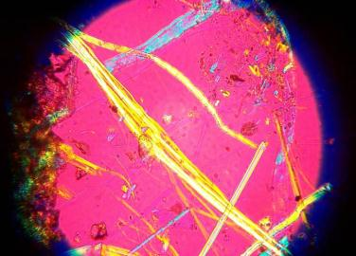
8 slides with material dispersed
Crosshairs
50 “non-negative” points per slide
A “point” is where the crosshairs intersect
Courtesy US EPA - Denver
80
Notes:
50 “non-negative” points per slide x 8 slides = 400 points.

Slide 81
Point Counting
  Point counts are usually reported in quarter percents (1.25%, 1.50%, 1.75%, etc.).
  Point counts are more defensible for low percentages compared to visual estimations.
  The NESHAP requires point count procedures on materials from trace to 10%.
  EPA “5 Page Memo” (May 18, 1991) allows for visual estimations if the client is aware of data usage limitations.
Notes:
When a sample is “point counted,” it supersedes visual estimations.
The NESHAP has required point counting for all samples ≤ 10%.
A 1991 EPA memo does allow for visual estimations when the client is aware of the limitations of using the data.
Point counting is most often used to determine if a sample is >1% asbestos.

Slide 82
Gravimetry
Gravimetry is a process in which acids, solvents and ashing (heating the sample to burn off organic materials) are used to selectively remove the binder components from a sample. Gravimetric procedures are designed to meet the following objectives:
  Isolate asbestos from the sample to allow weight determination.
  Concentrate asbestos, thereby lowering the detection limit in the total sample.
  Aid in the detection and identification of fibrous components.
  Remove organic fibers that are optically similar to asbestos.
82
Notes:
Gravimetry is a process in which acids, solvents and ashing (heating the sample to burn off organic materials) are used to selectively remove the binder components from a sample. Gravimetric procedures are designed to meet the following objectives:
Isolate asbestos from the sample to allow weight determination;
Concentrate asbestos, thereby lowering the detection limit in the total sample;
Aid in the detection and identification of fibrous components; and
Remove organic fibers that are optically similar to asbestos.

Slide 83
Gravimetry
If the sample is friable and contains organic components, the ashing procedure should be followed.
If the sample is friable and contains HCl-soluble components, the acid dissolution procedure should be followed.
If the sample is friable and contains both types of components, or if the sample is nonfriable; e.g., floor tiles, the two procedures can be applied, preferably with acid dissolution following ashing.
83
Notes:
If the sample is friable and contains organic components, the ashing procedure should be followed. If the sample is friable and contains HCl-soluble components, the acid dissolution procedure should be followed. If the sample is friable and contains both types of components, or if the sample is nonfriable; e.g., floor tiles, the two procedures can be applied, preferably with acid dissolution following ashing.
Gravimetry is not an identification technique, but is used to aid in qualitative PLM, AEM, or XRD.
A sufficient amount of suspect ACM should be collected and the laboratory should be informed to analyze only a portion of the sample via gravimetry. The remainder must be retained as evidence.

Slide 84
X-Ray Diffraction (XRD)
XRD is a technique that reveals a mineral's unique "fingerprint" on film.
Typically used in conjunction with PLM or TEM.
The technique is more expensive than PLM and cannot distinguish between fibrous and non-fibrous forms of asbestos.
XRD will provide qualitative, semi-quantitative and quantitative results.
84
Notes:
XRD, a technique that reveals a mineral's unique "fingerprint" on film, is typically used in conjunction with PLM or AEM. The technique is more expensive than PLM and cannot distinguish between fibrous and non-fibrous forms of asbestos. However, qualitative, semi-quantitative and quantitative results may be obtained from XRD.

Slide 85
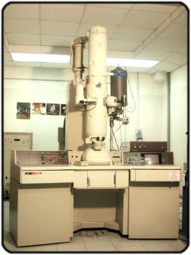
Analytical Electron Microscopy (AEM)
AEM analysis, often referred to as “TEM” analysis, is a reliable, although more expensive, method for the detection and positive identification of asbestos in some bulk building materials.
85
Notes:
AEM analysis, often referred to as “TEM” analysis, is a reliable although more expensive method for the detection and positive identification of asbestos in some bulk building materials. The method is particularly useful in the analysis of floor tiles and plasters, materials that contain a large amount of interfering materials and which contain asbestos fibers that may not be resolved by PLM techniques. The AEM method can also be used to quantify asbestos concentrations.

Slide 86
Analytical Electron Microscopy (AEM)
The method is particularly useful in the analysis of floor tiles and plasters, materials that contain a large amount of interfering materials and contain asbestos fibers that may not be resolved by PLM techniques.
Can be used to quantify asbestos concentrations.
86
Notes:
AEM analysis, often referred to as “TEM” analysis, is a reliable although more expensive method for the detection and positive identification of asbestos in some bulk building materials. The method is particularly useful in the analysis of floor tiles and plasters, materials that contain a large amount of interfering materials and which contain asbestos fibers that may not be resolved by PLM techniques. The AEM method can also be used to quantify asbestos concentrations.

Slide 87
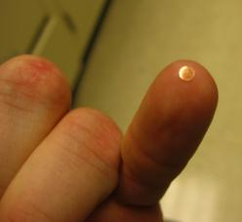
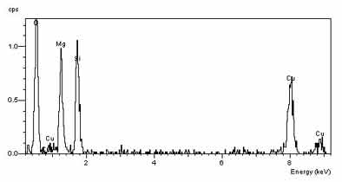
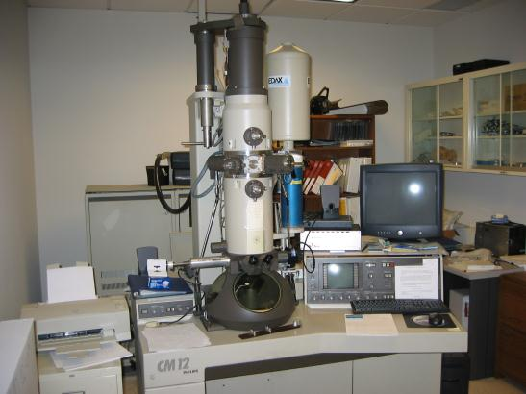
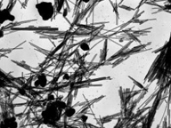

TEM Analysis
Fiber Chemistry (EDS)
TEM Sample Grid
Fibers magnified ~20,000X
Diffraction Pattern (SAED)

Slide 88
Other Analytical Techniques
Scanning electron microscopy is very useful for observing surface features in complex particle matrices and for determining elemental compositions. SEM cannot, however, detect small diameter fibers (~<0.2 mm) and cannot determine crystal structure.
Field test kits should never be used to confirm the presence or absence of asbestos since their results are unreliable.
88
Notes:
Scanning electron microscopy is very useful for observing surface features in complex particle matrices and for determining elemental compositions. SEM cannot, however, detect small diameter fibers (~<0.2 mm) and cannot determine crystal structure.
Field test kits should never be used to confirm the presence or absence of asbestos since their results are unreliable.

Slide 89
Quality Assurance
Sample Identification Numbers
Chain-of-Custody (COC) Forms
Quality Control (QC) Samples
Accredited Laboratories
89
Notes:
Scanning electron microscopy is very useful for observing surface features in complex particle matrices and for determining elemental compositions. SEM cannot, however, detect small diameter fibers (~<0.2 mm) and cannot determine crystal structure.
Field test kits should never be used to confirm the presence or absence of asbestos since their results are unreliable.

Slide 90
Sample Identification Numbers
A unique identification number must be assigned to each sample.
Could be a combination of a site code and the date and time the sample was taken.
For example, a sample obtained at St. Joseph's Hospital on July 1, 2010 at 2:17 pm, could be assigned the following number:
  SJH 100701 1417
90
Notes:
A unique identification number must be assigned to each sample. This number could be a combination of a site code and the date and time the sample was taken. For example, a sample obtained at St. Joseph's Hospital on July 1, 2010 at 2:17 pm, could be assigned the following number:
SJH 100701 1417

Slide 91
Sample Identification Numbers
Use of such a numbering system can help reduce a microscopist's potential bias.
Be sure to reference sample numbers properly in project notes, COC forms and final reports. Failure to do so can attract negative scrutiny.
91
Notes:
Use of such a numbering system can help reduce a microscopist's potential bias. For example, if the numbering system chosen clearly indicates that seven samples were taken from the same room, a microscopist might not be objective when analyzing each sample.
Be sure to reference sample numbers properly in project notes, COC forms and final reports. Failure to do so can attract negative scrutiny.

Slide 92
Chain-of-Custody (COC) Forms
EPA requires that a COC form be completed and accompany the samples when they leave the possession of the inspector.
The form should contain the following information:
  Project name and address
  Date of inspection/sampling
  Sample identification numbers
  Name/signature of sampler and date of sampling
  Name/signature of recipient(s) and date(s) of receipt
  Type of analysis to be performed
92
Notes:
In order to ensure that all samples are properly identified and tracked from the point of sample collection through receipt by the analytical laboratory, EPA requires that a COC form be completed and accompany the samples when they leave the possession of the inspector. (See Figure 6-1.)
A COC form should contain the following information:
Project name and address;
Date of inspection/sampling;
Sample identification numbers;
Name/signature of sampler and date;
Name/signature of recipient(s) and date;
Type of analysis to be performed;

Slide 93
Chain-of-Custody (COC) Forms
Other pertinent COC information
  Use of glove-bag sampling method
    It is very important that the glove-bag technique be noted on the COC form.
    When using the glove-bag technique the inspector may NOT wet the sample as would be done ordinarily.
    The laboratory probably will note that a particular sample was received “dry” and others were “wet.”
  Use of unusual sample container
  Dry material wetted by inspector, etc.
93
Notes:
Other pertinent information; e.g., use of glove-bag sampling method, use of unusual sample container, dry material wetted by inspector, etc. It is very important that the glove-bag technique be noted on the COC form. When using the glove-bag technique the inspector may NOT wet the sample as would ordinarily be done. The laboratory probably will note that a particular sample was received “dry” and others were “wet.” In the absence of glove-bag notations, improper sampling techniques may be alleged.

Slide 94
Chain-of-Custody (COC) Forms
Avoid lengthy notes on the COC form.
Since some laboratories require the use of their own COC forms, inspectors should contact them ahead of time to learn proper procedures.
A COC form should be completed immediately after the inspection. If mistakes are made in transferring information from field notes or sample containers to the form, a new form should be completed.
94
Notes:
Avoid lengthy notes on the COC form. The COC form should contain only information which uniquely identifies each sample.
Since some laboratories require the use of their own COC forms, inspectors should contact them ahead of time to learn proper procedures.
A COC form should be completed immediately after the inspection. If mistakes are made in transferring information from field notes or sample containers to the form, a new form should be completed.

Slide 95
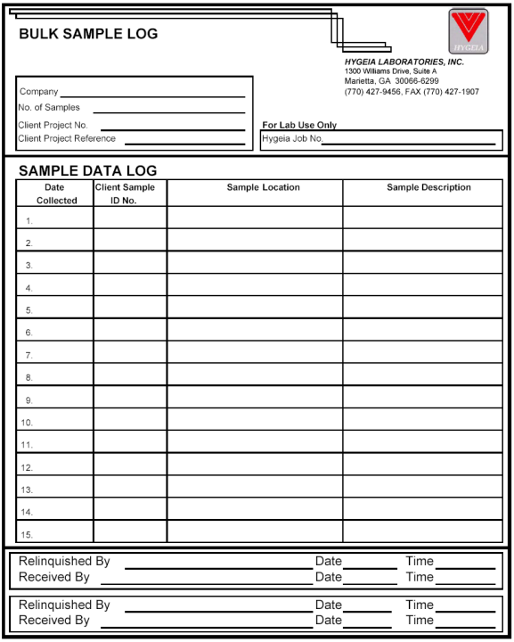


Chain of Custody Form
95
Notes:
This slide shows an example of a Chain of Custody Form.

Slide 96
Chain-of-Custody (COC) Forms
The form should not be signed until just before the samples leave the custody of the inspector.
Every person who takes custody of the collected samples must sign the COC form.
Samples should remain in the custody of one inspector until they are released to the laboratory in order to mitigate negative scrutiny on how the samples were handled post-inspection.
96
Notes:
The form should not be signed until just before the samples leave the custody of the inspector.
Every person who takes custody of the collected samples must sign the COC form. Samples should remain in the custody of one inspector until they are released to the laboratory in order to mitigate negative scrutiny on how the samples were handled post-inspection.

Slide 97
Quality Control (QC) Samples
Collection of side-by-side duplicates is recommended at the rate of one QC sample per building or one QC sample for every 20 samples taken, whichever is larger.
Since analyses of QC samples can help determine both sampling and analytical precision, it is important that the laboratory conducting the analysis not know which samples are QC samples.
97
Notes:
Collection of side-by-side duplicates is recommended at the rate of one QC sample per building or one QC sample for every 20 samples taken, whichever is larger. Since analyses of QC samples can help determine both sampling and analytical precision, it is important that the laboratory conducting the analysis not know which samples are QC samples.

Slide 98
Quality Control (QC) Samples
Inspectors can help ensure nonbiased analysis by collecting a side-by-side sample non-sequentially.
  The inspector should gather several samples at the facility and then go back to one of the sample locations for the side-by-side duplicate.
  In this way the side-by-side samples' identification numbers are not consecutive in time or number.
98
Notes:
Inspectors can help ensure nonbiased analysis by collecting a side-by-side sample non-sequentially. The inspector should gather several samples at the facility and then go back to one of the sample locations for the side-by-side duplicate. In this way the side-by-side samples' identification numbers are not consecutive in time or number.

Slide 99
Quality Control (QC) Samples
Side-by-side duplicates are analyzed to determine the consistency of analysis within a laboratory.
Significant differences in analytical results for duplicate samples should not be encountered.
Splits of side-by side duplicates may also be sent to a second laboratory to confirm the results of the first analyses.
Any significant disagreements should be investigated.
99
Notes:
Side-by-side duplicates are analyzed to determine the consistency of analysis within a laboratory. Significant differences in analytical results for duplicate samples should not be encountered. Splits of side-by side duplicates may also be sent to a second laboratory to confirm the results of the first analyses. Any significant disagreements should be investigated. It may be necessary for samples to be reanalyzed or additional samples to be collected.

Slide 100
Accredited Laboratories
NIST/NVLAP Accreditation Programs
  For PLM and TEM labs performing work for AHERA-related analysis.
  Required by many government agencies for NESHAP inspections.
AIHA Lab Accreditation
  Available for PLM labs
  Acceptable for Non-AHERA compliance
100
Notes:
To diminish the likelihood of challenges to the accuracy of laboratory results, regulatory agencies should only use laboratories which have participated in and been NVLAP-accredited by the National Institute for Standards and Technology (NIST). A list of accredited laboratories can be obtained through the EPA regional asbestos coordinator, the TSCA Hotline (202-554-1404) or the NVLAP (301-975-4016).

Slide 101
Accredited Laboratories
Be sure to contact the laboratory before conducting the inspection and discuss the following:
  Required type of analysis
  Sampling procedures
  Sample amounts
  Sample containers
  Chain of custody forms
  Packaging of materials for shipment
  Turnaround time for analysis
  Cost of analysis
101
Notes:
Be sure to contact the laboratory before conducting the inspection and discuss the following:
Required type of analysis;
Sampling procedures;
Sample amounts;
Sample containers;
Chain of custody forms;
Packaging of materials for shipment;
Turnaround time for analysis; and
Cost of analysis.

Slide 102
QUESTIONS?
102
Notes:
Although most inspectors will never be analysts, it is important to understand how labs obtain their results, how to interpret those results, and how to identify reliable as well as deficient results.
Similarly, regulatory inspectors may never conduct a full AHERA building inspection for ACM but they will have to be able to understand the nature and depth of the reports and determine their adequacy or inadequacy for NESHAP purposes.

