Slide 1
SEMAP 2017 Ozone Projections and Sensitivities / Contributions Prepared by: Talat Odman - Georgia Tech Yongtao Hu - Georgia Tech Presented to: SESARM Air Directors September 16, 2016

Slide 2
Modeling Overview
Used the EPA 2011 modeling platform
WRF 3.4 meteorology (PX, ACM2, KF, Morrison, RRTGM)
2011 NEI and projected 2017 emissions (eh)
SEMAP states revised point EGU emissions
Conducted 2011 and 2017 annual modeling with CMAQ v5.02 and CAMx v6.11 (EPA-revised) on 12US2 and LADCO12 grids
12US2 outputs for LADCO12 IC/BCs
Conducted 2017 ozone season (Apr-Oct) sensitivity modeling (brute-force) with CMAQ and source-apportionment modeling with CAMx-APCA on LADCO12
Baseline + 20 sensitivity runs with CMAQ
34 source tags with CAMx-APCA
Notes:
We modified CMAQ v5.02 for online emissions reductions

Slide 3
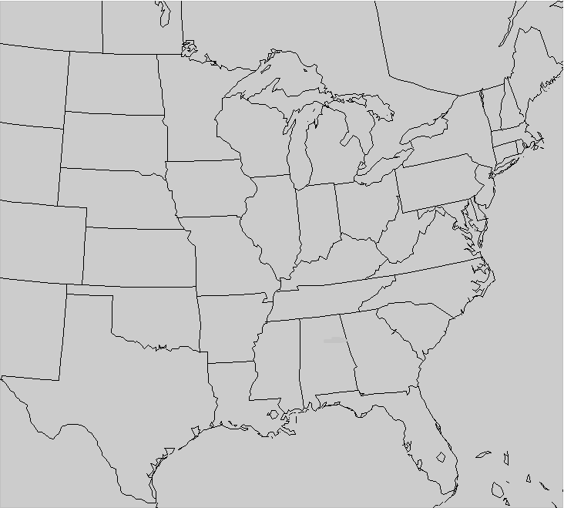
LADCO 12-km Modeling Domain
269×242 grid cells
25 layers
to 50 mb

Slide 4
Benchmarking and Performance Evaluation
Benchmarked CAMx
Against EPA results for 2 short periods
Tracking deviation from EPA configuration step by step
Difference due to photolysis
Difference due to meteorology processor
Difference due to code change
Compared CMAQ to CAMx
CB05 vs. CB6 chemistry
Conducted performance evaluations
Tables of statistics
Bubble plots of MNB and MNE (with 60 ppb cutoff)

Slide 5
Performance Statistics
CAMx no cutoff |  |  |  |  |  |  |  | CAMx 60 ppb cutoff
 | mean MDA8 | # of Pairs | MB (ppb) | ME (ppb) | MNB (%) | MNE (%) |  |  | mean MDA8 | # of Pairs | MB (ppb) | ME (ppb) | MNB (%) | MNE (%)
Coastal SEMAP | 45.1 | 42751 | 8.34 | 9.66 | 23.78 | 26.31 |  | Coastal SEMAP | 65.86 | 5869 | 3.48 | 6.97 | 5.46 | 10.6
Interior SEMAP | 47.4 | 13385 | 5.78 | 8.13 | 15.27 | 19.81 |  | Interior SEMAP | 65.9 | 2178 | 1.85 | 6.99 | 3.06 | 10.65
Non- SEMAP | 44.9 | 134407 | 3.22 | 7.75 | 11.5 | 20.58 |  | Non- SEMAP | 67.3 | 19613 | -2.31 | 7.91 | -3.23 | 11.75
CMAQ no cutoff |  |  |  |  |  |  |  | CMAQ 60 ppb cutoff
 | mean MDA8 | # of Pairs | MB | ME | MNB | MNE |  |  | mean MDA8 | # of Pairs | MB | ME | MNB | MNE
Coastal SEMAP | 45.1 | 42751 | 5.46 | 8.33 | 18.41 | 23.62 |  | Coastal SEMAP | 65.86 | 5869 | -2.52 | 6.8 | -3.64 | 10.21
Interior SEMAP | 47.4 | 13385 | 1.19 | 6.44 | 6.12 | 15.89 |  | Interior SEMAP | 65.9 | 2178 | -4.88 | 7.67 | -7.22 | 11.53
Non- SEMAP | 44.9 | 134407 | 2.84 | 7.38 | 11.76 | 20.26 |  | Non- SEMAP | 67.3 | 19613 | -4.65 | 8.17 | -6.68 | 12.02

Slide 6
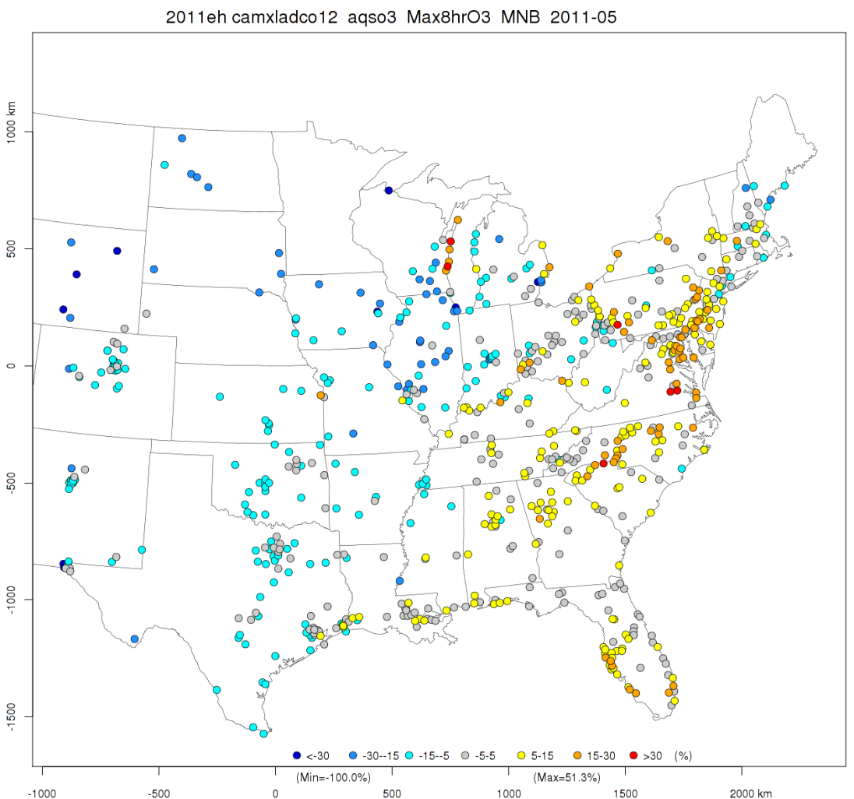
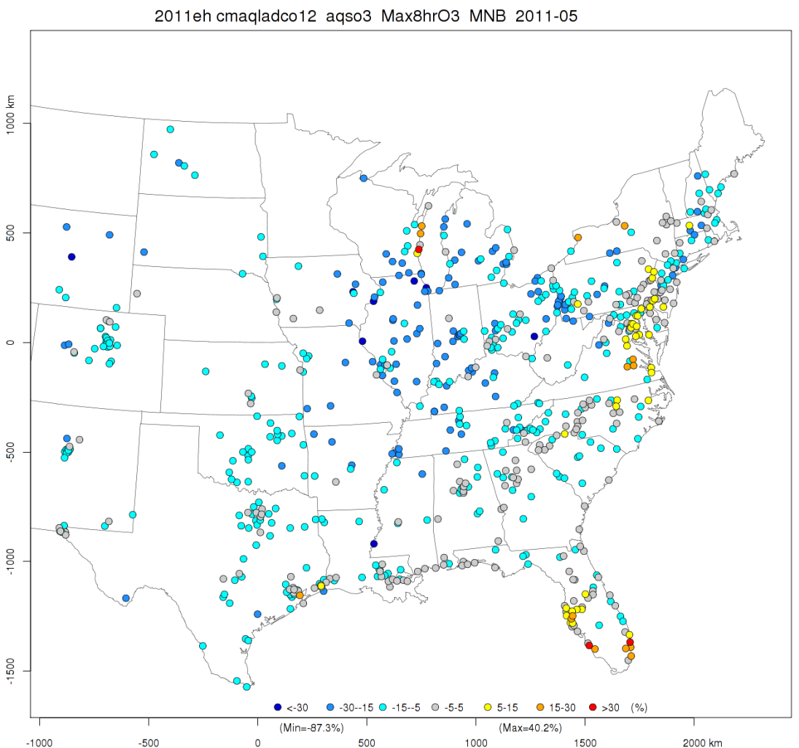
May 2011
CAMx
CMAQ
Notes:
Cutoff is 60 ppb.

Slide 7
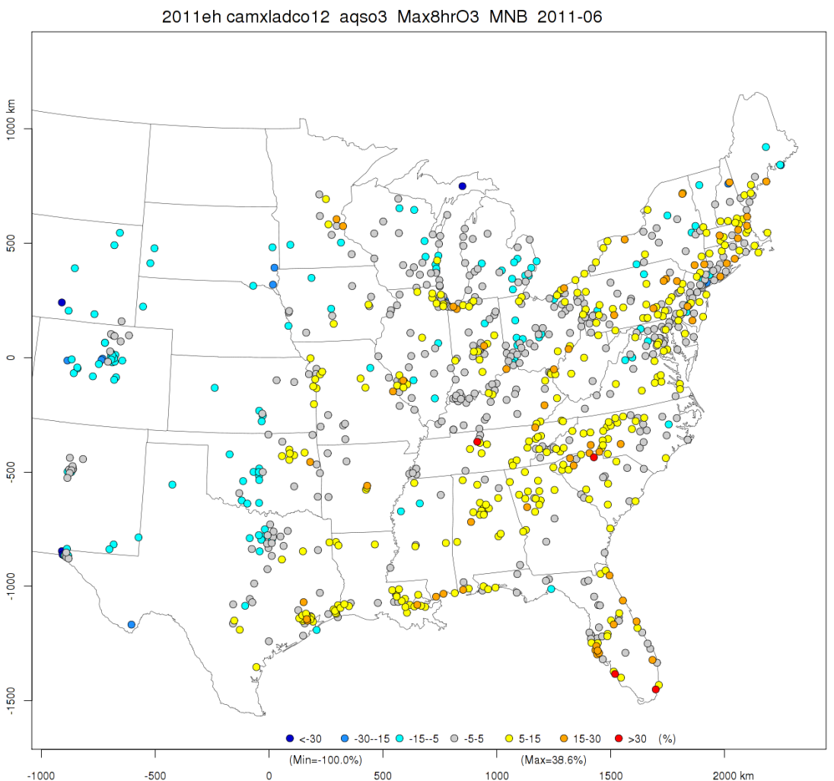
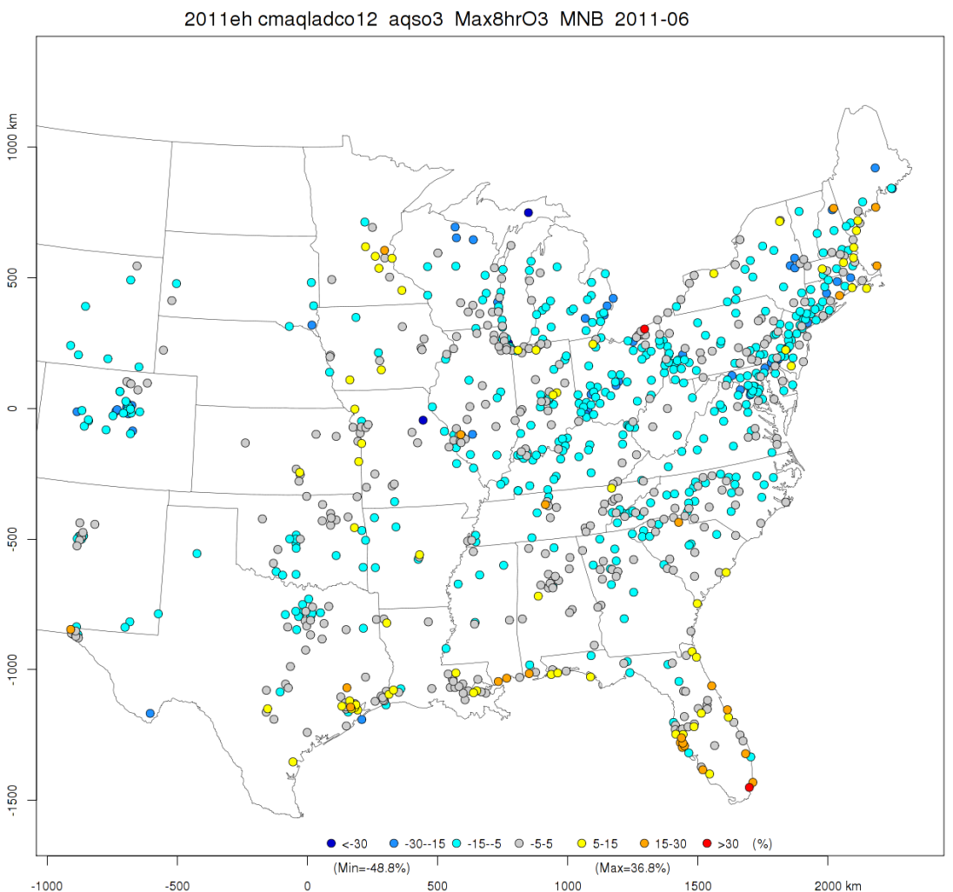
June 2011
CAMx
CMAQ

Slide 8
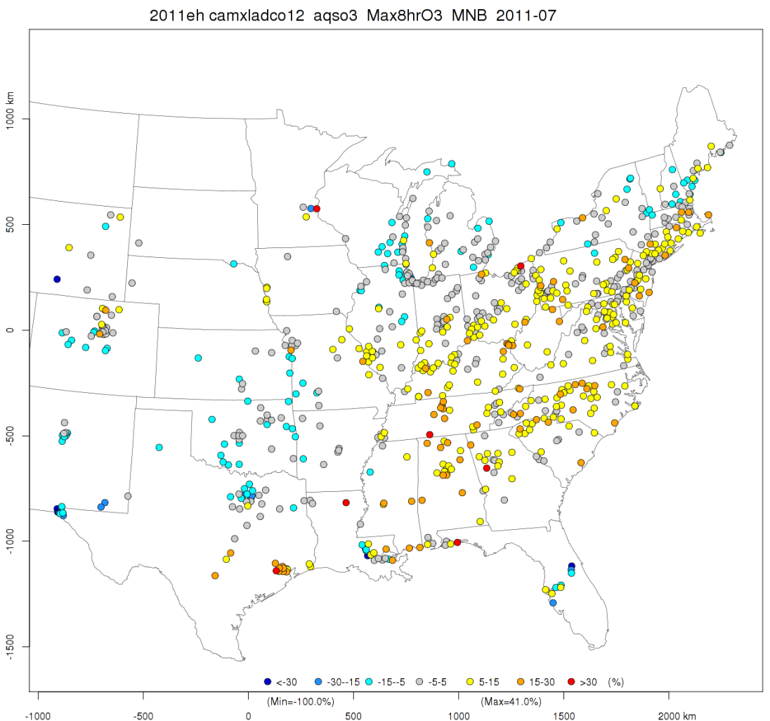
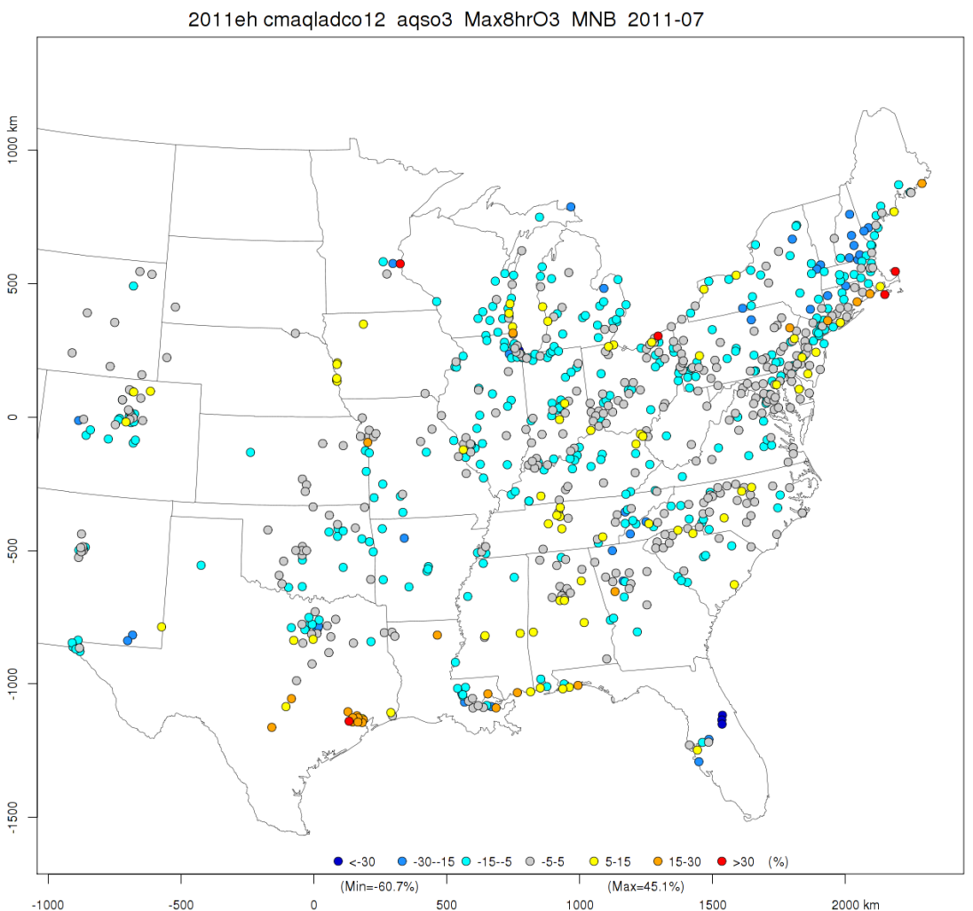
July 2011
CAMx
CMAQ

Slide 9
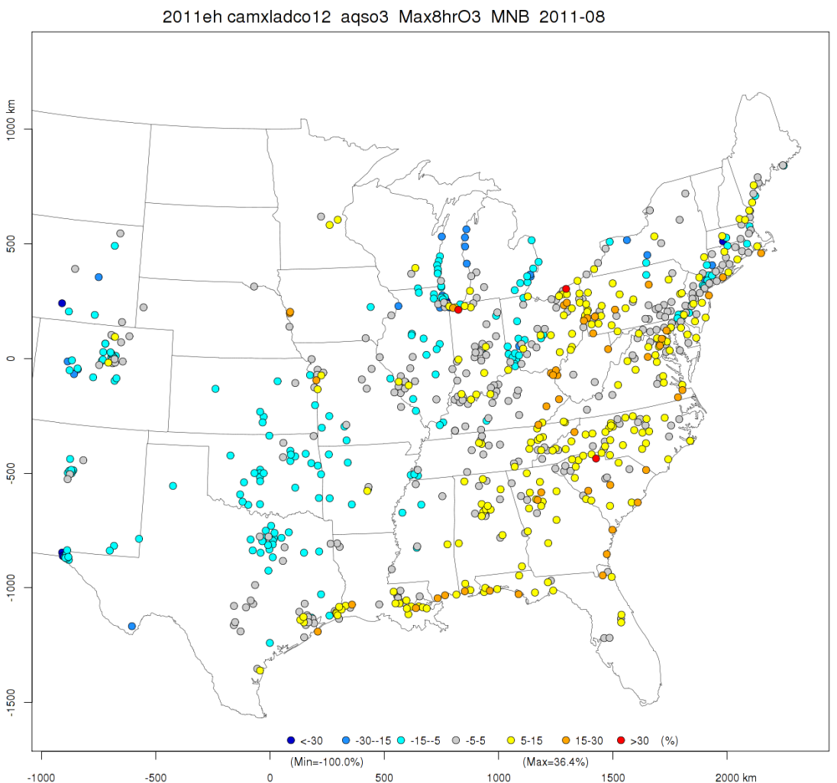
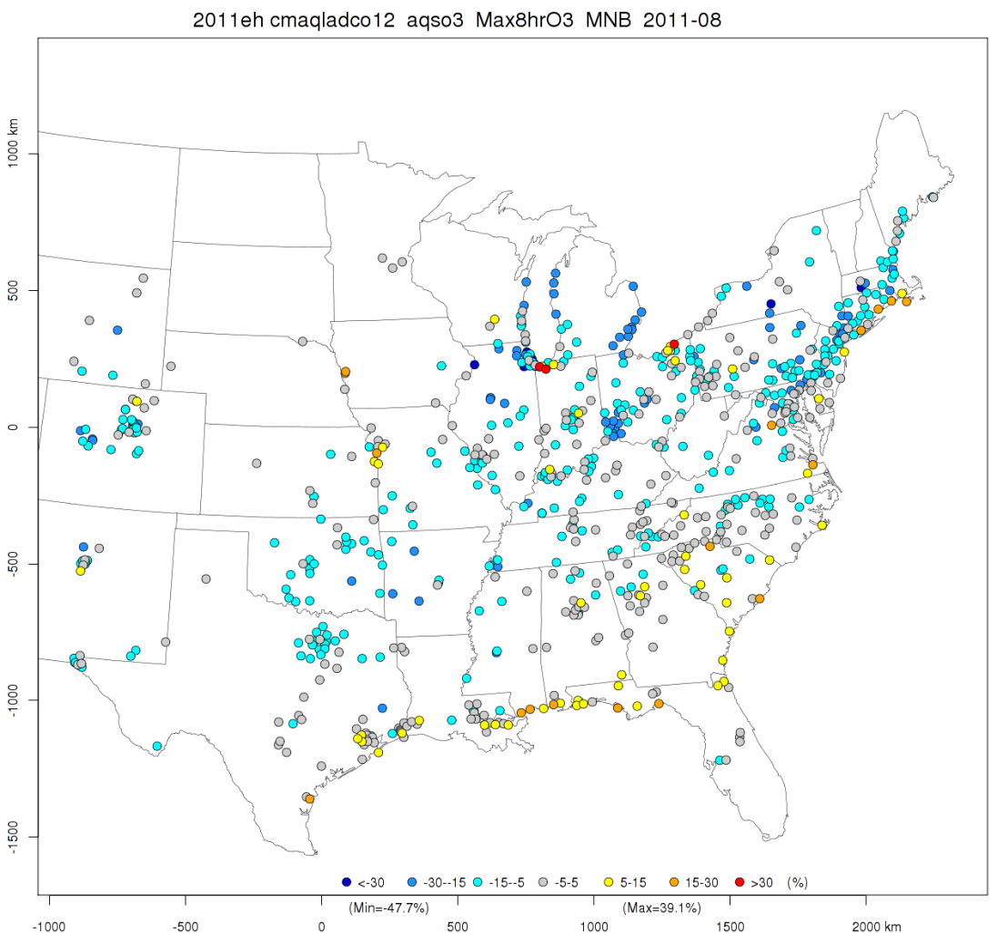
August 2011
CAMx
CMAQ

Slide 10
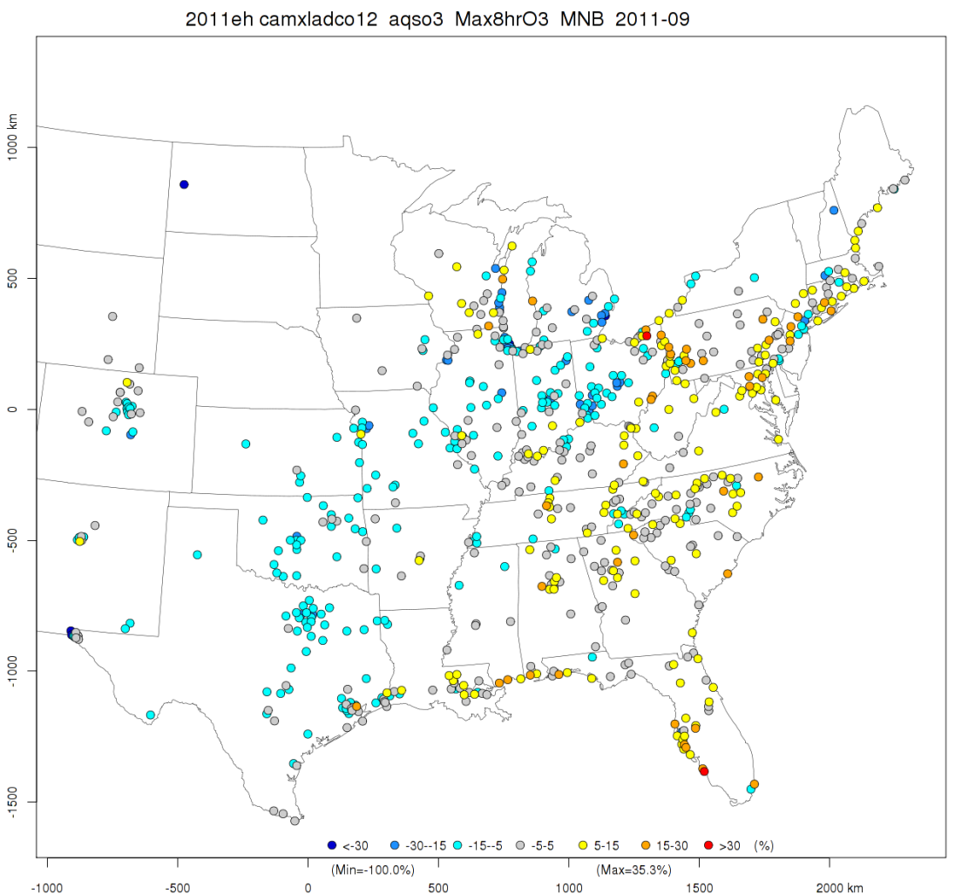
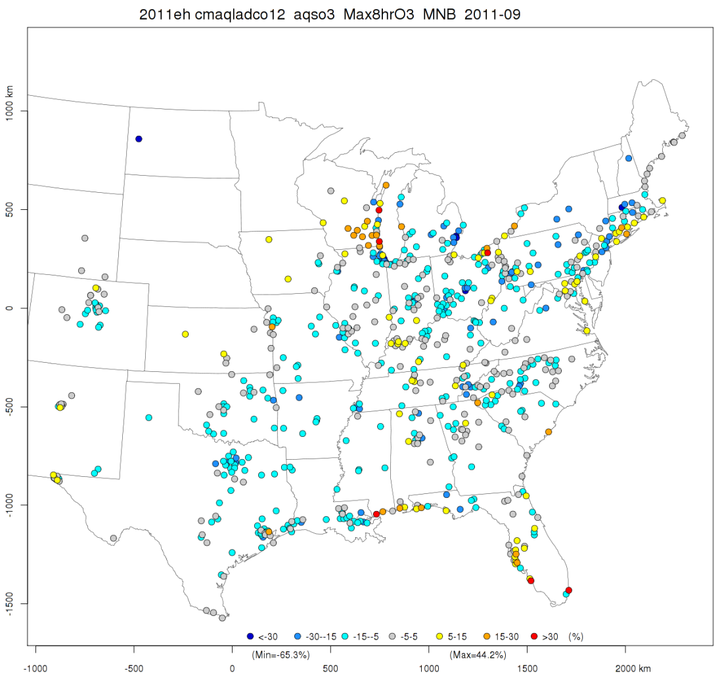
September 2011
CAMx
CMAQ

Slide 11
Calculation of DVF
Ran MATS 2.6.1 with 2011 as “baseline” and 2017 base-case as “forecast” to get RRFs
RRF = (2017_{base}/2011)
DVF = DVC × RRF
Options:
Use of Model Data
Monitor cell (1 x 1)
Design Values Current (DVC)
5-year (2009-2013) weighted average
Relative Response Factor (RRF)
Minimum 5 days with maximum 8-hr ozone ≥ 76 ppb, or
Minimum 5 days above 60 ppb

Slide 12
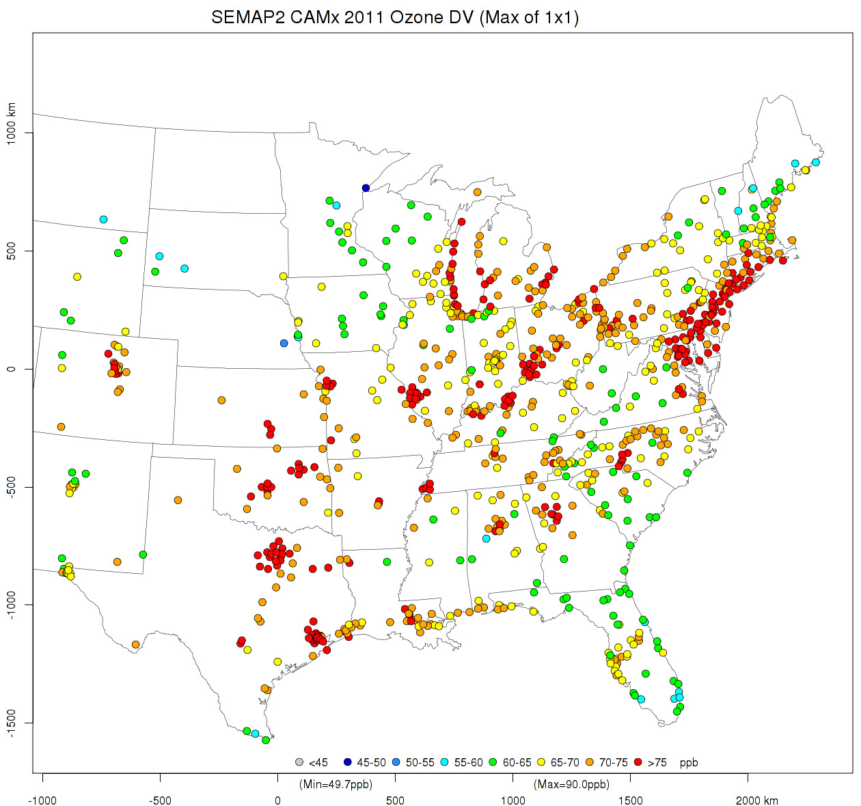
2011 DVCs: 1×1 RRF & 2009-2013 DVC

Slide 13
2011 DVCs: 1×1 RRF & 2009-2013 DVC

Slide 14
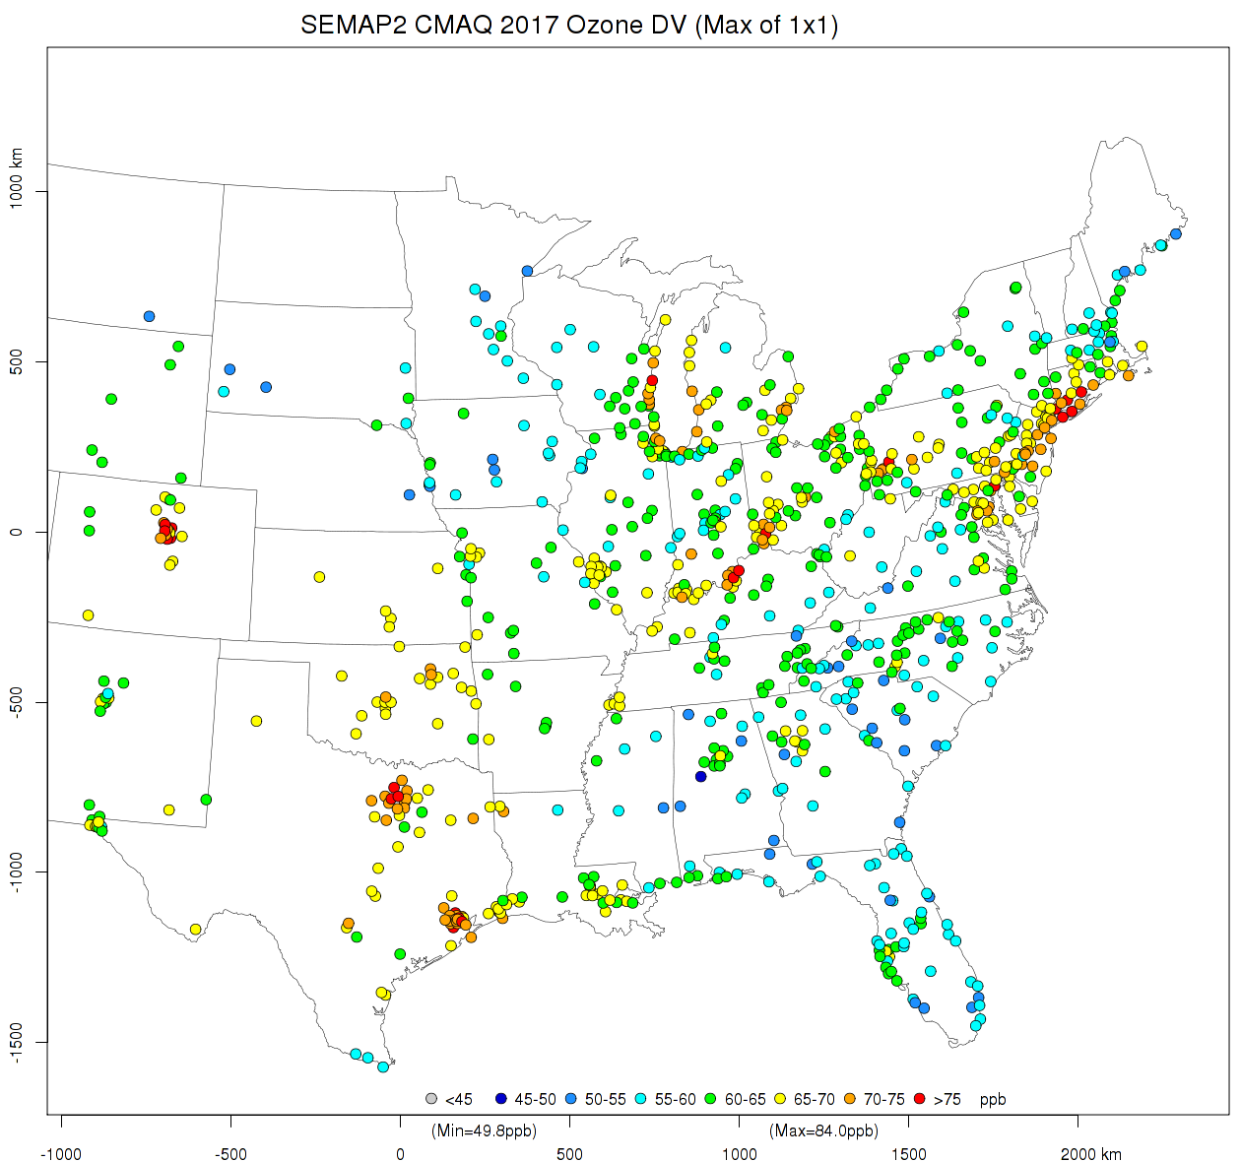
2017 DVFs: 1×1 RRF & 2009-2013 DVC (with CMAQ)

Slide 15
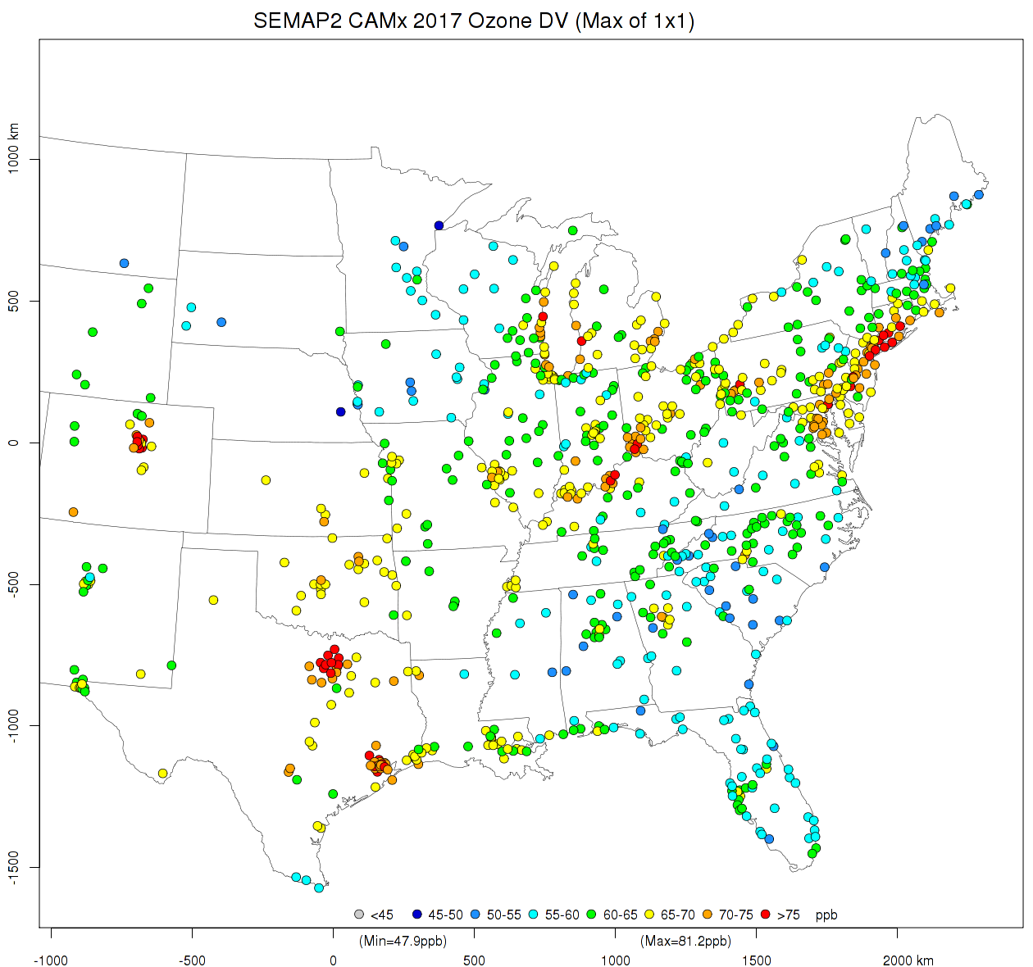
2017 DVFs: 1×1 RRF & 2009-2013 DVC (with CAMx)

Slide 16
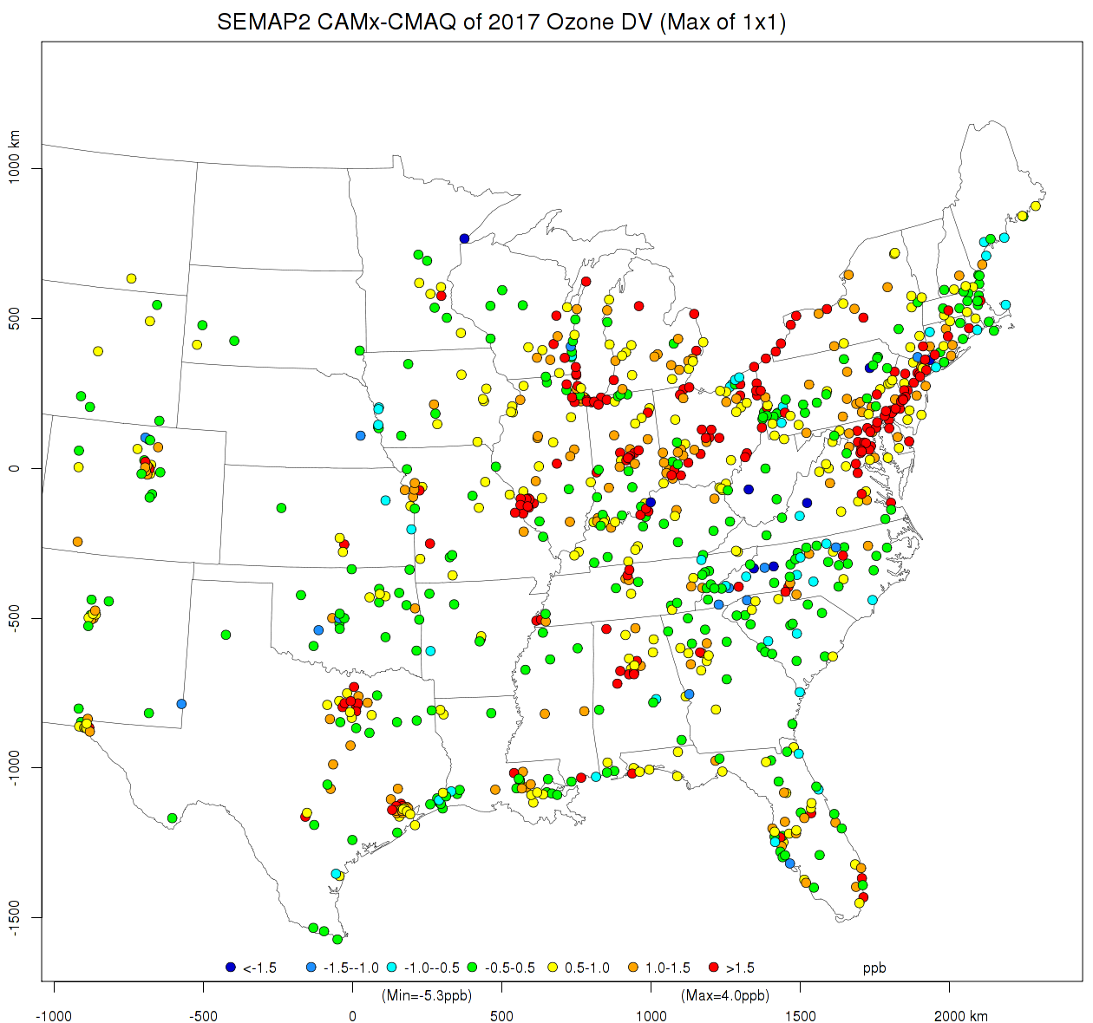
Difference of 2017 DVFs: CAMx - CMAQ

Slide 17
Sensitivities of Ozone to NO_{x} Zero-outs with CMAQ
7 months (Apr-Oct) on LADCO12 grid
2017 baseline run
20 Sensitivity runs
Statewide 100% emission reductions
All anthropogenic NO_{x}
EGU NO_{x}
10 SEMAP states
20 model runs (2 sources × 10 states)
Sensitivity = Baseline ̶ Zero-out

Slide 18
Contributions to Ozone with CAMx-APCA
7 months (Apr-Oct) on LADCO12 grid
Contributions of 34 sources (NO_{x} & VOCs):
Point EGU CSAPR (10 SEMAP states)
Point EGU CAIR but not CSAPR (AL, NC, SC, WV)
Point non-IPM CAIR but not CSAPR (AL, KY, NC, SC, TN, VA, WV)
Other anthropogenic (10 states)
Biogenic and dust
Fires
Other states, Canada & Mexico, and offshore
Contributions of IC/BCs
∑contributions = ozone

Slide 19
Sensitivity Movies http://semap.ce.gatech.edu/node/1868
Movies of CAMx Contributions
NO_{x} contributions to daily maximum 8-hr average ozone of all 34 tags and all anthropogenic NO_{x} and EGU NO_{x} contributions of 10 SEMAP states
Movies of CMAQ Sensitivities
Sensitivities of daily maximum 8-hr average ozone to all anthropogenic NO_{x} and EGU NO_{x} emissions

Slide 20
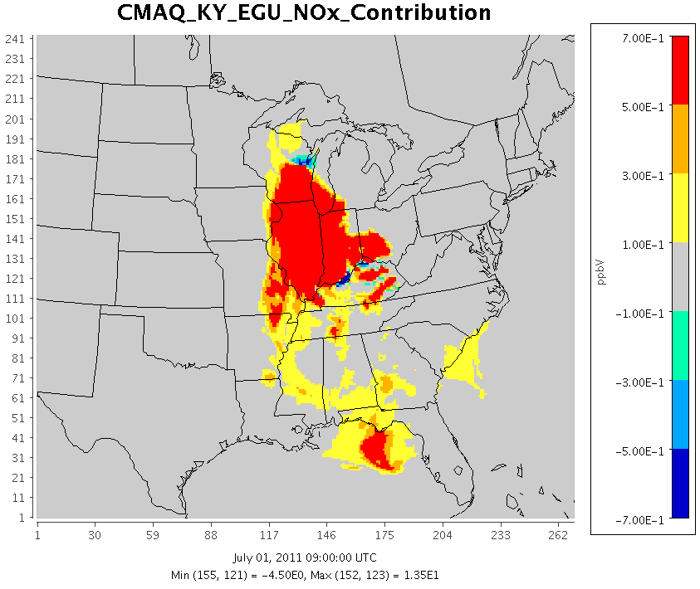
CMAQ Sensitivity vs. CAMx Contribution

Slide 21
Sensitivity Charts http://semap.ce.gatech.edu/node/1869
Absolute Sensitivities
CMAQ sensitivities of daily maximum 8-hr average ozone to all anthropogenic NOx and EGU NOx emissions by site
All days in ozone season (Apr-Oct)
CAMX contributions to daily maximum 8-hr ozone of all anthropogenic NOx and EGU NOx by site
All days in ozone season (Apr-Oct)

Slide 22
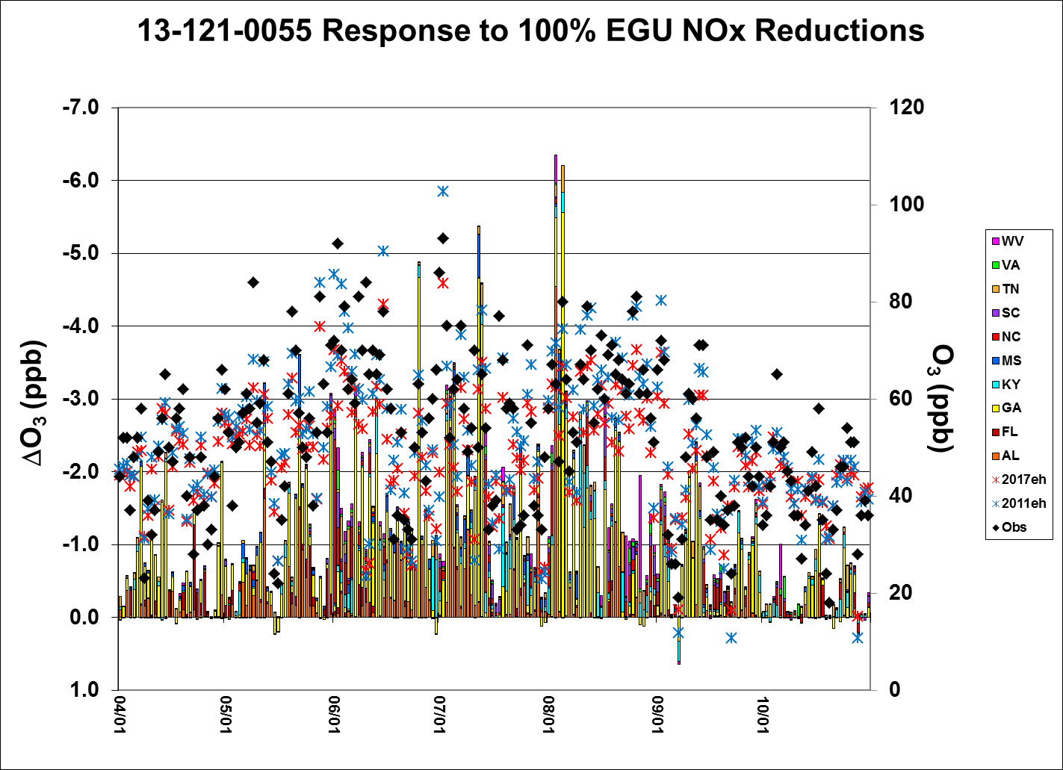
(CMAQ, All Days)
Notes:
There are charts for each of the 962 ozone monitoring sites in the domain, for all anthropogenic NOx and EGU NOx, both for CMAQ and CAMx.
The example here is for:13-121-0055 (Confederate Ave., Atlanta, GA), sensitivity to EGU NOx with CMAQ.

Slide 23
Calculation of ΔDVF (Relative Sensitivity)
Ran MATS 2.6.1
2017 base case as “baseline” and 2017 sensitivity as “forecast”
5-year weighted average DVC and monitor (1 × 1) cell model data
For each site in the state with at least 5 days with maximum 8-hr ozone ≥ 76 ppb or 5 days above 60 ppb in 2017
RRF = (2017_{sens}/2017_{base})
ΔDVF = DVF – (DVF*RRF) = DVF*(1-RRF)

Slide 24
Sensitivity Charts (continued) http://semap.ce.gatech.edu/node/1869
CMAQ Relative Sensitivities
Sensitivities of ozone design values to all anthropogenic NOx emissions by state
Sites with at least 5 days above 60 ppb in 2017 (days with maximum 8-hr ozone >=76 ppb)
Sensitivities of ozone design values to EGU NOx emissions by state
Sites with at least 5 days above 60 ppb in 2017 (days with maximum 8-hr ozone >=76 ppb)

Slide 25
Sensitivity Charts (continued) http://semap.ce.gatech.edu/node/1869
CAMx Relative Sensitivities
Contributions of all anthropogenic NOx emissions to ozone design values by state
Sites with at least 5 days above 60 ppb in 2017 (days with maximum 8-hr ozone >=76 ppb)
Contributions of EGU NOx emissions to ozone design values by state
Sites with at least 5 days above 60 ppb in 2017 (days with maximum 8-hr ozone >=76 ppb)

Slide 26
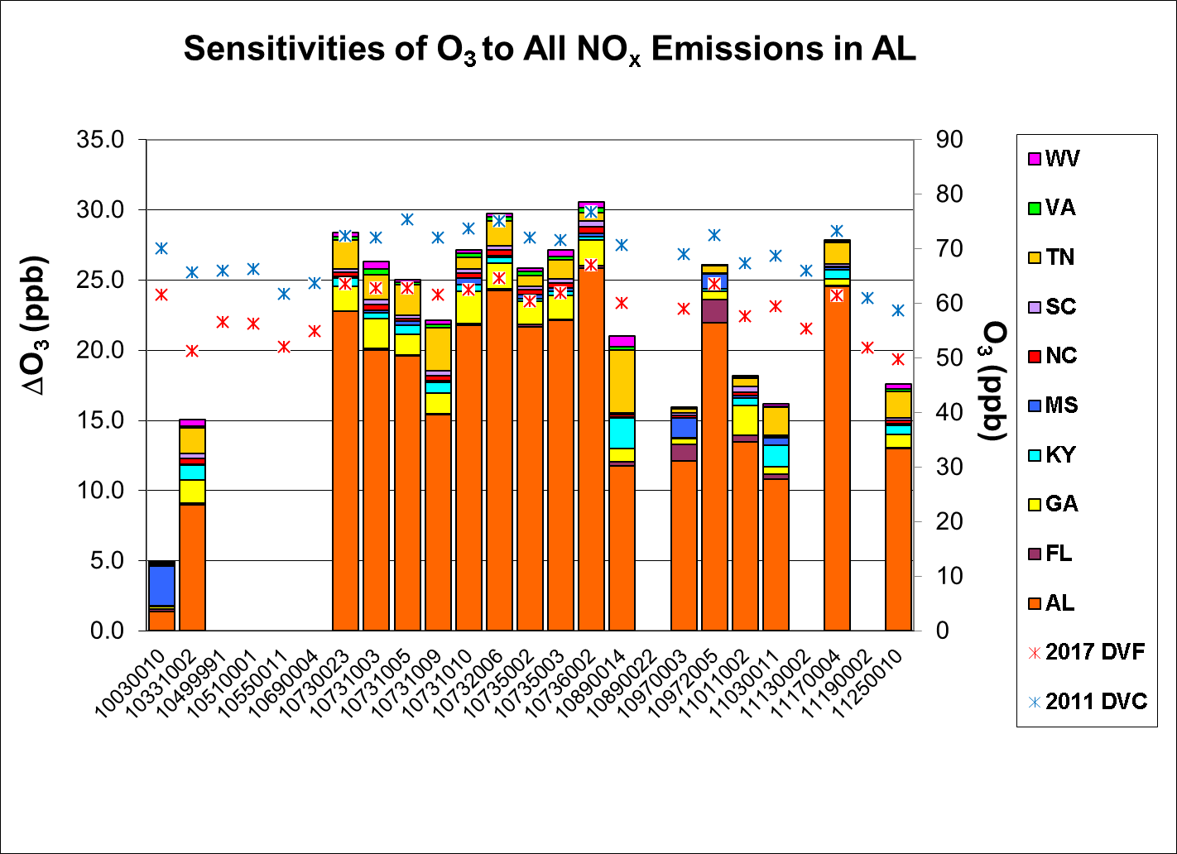
CMAQ

Slide 27
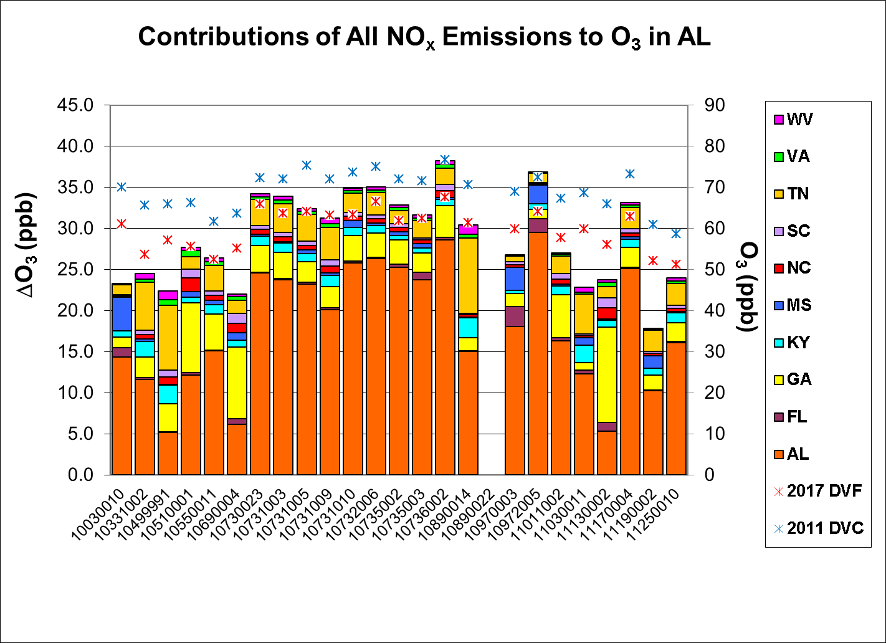
CAMx

Slide 28
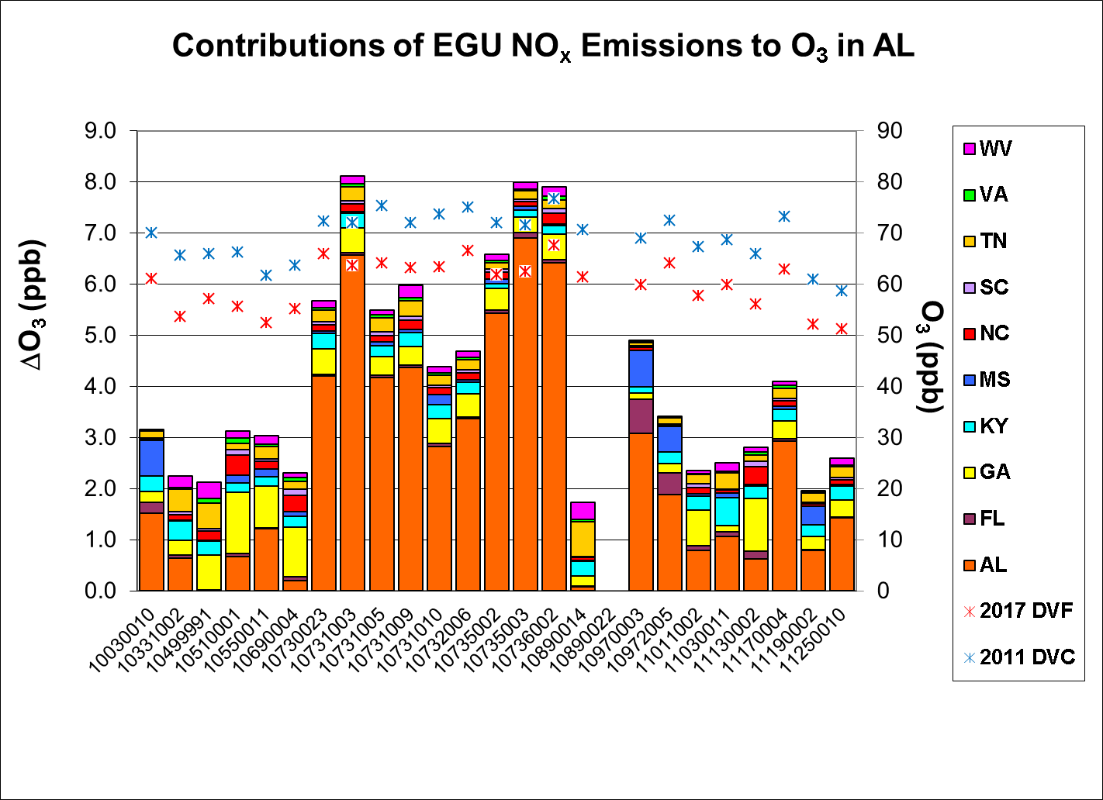
CAMx

Slide 29
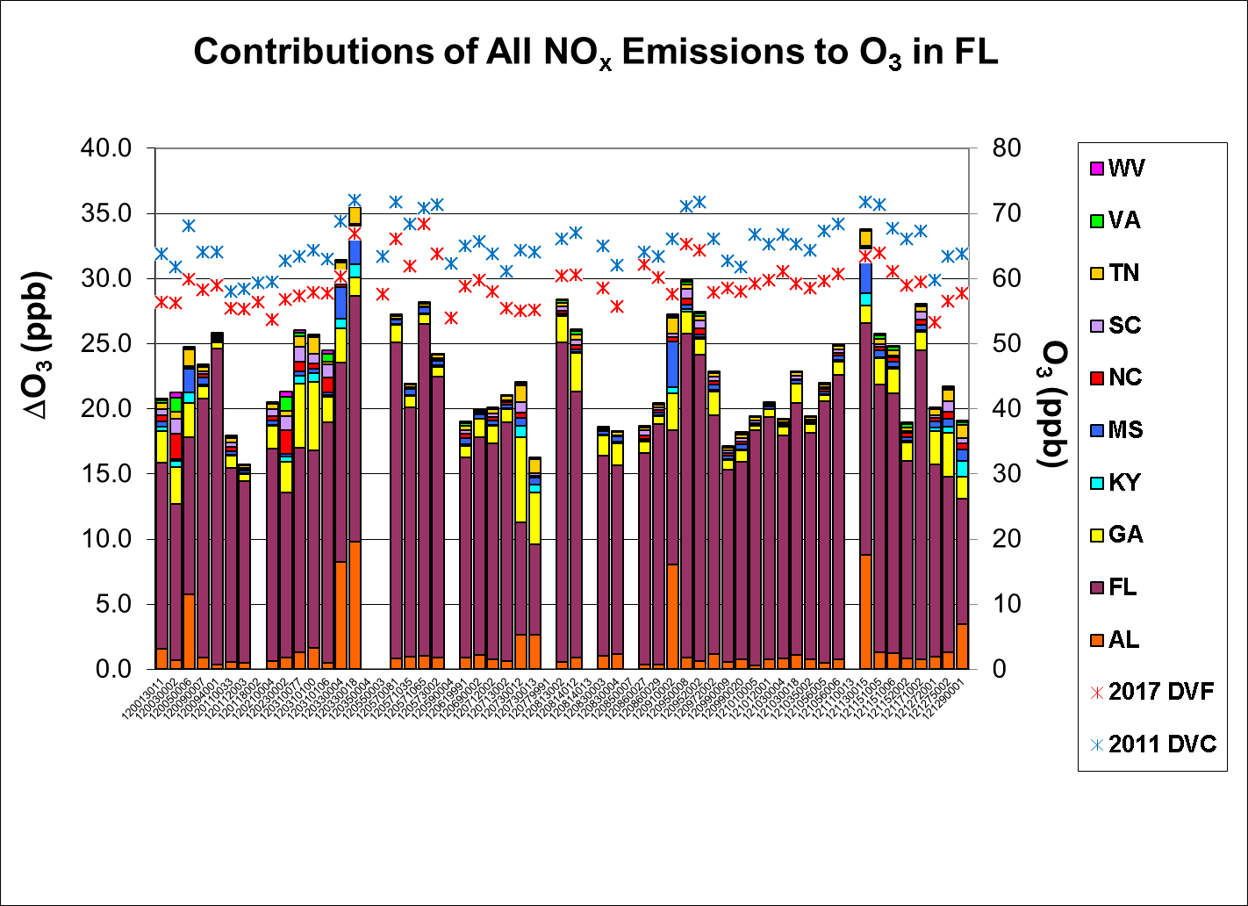
CAMx

Slide 30
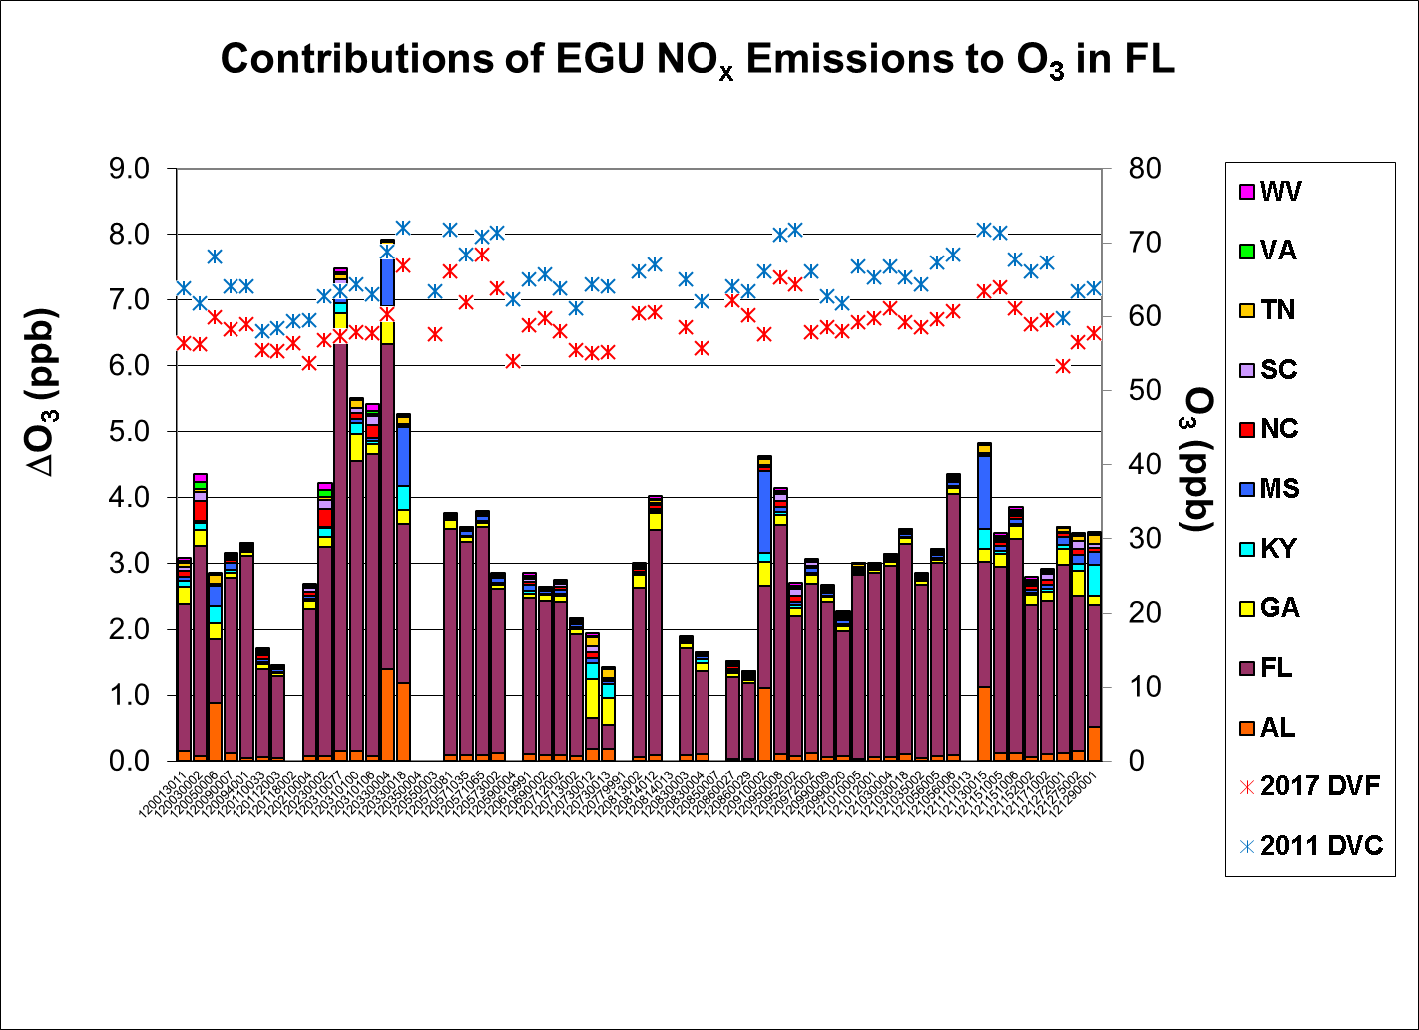
CAMx

Slide 31
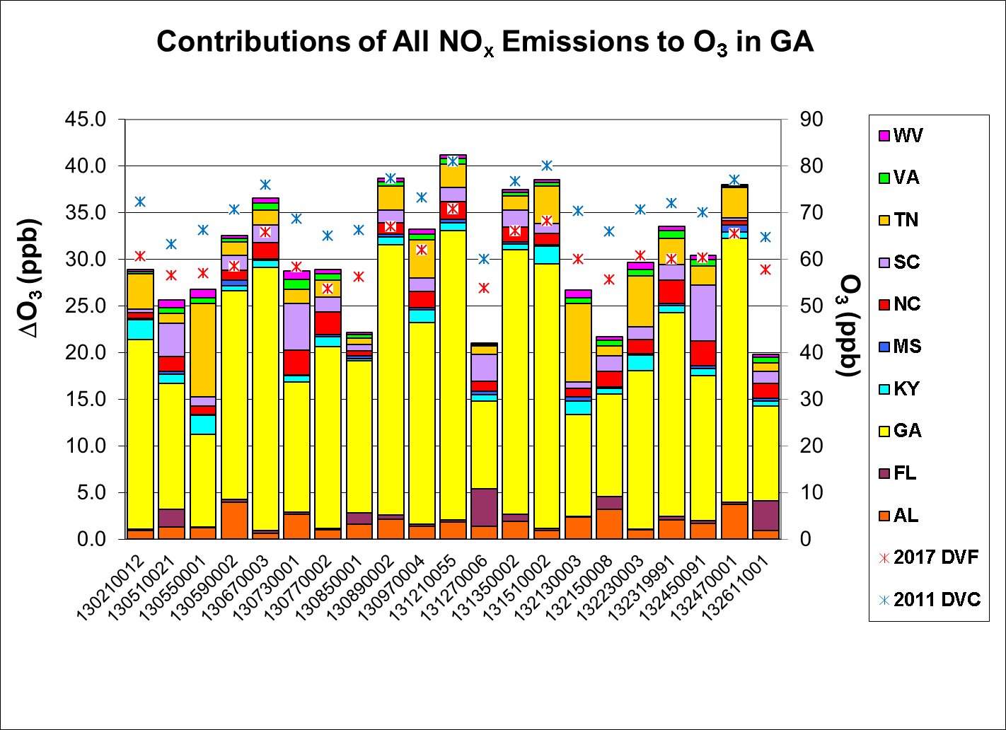
CAMx

Slide 32
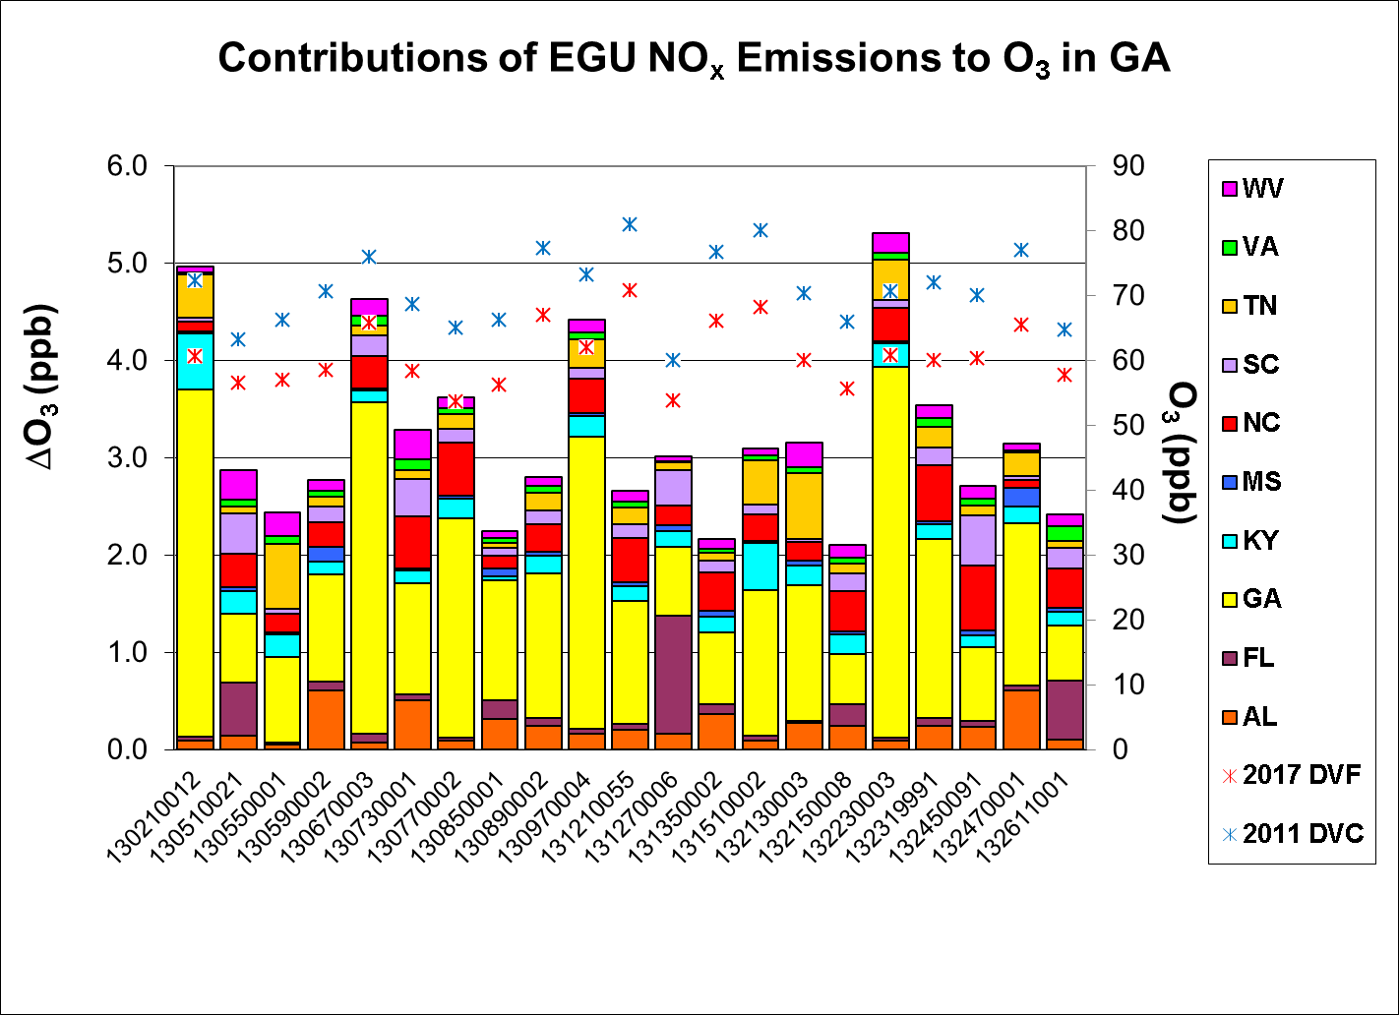
CAMx

Slide 33
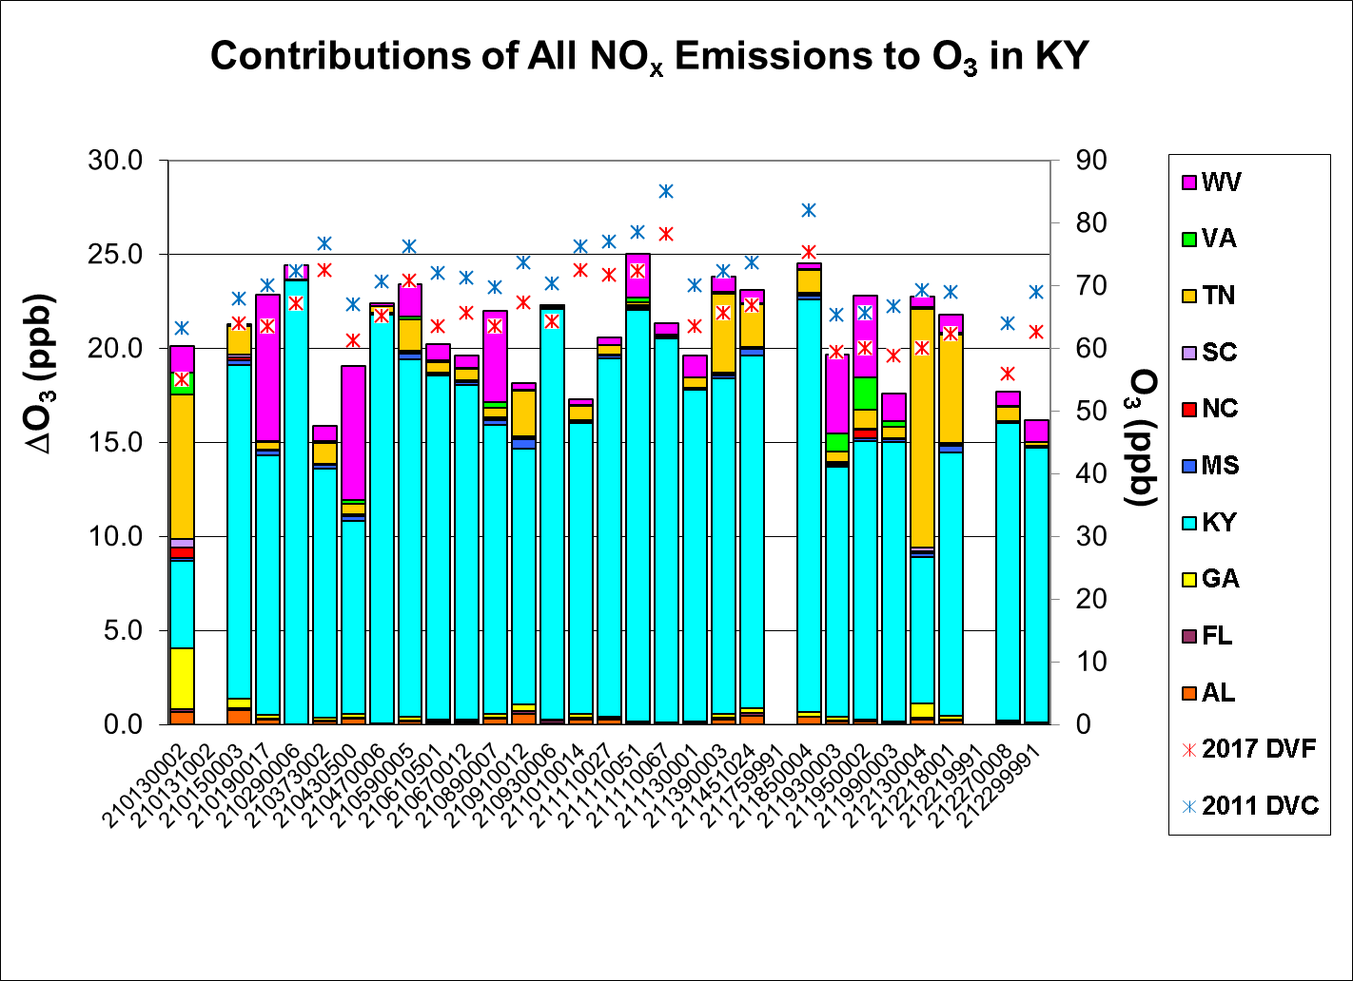
CAMx

Slide 34
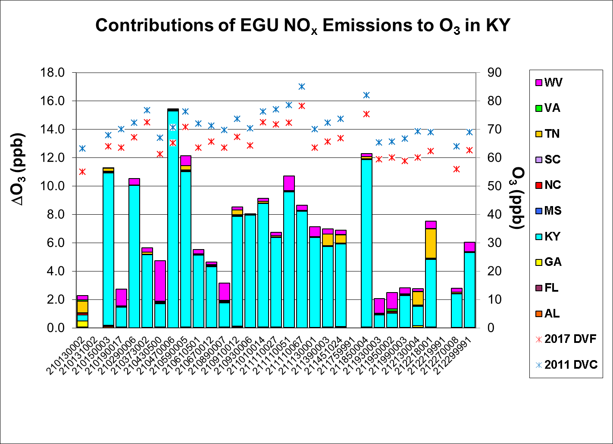
CAMx

Slide 35
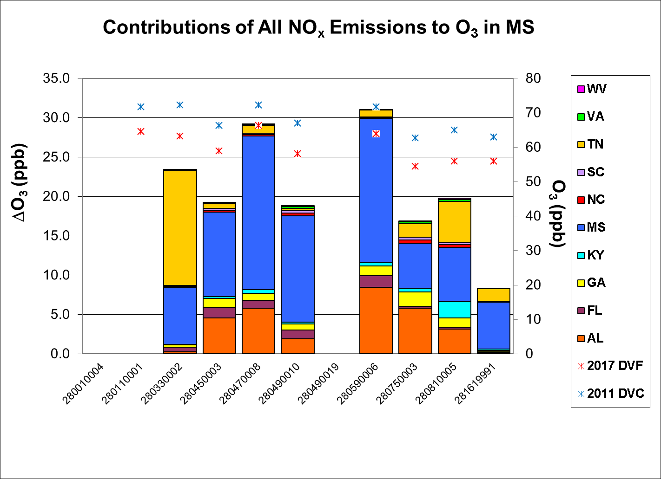
CAMx

Slide 36
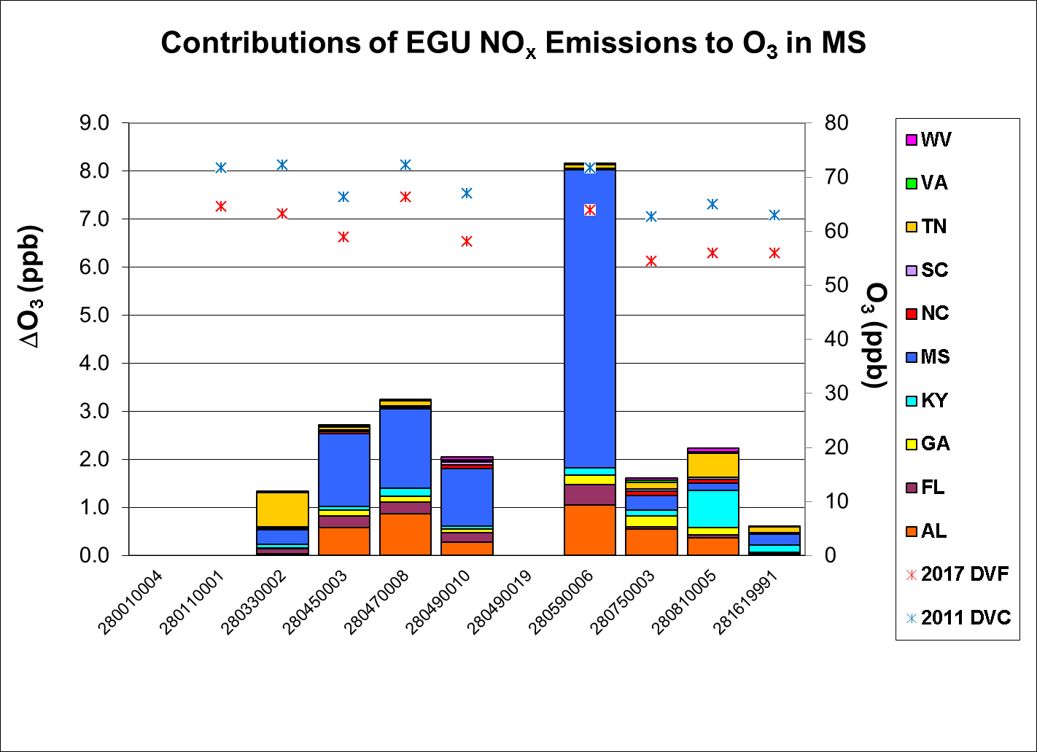
CAMx

Slide 37
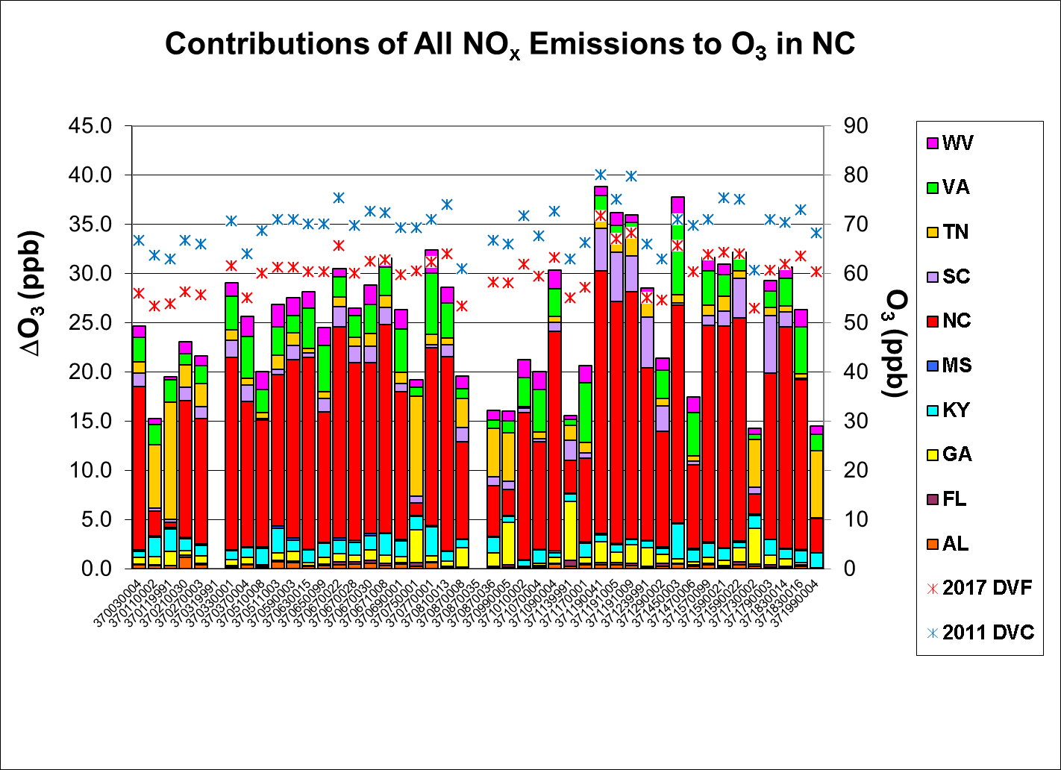
CAMx

Slide 38
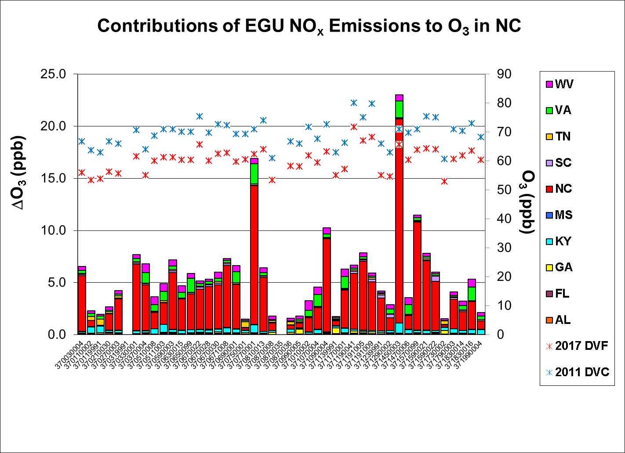
CAMx

Slide 39
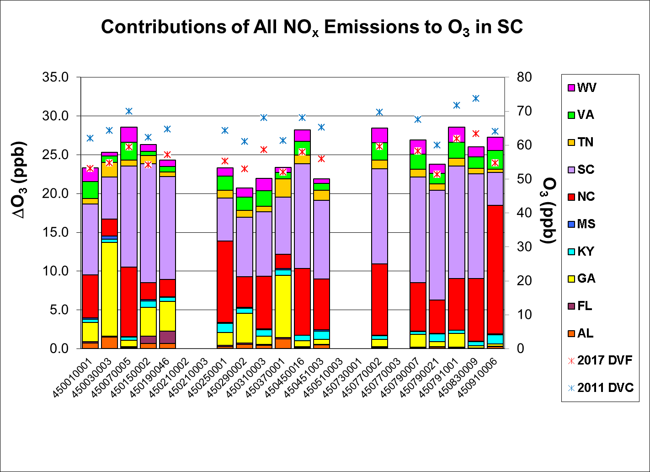
CAMx

Slide 40
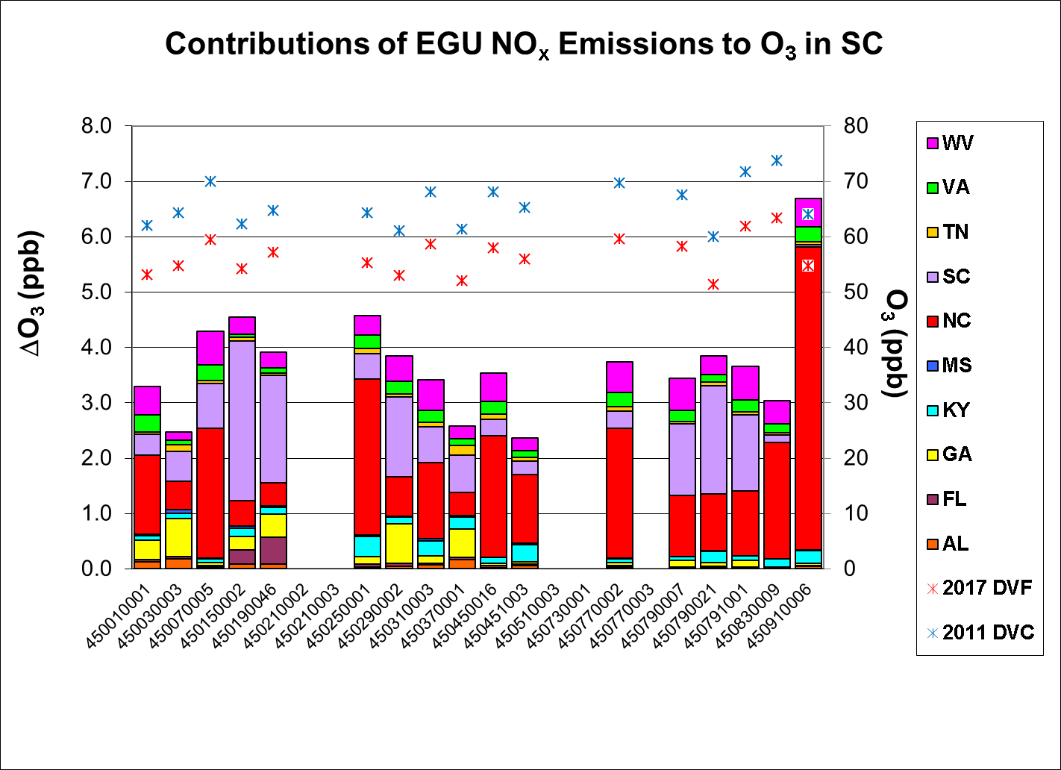
CAMx

Slide 41
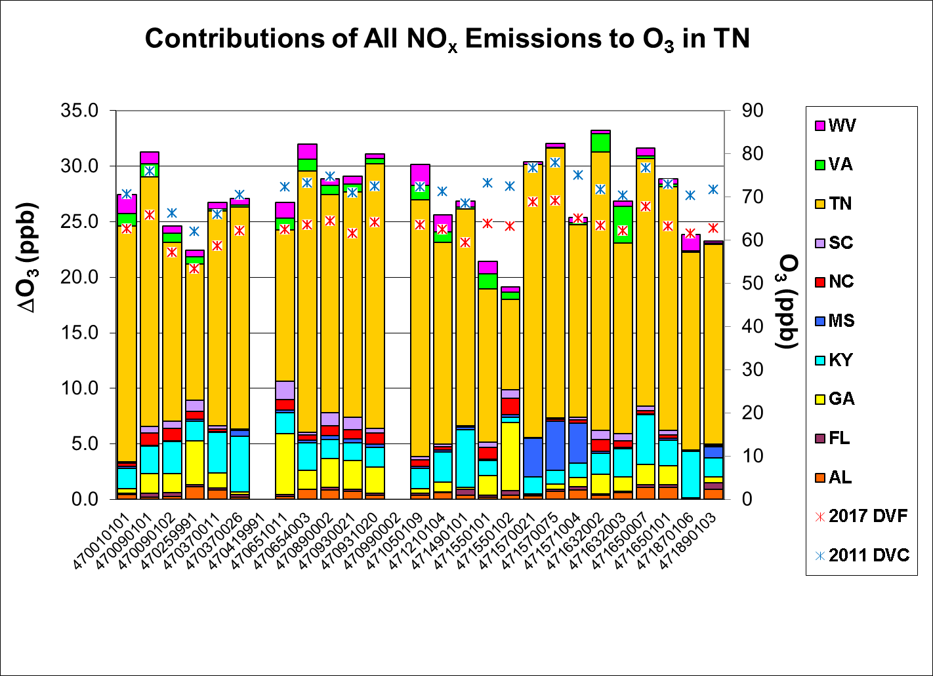
CAMx

Slide 42
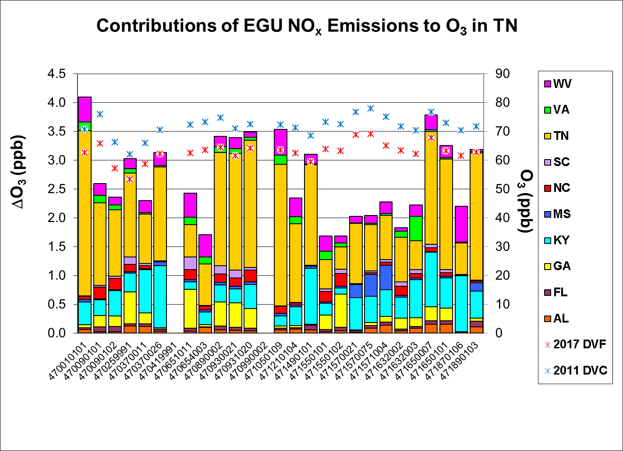
CAMx

Slide 43
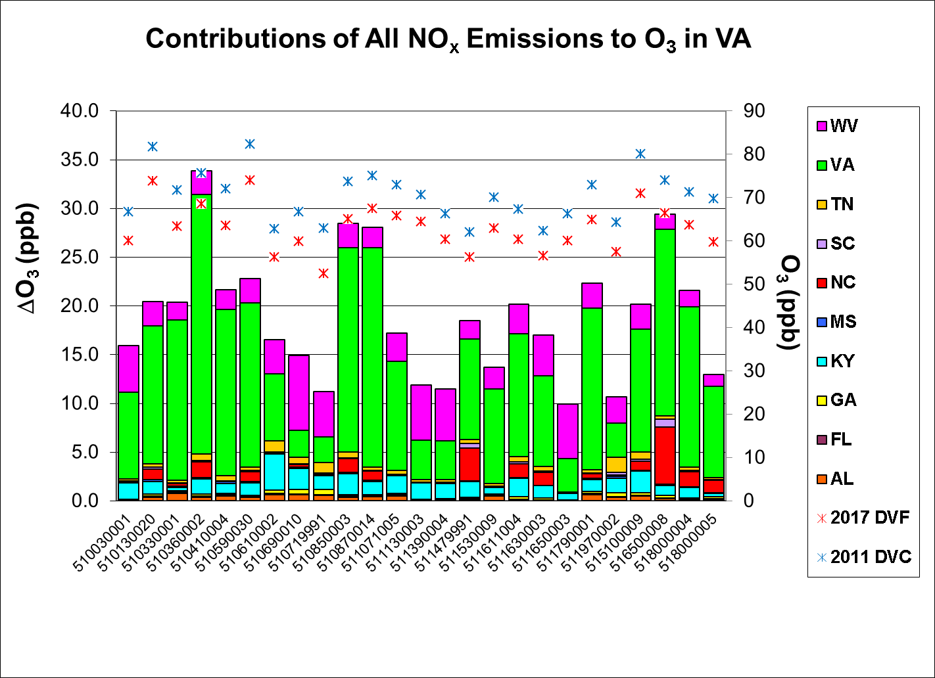
CAMx

Slide 44
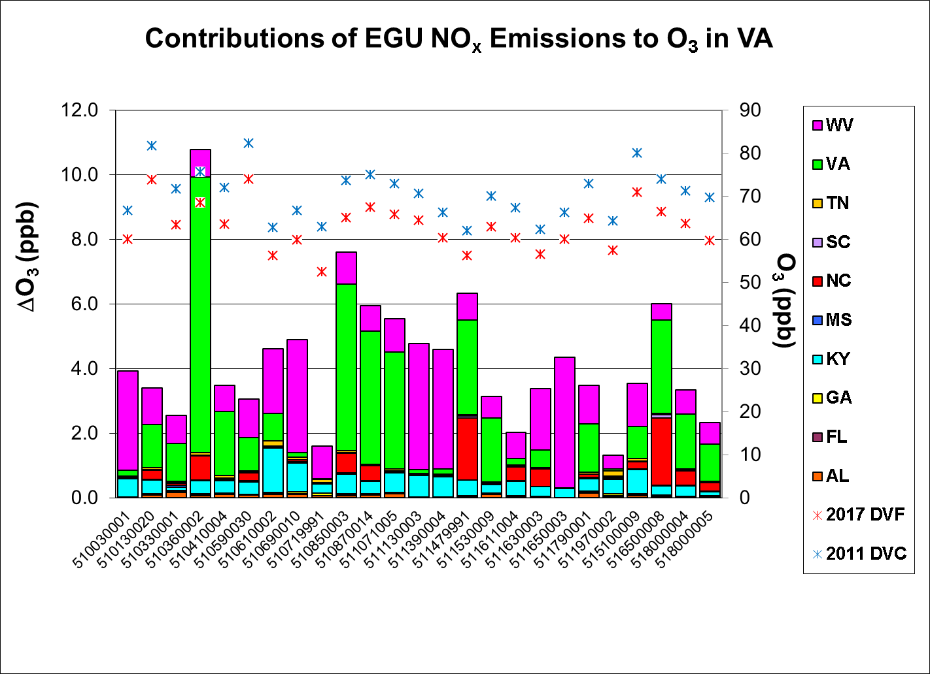
CAMx

Slide 45
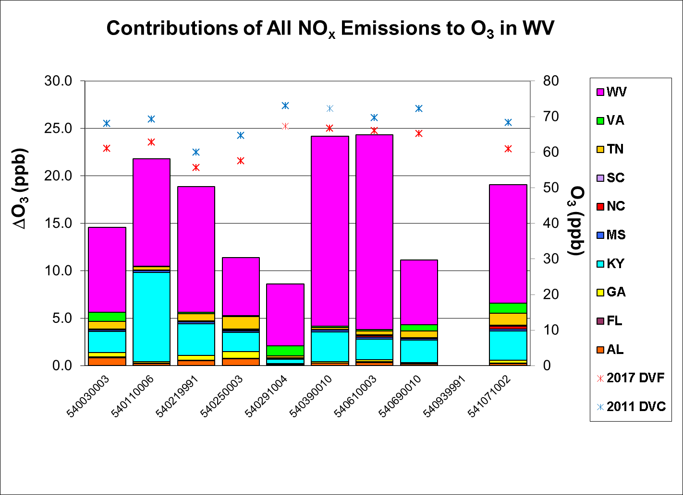
CAMx

Slide 46
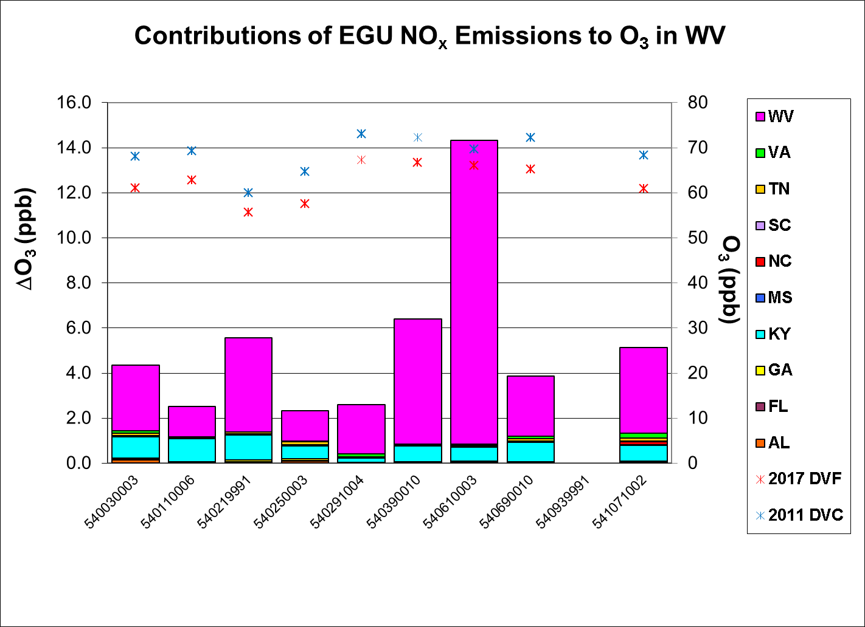
CAMx

Slide 47
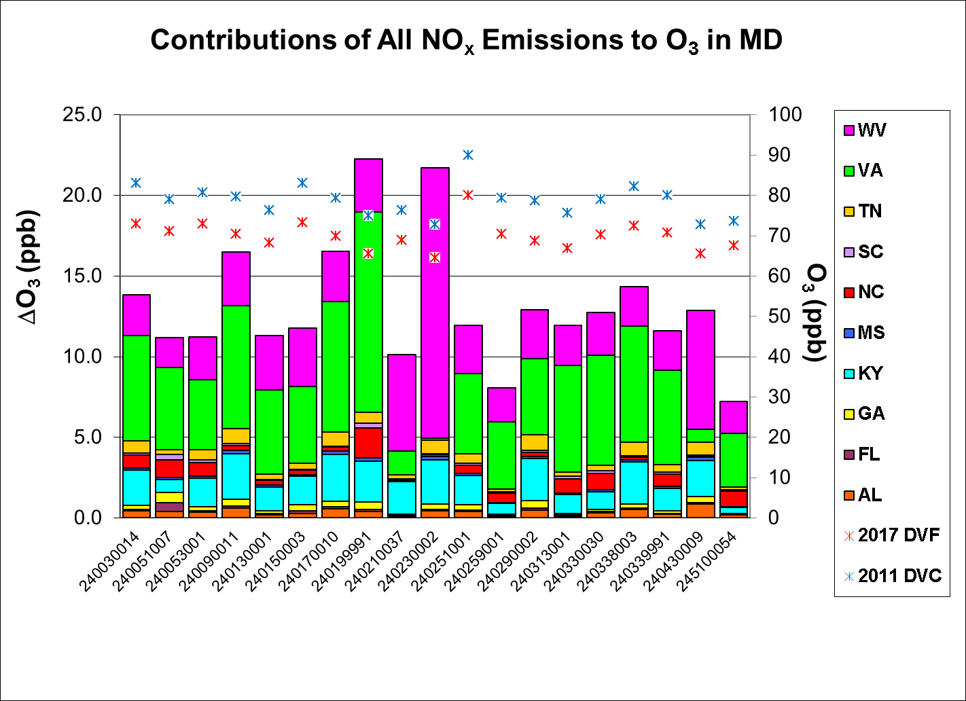
CAMx

Slide 48
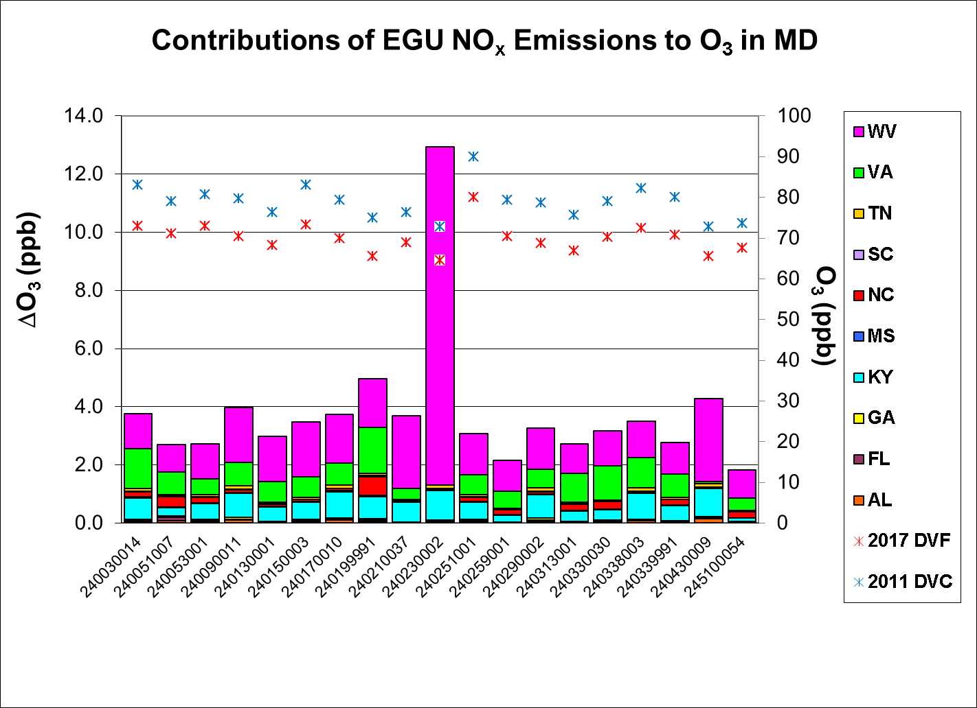
CAMx

Slide 49
Sensitivity Tables http://semap.ce.gatech.edu/node/1870
Absolute Sensitivities
CAMx-APCA contributions of various emission sources to daily maximum 8-hr ozone of all anthropogenic NOx and EGU NOx by site
All days in ozone season (Apr-Oct)
Relative Sensitivities
CAMx-APCA contributions of various sources to ozone design values by site
Sites with at least 5 days above 60 ppb in 2017 (days with maximum 8-hr ozone >=76 ppb)

Slide 51
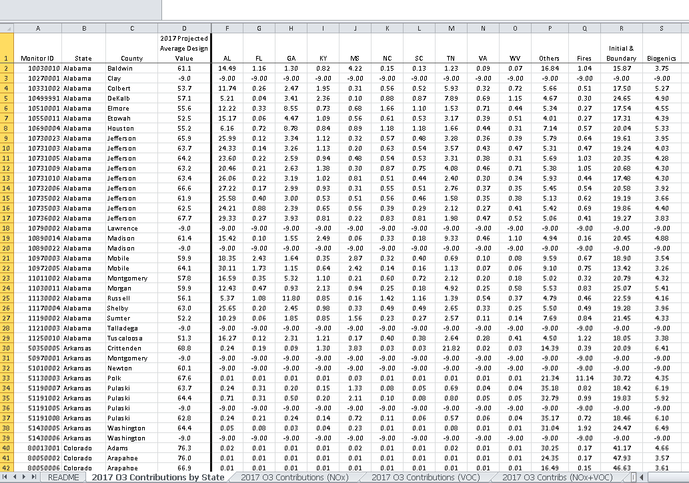

Slide 52
Summary
CAMx DVF are generally larger than CMAQ DVFs (about 1.0 ppb on average)
RRFs are generally smaller with CAMx
CAMx sensitivities (contributions to ozone) are larger than CMAQ sensitivities (responses to zero-outs)
Recall CAMx ozone was larger than CMAQ ozone
CAMx contributions span broader areas and are less detailed than CMAQ sensitivities
CAMx contribution is always positive while CMAQ response can be negative and even turn from positive to negative along plume trajectory.
The home state typically has the largest impact on its own monitors. Neighboring states have the next largest impact.
A significant impact according to CAMx may be insignificant according to CMAQ

Slide 53
Backup Slides

Slide 54
NO_{x} Sensitivity Updates
Previous Sensitivity Modeling | New Sensitivity Modeling
CMAQv5.01 | CMAQv5.01 and CAMx-APCA
5-Month ozone season | 7-Month ozone season
SEMAP 2018 | SEMAP 2017
State-wide VOC reductions | VOC contributions
State-wide NO_{x} reductions | State-wide NO_{x} zero-outs and NO_{x} contributions
Absolute difference RRF approach (MATS 2.5.1) | Absolute difference RRF approach (MATS 2.6.1)
>70 ppb cutoff (based on modeled future year values) | >60 ppb cutoff (based on modeled future year values)

