Slide 1
Network Design and Assessment 101
National Ambient Air Monitoring Conference
August 13, 2018
Lewis Weinstock, Ben Wells
Office of Air Quality Planning and Standards
Bob Judge
EPA Region 1

Slide 2
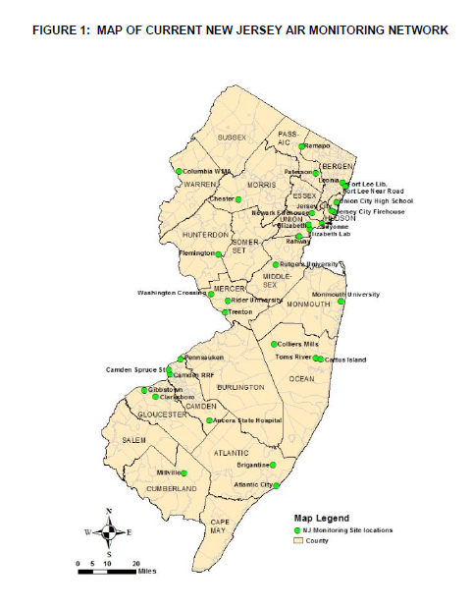
Topics we will cover
Network Design and Assessment 101
Issues to consider/understand in network design (new and existing)
Sources of information
Meeting CFR requirements
Public noticing and Regional involvement through the AMNP
Periodic network assessments
Analytical tool demonstration

Slide 3




Network Design and Assessment 101
Theories of air monitoring network evolution

Slide 4

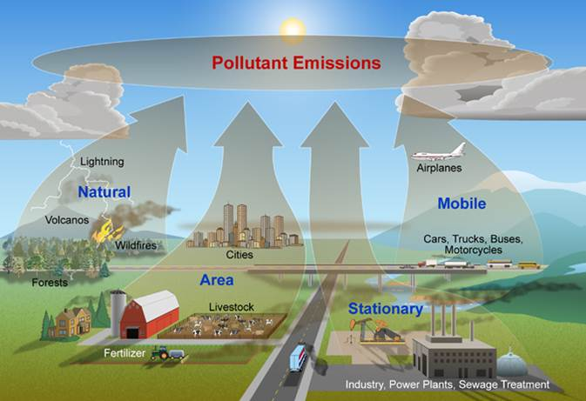
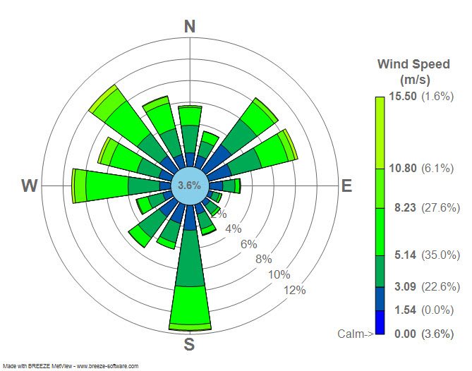
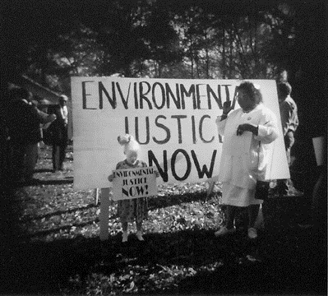
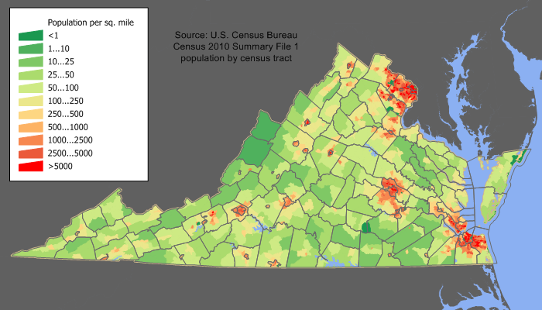


Designing a Network
Issues to Consider

Slide 5
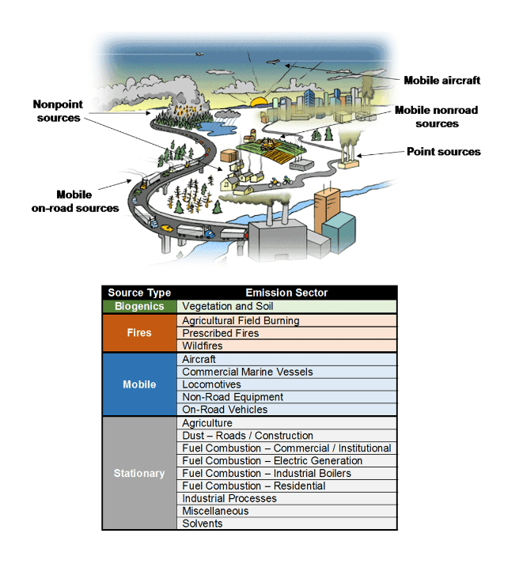
Emissions
Network Design and Assessment 101
Complexity depends on the size of your territory and range of sources
What source types dominate?
Where can you find the latest data on emissions, traffic counts, etc
What is the role of transport?
What is the mix of primary versus secondary pollutants?

Slide 6
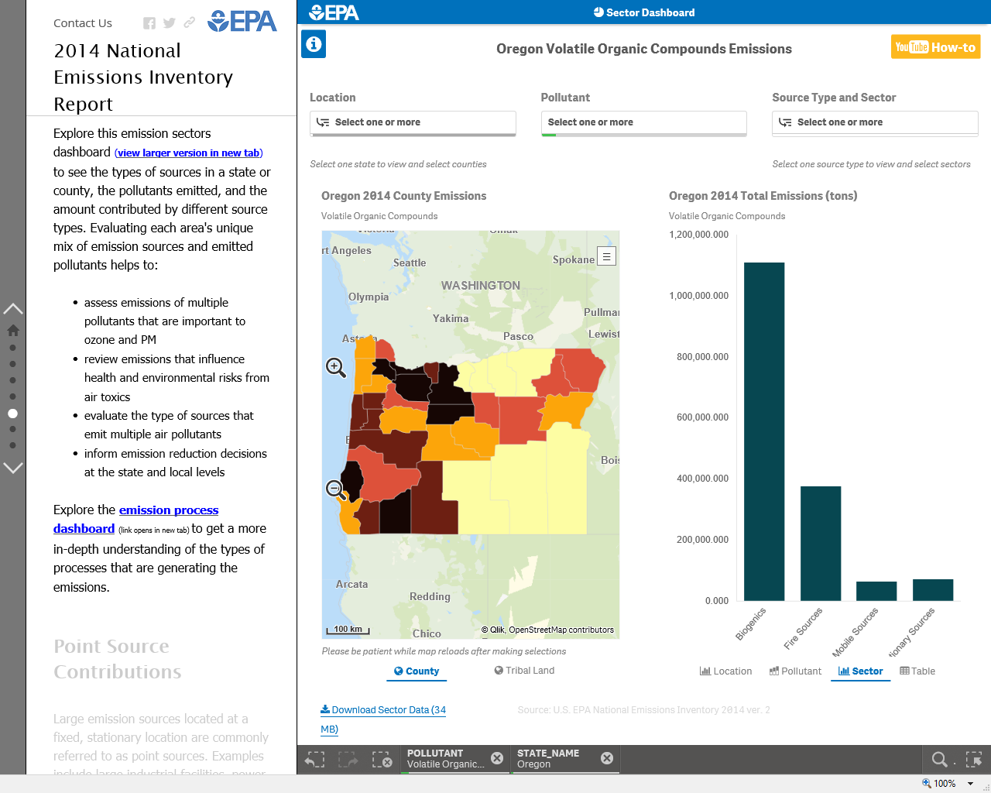
Network Design and Assessment 101
https://gispub.epa.gov/neireport/2014/

Slide 7
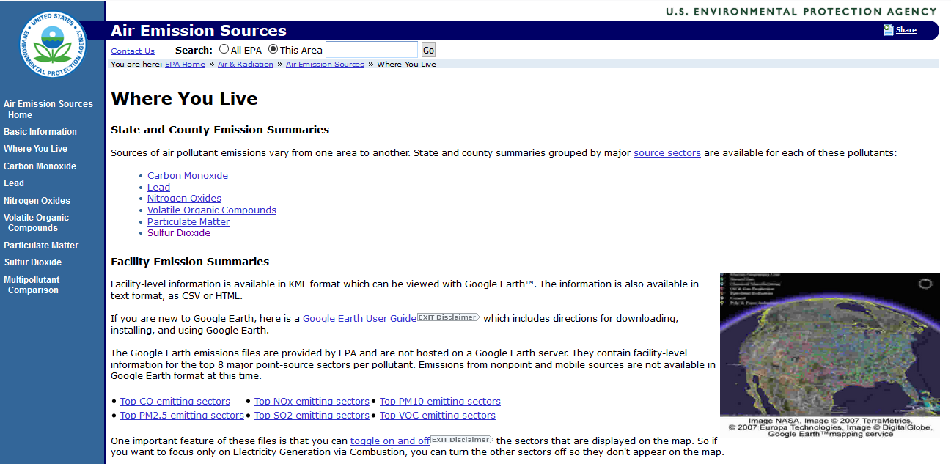
Network Design and Assessment 101
https://www3.epa.gov/air/emissions/where.htm

Slide 8

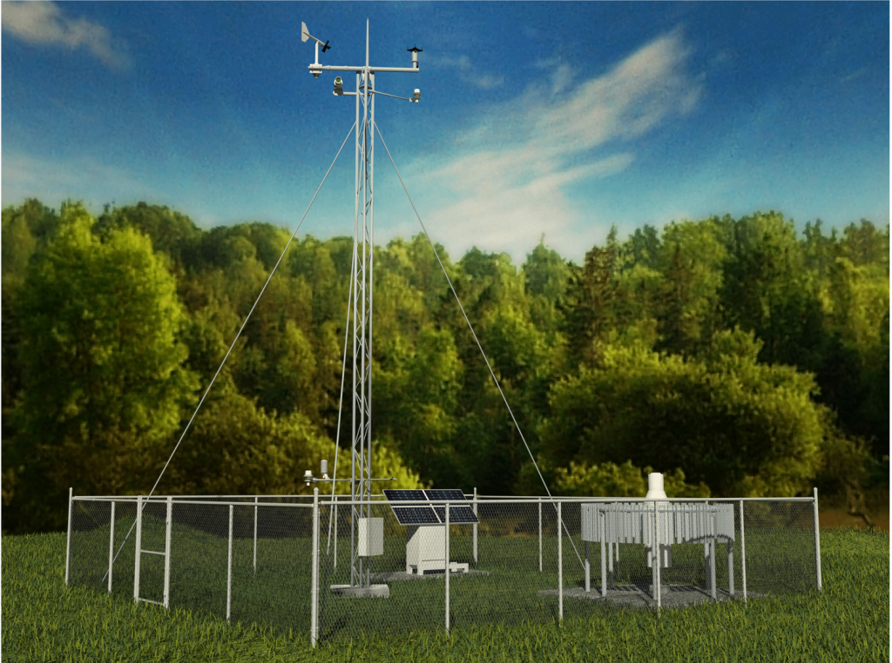
Meteorology
Network Design and Assessment 101
Fundamental need to understand basic source to receptor transport
Critical for understanding more complex meteorological relationships
  Valleys
  Ocean breeze
  Upslope winds
Helps to establish upwind-downwind pollutant comparisons
Key input into dispersion modeling
Real-time data critical to air quality forecasting

Slide 9
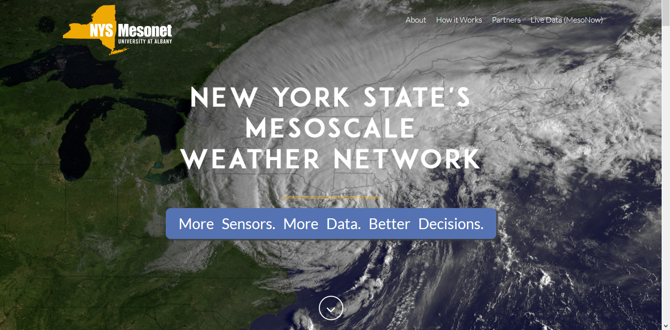
Meteorological Data Sources
Network Design and Assessment 101
EPA’s Support Center for Regulatory Atmospheric Modeling (SCRAM)
  https://www.epa.gov/scram
NOAA's National Centers for Environmental Information (NCEI)
  https://www.ncdc.noaa.gov/data-access/quick-links#dsi-3505
Local Mesonet networks
  E.g., http://www.nysmesonet.org/
AQS/AirNow – your own network met data

Slide 10
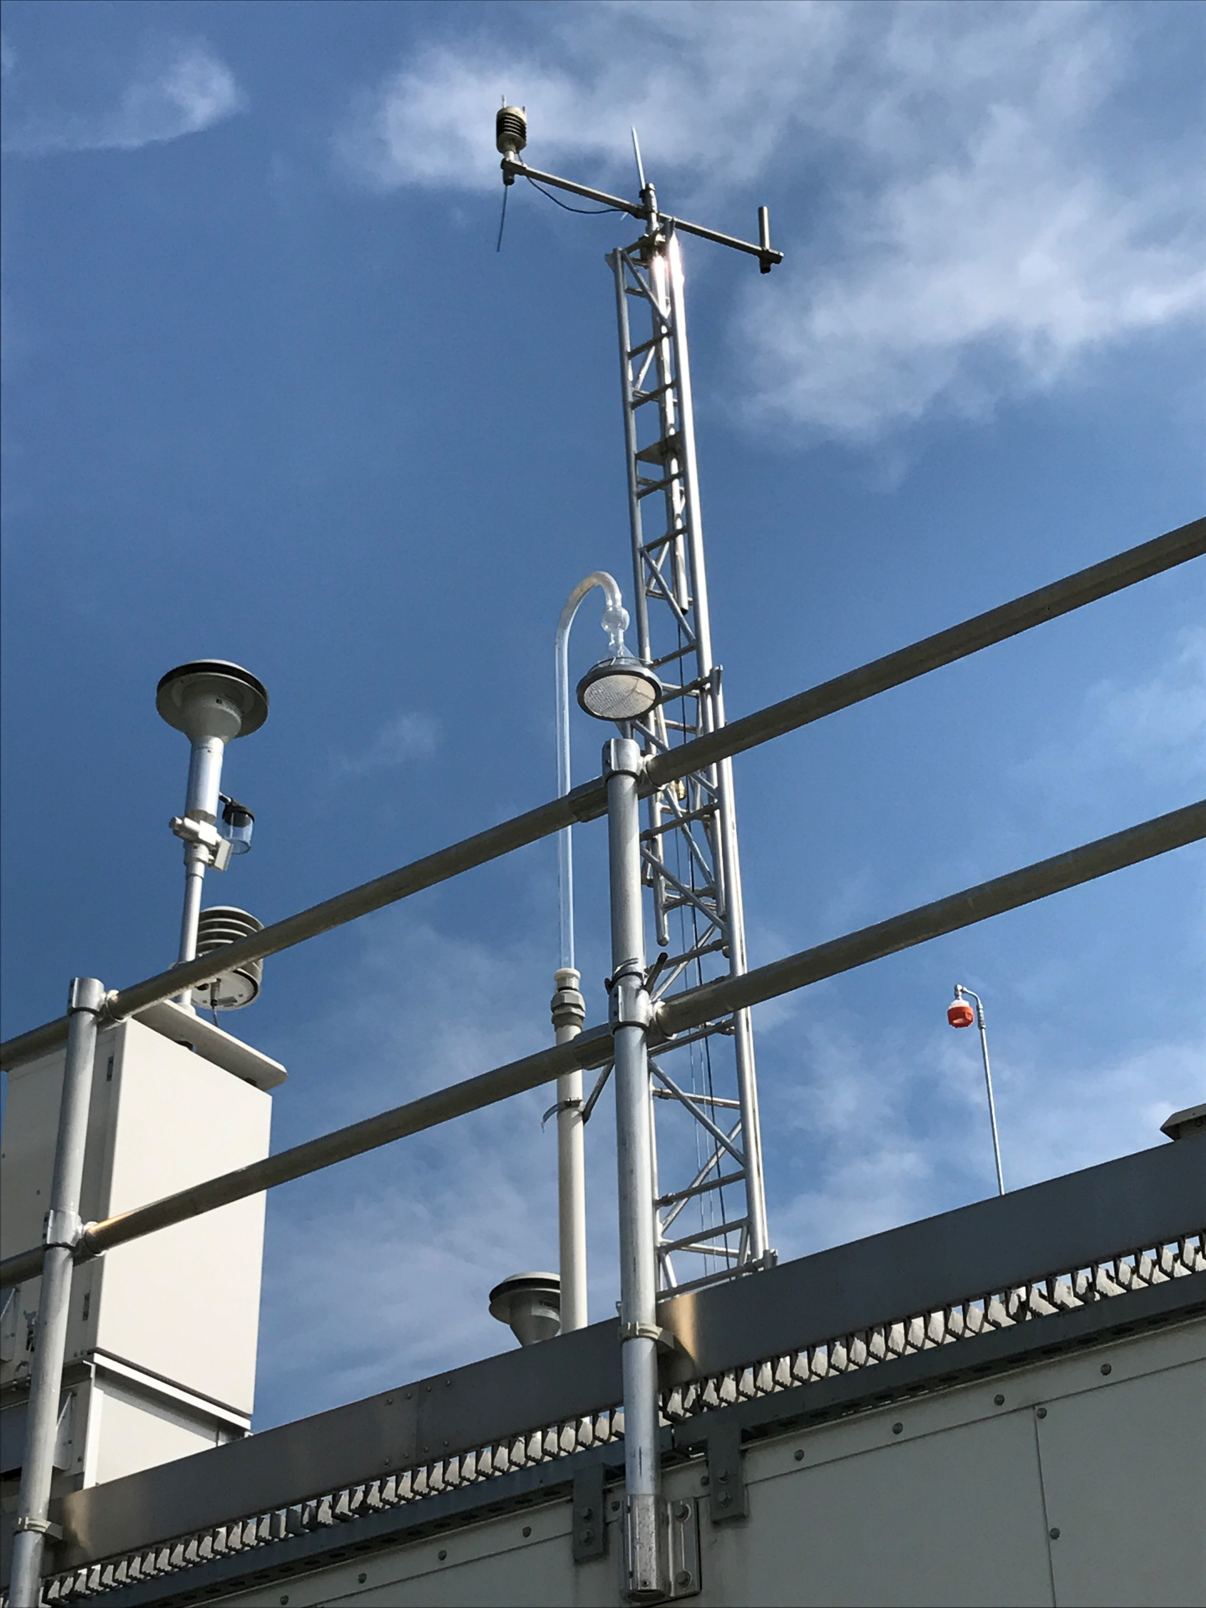
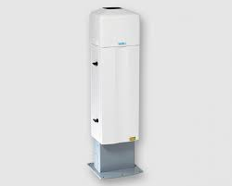
Obtaining Local Met Data
Network Design and Assessment 101
Met data measurements required at NCore and PAMS sites
Importance of obtaining your own QA’d local met data cannot be overemphasized
Instrumentation for surface and upper air data is relatively inexpensive and trouble-free
Guidance is available on how to obtain quality met data
  https://www3.epa.gov/ttn/amtic/files/ambient/met/Volume_IV_Meteorological_Measurements.pdf

Slide 11
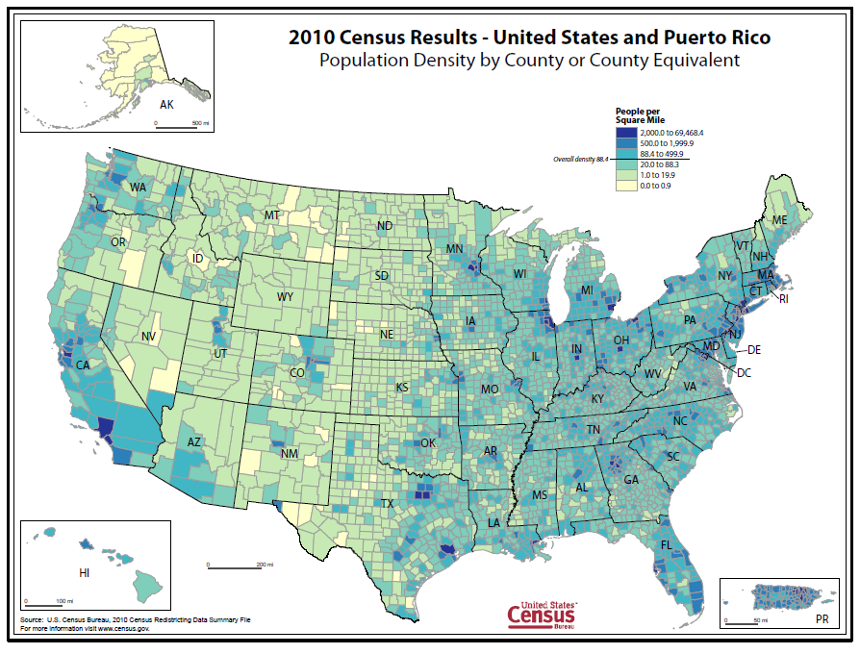
Demographic Data
Network Design and Assessment 101
Where are your population centers?
  CBSA estimates
Research detailed information at the census tract or block level
  https://www.census.gov/geo/maps-data/data/tiger-data.html
Additional tools
  EJSCREEN EPA's Environmental Justice Screening and Mapping Tool (Version 2017)
Take advantage of your agency’s GIS capabilities!

Slide 12
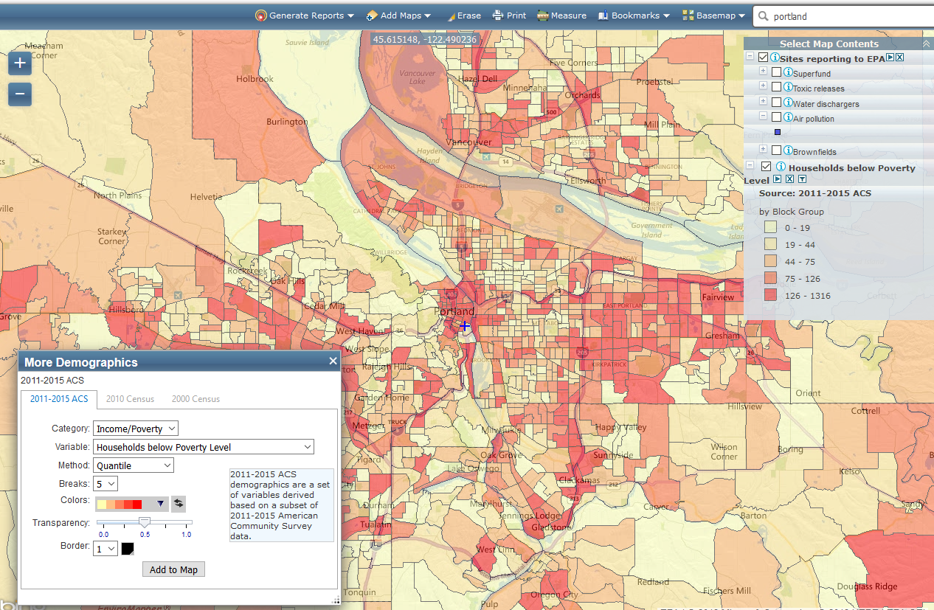
Network Design and Assessment 101
Sample EJ Screen Output

Slide 13
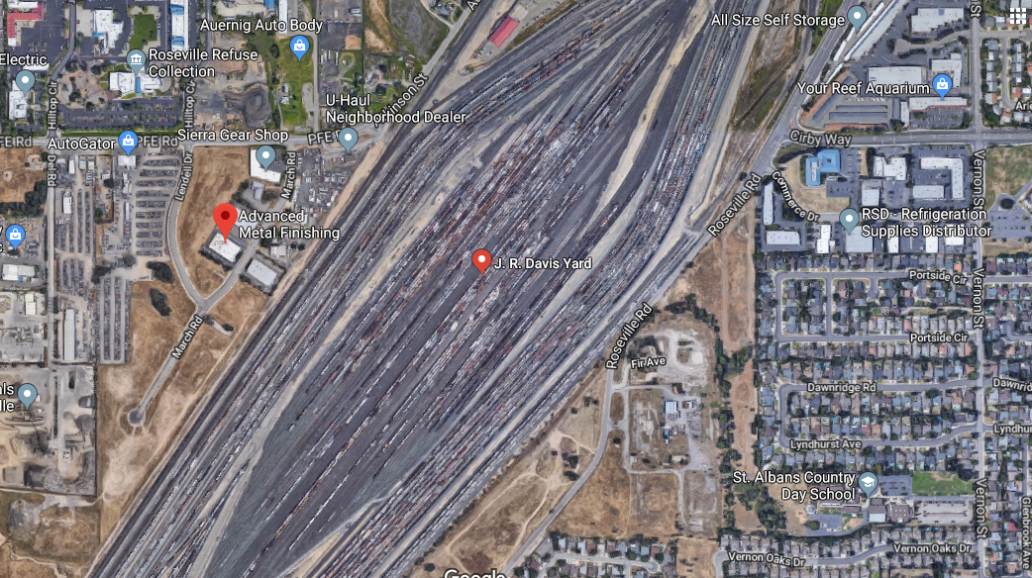

Local Issues
Network Design and Assessment 101
Know your community – where are the areas of greatest risk and community involvement
  Railyards, airports, ports, industrial centers, major roadway projects
Engage with your peers and management
  Planning and enforcement staff
  Professional and political leadership
  Public affairs
Input from community and environmental groups
Sometimes monitoring is indicated/required for other than technical reasons
  “Monitor on every block syndrome”

Slide 14

A Deeper Dive on Network Planning Issues in the CFR
Network Design and Assessment 101
Site types
Scales of representation
Minimum Requirements
Annual network plans and network assessments
Probe and Siting requirements

Slide 15
Site Types
Network Design and Assessment 101
Highest concentrations expected to occur in the area covered by the network.
Typical concentrations in areas of high population density.
Impact of significant sources or source categories on air quality.
General background concentration levels.
Extent of regional pollutant transport among populated areas; and in support of secondary standards.
Measure air pollution impacts on visibility, vegetation damage, or other welfare-based impacts.

Slide 16
Site types x Pollutant Crosswalk
Network Design and Assessment 101
Site Type | PM2.5 | PM10 | Pb | O3 | SO2 | NO2 | CO
Maximum Concentration | ☑ | ☑ | ☑ | ☑ | ☑ DRR | ☑ Area-wide | □
Population Oriented | ☑ | ☑ |  | ☑ | ☑ | ☑ | ☑ NCORE
Source Impact |  | □ | ☑ | N/A | ☑ DRR | ☑ NR | ☑ NR
Background and Regional Transport | ☑ |  |  | ☑ | □ NCORE |  | □ NCORE
Welfare Impacts | ☑ RH | ☑ RH |  | □ |  |  | N/A
☑ Required □ Case Specific  Uncommon N/A

Slide 17
Spatial Scales
Network Design and Assessment 101
1.2 Spatial Scales. (a) To clarify the nature of the link between general monitoring objectives, site types, and the physical location of a particular monitor, the concept of spatial scale of representativeness is defined. The goal in locating monitors is to correctly match the spatial scale represented by the sample of monitored air with the spatial scale most appropriate for the monitoring site type, air pollutant to be measured, and the monitoring objective.
(b) Thus, spatial scale of representativeness is described in terms of the physical dimensions of the air parcel nearest to a monitoring site throughout which actual pollutant concentrations are reasonably similar.

Slide 18
Network Design and Assessment 101
Spatial Scales
1) Microscale--defines the concentrations in air volumes associated with area dimensions ranging from several meters up to about 100 meters.
(2) Middle scale--defines the concentration typical of areas up to several city blocks in size with dimensions ranging from about 100 meters to 0.5 kilometer.
(3) Neighborhood scale--defines concentrations within some extended area of the city that has relatively uniform land use with dimensions in the 0.5 to 4.0 kilometers range. The neighborhood and urban scales listed below have the potential to overlap in applications that concern secondarily formed or homogeneously distributed air pollutants.
(4) Urban scale--defines concentrations within an area of city-like dimensions, on the order of 4 to 50 kilometers. Within a city, the geographic placement of sources may result in there being no single site that can be said to represent air quality on an urban scale.
(5) Regional scale--defines usually a rural area of reasonably homogeneous geography without large sources, and extends from tens to hundreds of kilometers.
National and global scales--these measurement scales represent concentrations characterizing the nation and the globe as a whole.
smaller
larger

Slide 19
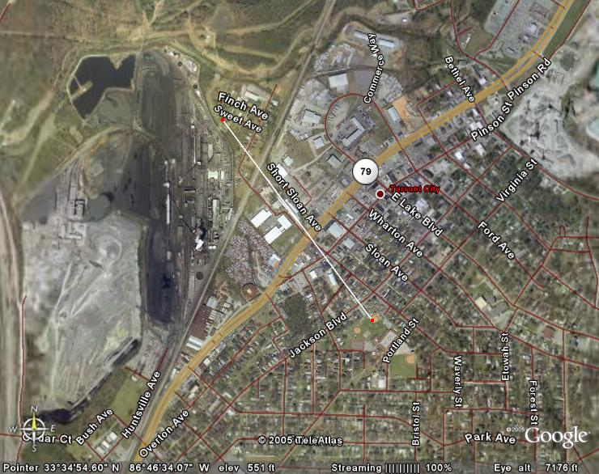
Network Design and Assessment 101
50m from fenceline
Microscale
Coke Facility
200m from fenceline
Middle scale
700m from fenceline
Neighborhood scale

Slide 20
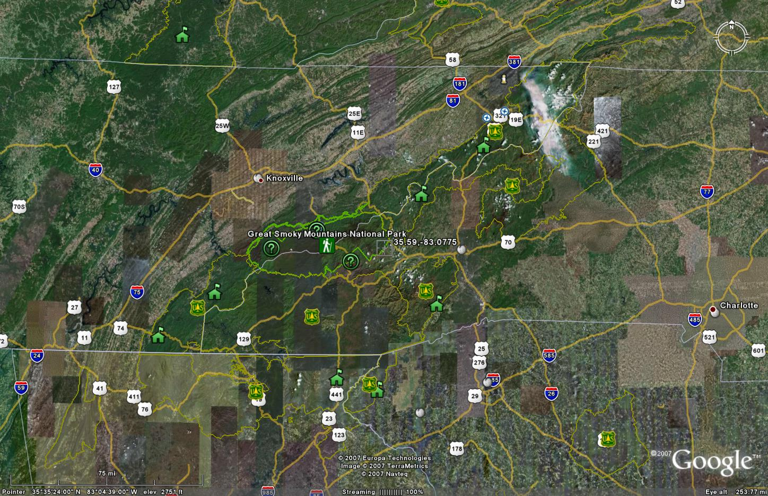
Network Design and Assessment 101
Great Smokey Mtn. National Park regional scale O3 monitor for background concentrations.

Slide 21
Minimum Network Requirements
40 CFR Part 58 Appendix D
Network Design and Assessment 101
Design value and population tables
  O3, PM2.5, PM10
Population Only
  Area-wide NO2
Special Objectives
  Susceptible and vulnerable populations (NO2)
  Background and Transport (O3, PM2.5)
  Certain general aviation airports (Pb)
Emissions Threshold
  Pb (lead)
Population and Emissions
  SO2 (Population Weighted Emissions Index)
Based on network requirements (which include population)
  Near-road (NO2, CO, PM2.5)
  NCore (PM2.5 mass and speciation, PM10-2.5 mass, O3, SO2, CO, NO/NOy, basic meteorology)
  PAMS (hourly averaged VOCs, carbonyls, O3, NO/NO2/NOy, extensive meteorology)

Slide 22
Probe and Monitoring Path Siting
40 CFR Part 58 Appendix E
Network Design and Assessment 101
Once a particular site/monitor location has been identified…States have to assess:
  Permissible height above the ground for monitor/sampler inlet
  Vertical and horizontal spacing from supports
  Spacing from minor sources, obstructions, and trees
  Spacing from roadways
  Requirements for probe material and sampling residence time
  Waiver provisions

Slide 23
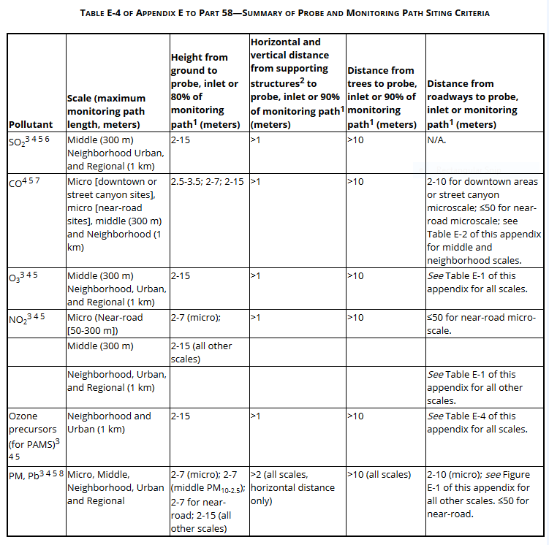
Network Design and Assessment 101
Table E-4
1Monitoring path for open path analyzers is applicable only to middle or neighborhood scale CO monitoring, middle, neighborhood, urban, and regional scale NO2 monitoring, and all applicable scales for monitoring SO2, O3, and O3 precursors.
2When probe is located on a rooftop, this separation distance is in reference to walls, parapets, or penthouses located on roof.
3Should be greater than 20 meters from the dripline of tree(s) and must be 10 meters from the dripline when the tree(s) act as an obstruction.
4Distance from sampler, probe, or 90 percent of monitoring path to obstacle, such as a building, must be at least twice the height the obstacle protrudes above the sampler, probe, or monitoring path. Sites not meeting this criterion may be classified as middle scale (see text).
5Must have unrestricted airflow 270 degrees around the probe or sampler; 180 degrees if the probe is on the side of a building or a wall.
6The probe, sampler, or monitoring path should be away from minor sources, such as furnace or incineration flues. The separation distance is dependent on the height of the minor source's emission point (such as a flue), the type of fuel or waste burned, and the quality of the fuel (sulfur, ash, or lead content). This criterion is designed to avoid undue influences from minor sources.
7For micro-scale CO monitoring sites, the probe must be >10 meters from a street intersection and preferably at a midblock location.
8Collocated monitors must be within 4 meters of each other and at least 2 meters apart for flow rates greater than 200 liters/min or at least 1 meter apart for samplers having flow rates less than 200 liters/min to preclude airflow interference, unless a waiver is in place as approved by the Regional Administrator pursuant to section 3 of Appendix A.

Slide 24



Real-world Challenges meeting Siting requirements
Network Design and Assessment 101
#@$%* trees
Restrictions on airflow in an arc around the inlet
Impact of nearby minor sources such as wood stoves, residential/commercial boilers, or unpaved roads/driveways
Roads with too much traffic (e.g., ozone)
Vertical placement – security versus breathing zone versus logistics
Human factor in getting site approval
  Reluctant school boards
  Negotiations over lease fees
  “The site looks ugly”
Compliance Strategy
Not a monitoring site location

Slide 25
Annual Monitoring Network Plans – Overview
40 CFR 58.10
Network Design and Assessment 101
A process that requires coordination and communication between monitoring agencies, EPA, and the public
  The annual monitoring network plan must be made available for public inspection and comment for at least 30 days prior to submission to the EPA and the submitted plan shall include and address, as appropriate, any received comments.
Due July 1 of each year
  Any plan that proposes network modifications is subject to the approval of the EPA Regional Administrator, who shall approve or disapprove the plan within 120 days of submission of a complete plan to the EPA.
Detailed list of requirements in CFR has evolved since 2007

Slide 26
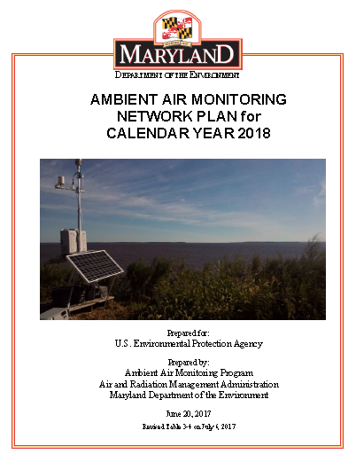

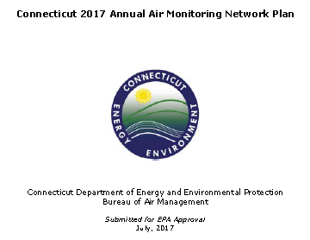
The Annual Network Plan Process - Outreach
Network Design and Assessment 101
The AMNP process has become they key way for stakeholders to become informed and active in your organization’s monitoring activities.
AMNP’s typically include site lists, photographs, satellite maps, metadata, EPA approval letters, details about network revisions, public and EPA comments, and statistical analyses.
States post their draft plans for public notice and comment:
EPA posts all the final plans here: https://www.epa.gov/amtic/state-and-local-monitoring-plans

Slide 27
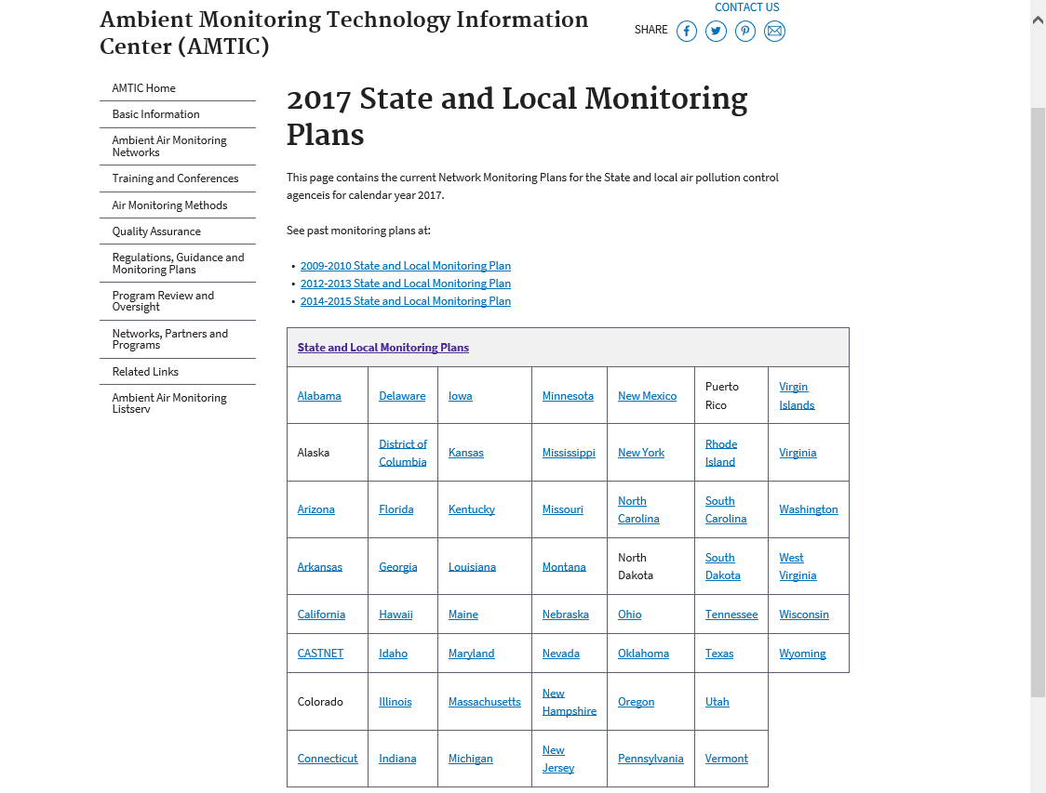
Network Design and Assessment 101

Slide 28
EPA Regional Review
§58.10 Annual monitoring network plan and periodic network assessment
(a)(1) Beginning July 1, 2007, the state, or where applicable local, agency shall submit to the Regional Administrator an annual monitoring network plan which shall provide for the documentation of the establishment and maintenance of an air quality surveillance system that consists of a network of SLAMS monitoring stations that can include FRM, FEM, and ARM monitors that are part of SLAMS, NCore, CSN, PAMS, and SPM stations. The plan shall include a statement of whether the operation of each monitor meets the requirements of appendices A, B, C, D, and E of this part, where applicable....
…
(b) The annual monitoring network plan must contain the following information for each existing and proposed site:
(1) The AQS site identification number.
(2) The location, including street address and geographical coordinates.
(3) The sampling and analysis method(s) for each measured parameter.
(4) The operating schedules for each monitor.
(5) Any proposals to remove or move a monitoring station within a period of 18 months following plan submittal.
(6) The monitoring objective and spatial scale of representativeness for each monitor as defined in appendix D to this part.
(7) The identification of any sites that are suitable and sites that are not suitable for comparison against the annual PM_{2.5} NAAQS as described in §58.30.
(8) The MSA, CBSA, CSA or other area represented by the monitor.
(9) The designation of any Pb monitors as either source-oriented or non-source-oriented according to Appendix D to 40 CFR part 58.
(10) Any source-oriented monitors for which a waiver has been requested or granted by the EPA Regional Administrator as allowed for under paragraph 4.5(a)(ii) of Appendix D to 40 CFR part 58.
(11) Any source-oriented or non-source-oriented site for which a waiver has been requested or granted by the EPA Regional Administrator for the use of Pb-PM₁₀ monitoring in lieu of Pb-TSP monitoring as allowed for under paragraph 2.10 of Appendix C to 40 CFR part 58.
(12) The identification of required NO₂ monitors as near-road, area-wide, or vulnerable and susceptible population monitors in accordance with Appendix D, section 4.3 of this part.
(13) The identification of any PM_{2.5} FEMs and/or ARMs used in the monitoring agency's network where the data are not of sufficient quality such that data are not to be compared to the NAAQS….
Network Design and Assessment 101
28

Slide 29
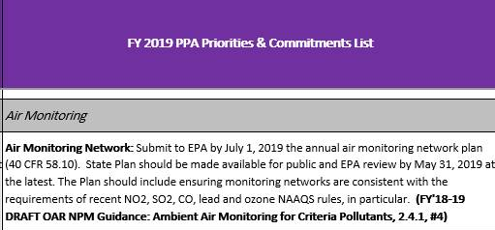
EPA Regional Review
Network Design and Assessment 101
As with other important items, submittal of the Annual Network Plan is included in the Performance Partnership Agreement (PPA) entered into between the EPA Regional Administrator and the State Environmental Commissioner.
States usually discuss significant changes prior to proposal, but we always receive a copy for proposed plan on the first day of the comment period.
EPA comments are coordinated across the Air Branch (monitoring, planning, permitting) and comments are (always) sent to State by end of the comment period.

Slide 30
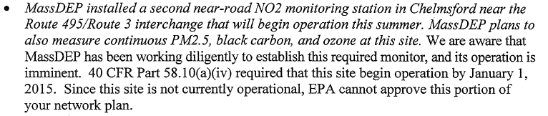
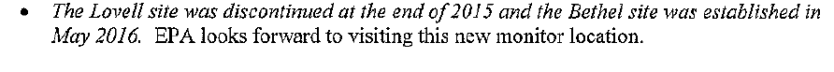
EPA Regional Review
Network Design and Assessment 101
As we review:
We ensure minimum CFR
network minimums are met,
and point out if they are not.
Shutdowns are “approved” if acceptable.
New sites are approved, as appropriate (EPA reviews all new sites before they are formally “selected” by State)

Slide 31
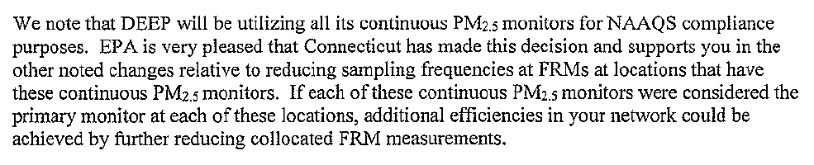
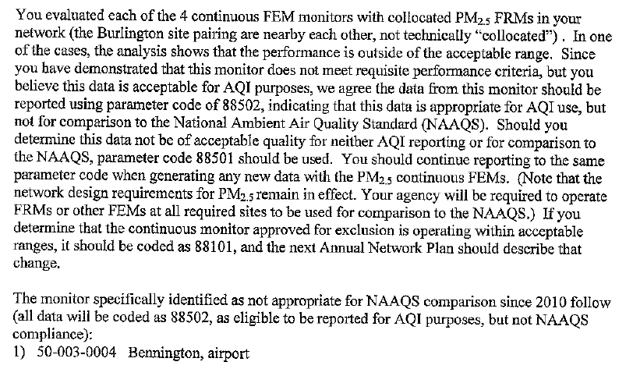
EPA Regional Review
Network Design and Assessment 101
As we review:
We approve acceptable sampling frequency changes.
We ensure continuous PM_{2.5} FEM monitors are reporting as NAAQS compliance (88101) unless explicitly approved otherwise.
From 2016->
From 2014->

Slide 32
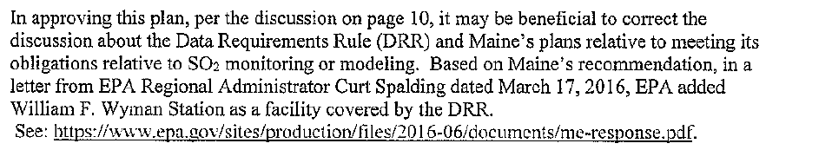
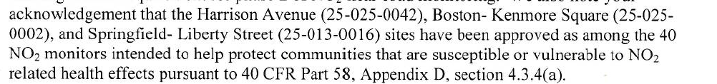
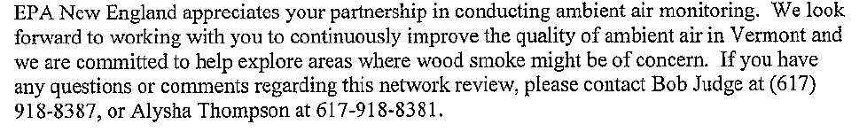
EPA Regional Review
Network Design and Assessment 101
As we review:
We review relative to the DRR.
We review relative to the 40 S/V.
We suggest resource saving opportunities.
We suggest other
“monitoring” needs.

Slide 33
EPA Regional Review
Network Design and Assessment 101
Upon receipt of final ANP, we review to see that all public comments are addressed, and Regional Administrator (designee) approves the plan, if appropriate.

Slide 34
Contrasting Annual Plans and Network Assessment
Network Design and Assessment 101
Element | Annual Plan | 5-Year Assessment
Frequency | Annually | 5-years (2010, 2015, 2020)
EPA Approval & Public Comment Requirement | Yes (for changes) | Network modification plan submitted as part of AMNP by following year (e.g, 2021)
Specified Content Requirements | Extensive | Minimal (technologies, susceptible individuals, data users)
Applicability period | Relatively short - 18 months (see 58.10(b)(5)) | Long – expected to be very forward looking

Slide 35
A Few early (pre 2015) misimpressions about assessments
Network Design and Assessment 101
Belief | EPA Position
The content and format of the assessment is closely specified by EPA. | There is a lot of freedom to design and implement an assessment according to agency needs. Work closely with your EPA Region to meet expectations.
EPA is the primary client for the assessment. | The assessment is a tool to encourage the agency and it’s stakeholders to plan for the future. We believe that the State/ Local Agency is the client for this product.
The assessment needs to justify the operation of the current network. | Networks are expected to evolve over time as objectives and requirements change. Assessments should present the case for network divestments and investments. It should not seek to justify the existing network- it should look closely at emerging needs, and constantly look to be more efficient- including shutting down low value or duplicative monitors. Work with your Region on these!
Use of statistical analysis tools is essential. | A successful assessment can be completed without complex statistics. What IS needed is a basic analysis of current air quality and trends, thoughtful evaluation of agency needs and priorities, understanding of EPA requirements, and a dose of creativity, insight, and imagination.

Slide 36
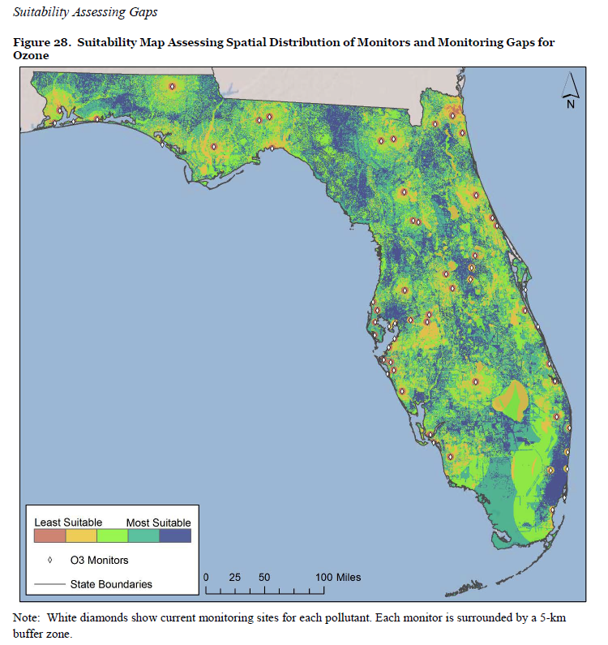
Useful Components & Random Observations
Network Design and Assessment 101
Develop a scoring/weighting system for monitors
  Factors might include population, emissions, concentration relative to NAAQS, trends, correlation, and qualitative issues (e.g., use in health studies)
  FL DEP: https://www3.epa.gov/ttn/amtic/files/networkplans/FLassess2015.pdf
Band together with your neighbors
  LADCO/Region 5: http://www.ladco.org/reports/general/Regional_Network_Assessment/RNA15.html

Slide 37
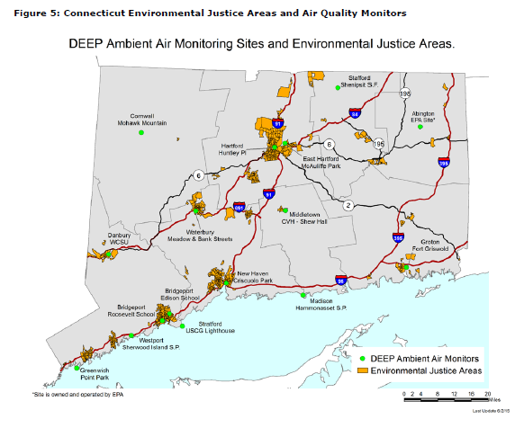
Useful Components & Random Observations
Network Design and Assessment 101
Include a good executive summary upfront
  WA Dept of Ecology: https://www3.epa.gov/ttn/amtic/files/networkplans/WAAssess2015.pdf
Evaluate monitoring equipment inventory and needs
  Philadelphia AMS: https://www3.epa.gov/ttn/amtic/files/networkplans/PAPhilaassess2015.pdf
Discuss sensitive populations
  CT DEP: https://www3.epa.gov/ttn/amtic/files/networkplans/CTAssess2015.pdf

Slide 38
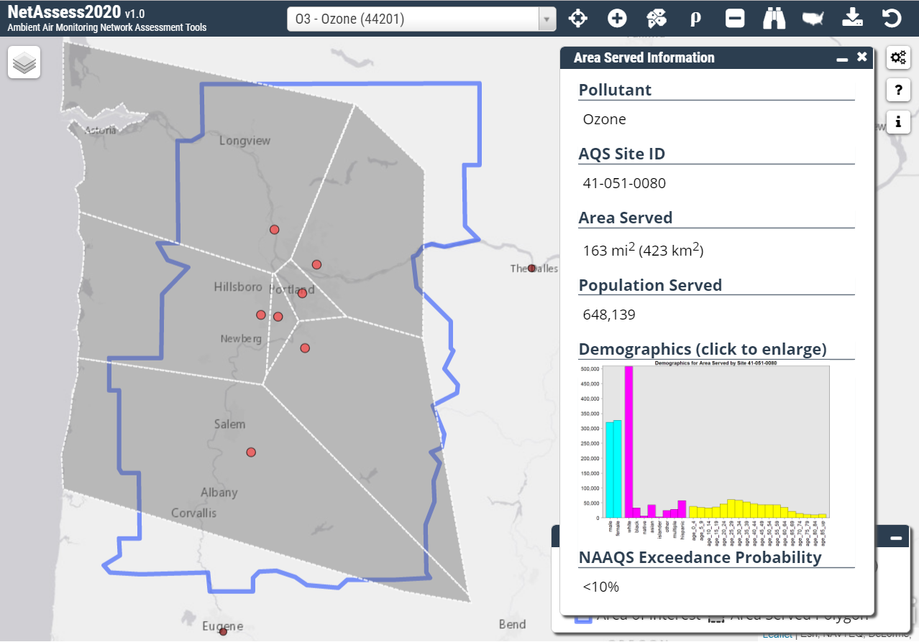
Network Assessment Tools: NetAssess2020
Network Design and Assessment 101
Update of the LADCO tool used in the 2015 network assessments
  Still under development, our goal is to have it online by early 2019
Intent is to provide data that agencies can use in conducting their network assessments
  Design values and trends data
  Population data (“area served”)
  Correlation matrices
Focus is on the 6 criteria pollutants
  Not all data is useful for all pollutants
  For example, correlation matrices may be useful for ozone and PM, probably not for Pb
We are open to suggestions for other types of data that may be useful to include in the tool
On to the demo!

